Slide 1
Test of Binary Mergers in Hierarchical Triples
LR w/ Zhong-Zhi Xianyu
Induced Ellipticity for Inspiraling Binary Systems Lisa Randall (Harvard U., Phys. Dept.), Zhong-Zhi Xianyu (Harvard U. & Harvard U., Dept. Math.). Aug 28, 2017. 13 pp. Published in Astrophys .J. 853 (2018) no.1, 93 e print: arXiv:1708.08569 [gr-qc] | PDF
An Analytical Portrait of Binary Mergers in Hierarchical Triple Systems
Lisa Randall (Harvard U.), Zhong-Zhi Xianyu (Harvard U. & Harvard U.). Feb 15, 2018.
e-Print: arXiv:1802.05718 [gr-qc] | PDF
A Direct Probe of Mass Density Near Inspiraling Binary Black Holes
https://arxiv.org/pdf/1805.05335.pdf

Slide 2
Introduction
Successful GW detection of black hole mergers (and ns)
Rates predicted at tens/year
What can we learn?
  Black hole and neutron star physics!
  But what else? Environment?
  “New way to probe Universe”
  Should exist measurable, calculable differences due to tidal gravitational forces
Can tidal effects teach us about black hole neighborhoods?
  Galaxy, globular cluster, isolated?
  What observables should we consider and what can we hope to learn?

Slide 3
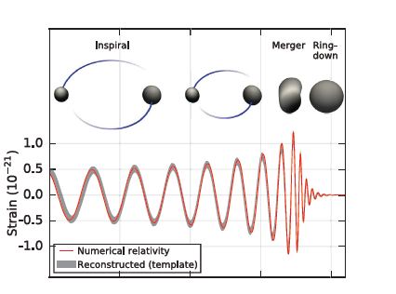
Merger History
3 stages: inspiral, merger, ringdown
Inspiral “chirp Analytically Calculable
  As should be gravitational perturbations to it

Slide 4
Eccentricity
GWs circularize orbits
  LIGO relies on circular templates
However, eccentricity can be generated from surrounding matter, and survive even if source only temporary
  Potentially distinguish GN and SMBH, GC, isolated (natal kick) generation
Previously, studied numerically (eg Antonini, Perets)
Here present an analytical method for eccentricity distribution from galactic center black hole
Account for both tidal forces and evaporation caused by environment

Slide 5
Statistically Probe Merger Origins
Formation channels:
  Isolated
    Natal kick?
  Dynamical: GC, SMBH
    Hierarchical Triples
Observables:
  Mass, spin, eccentricity
Integrate over initial distributions to find eccentricity distribution
  Numerical, Analytical approaches
Insights from resulting distributions
  True measure of utility depends on what numbers turn out to be

Slide 6
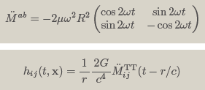
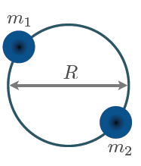


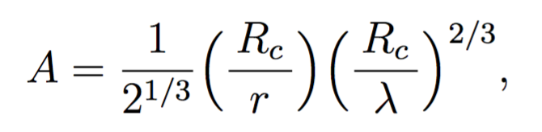


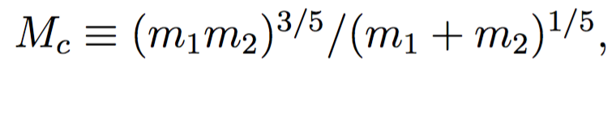
Review: GW Emission from Inspiraling Binary
Assume circular, fixed orbit,
point masses
Mass quadrupole
Chirp mass:

Slide 7
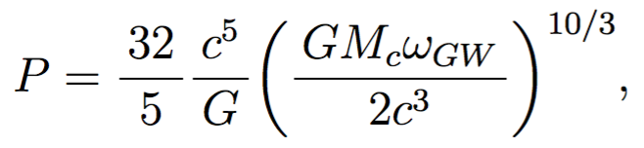
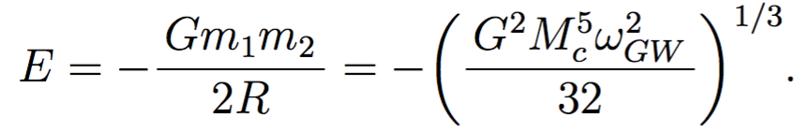

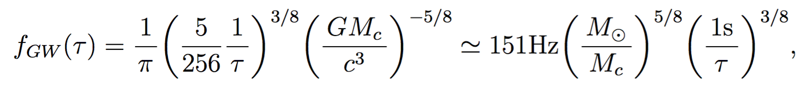
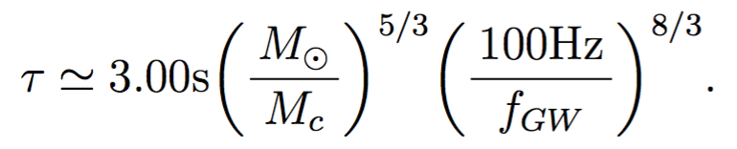
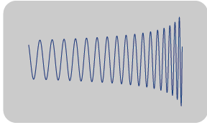
Inspiral from GW: radius not fixed
Radiation power:
Energy:
Solve for

Slide 8



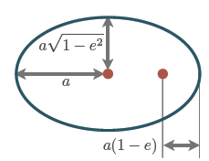

Generalize: Eccentric Orbit
Orbital frequency no longer constant
Eccentric anomaly
Polar coordinates

Slide 9
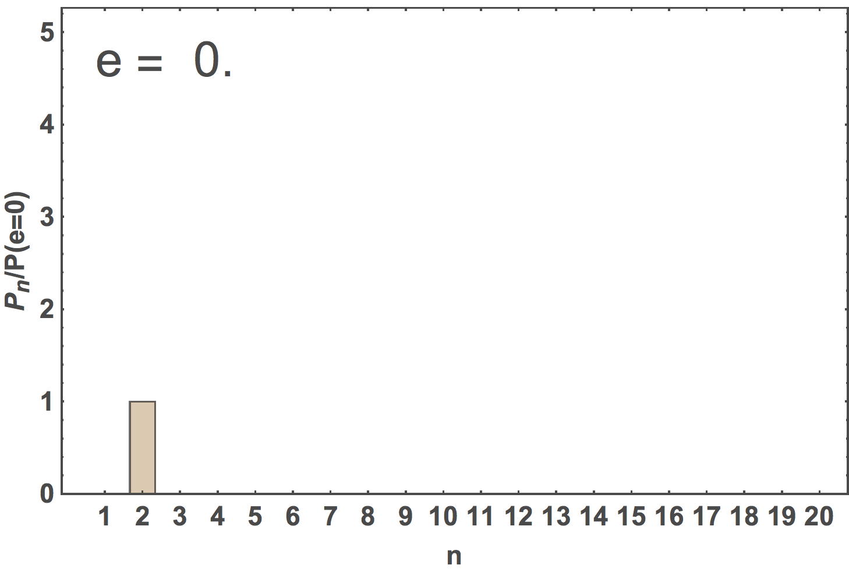


Sound and Shape of Eccentricity
No longer constant frequency
Higher harmonics
Quadrupole dominates for small e
Large e:

Slide 10



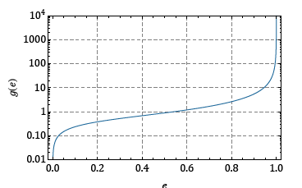
Eccentricity loss during infall
Use dJ/dt, dE/dt from GW to derive
da/dt, de/dt =>a(e)
Note base frequency ~1/a^{3/2}
a depends on e so even base frequency dependence reflects eccentricity

Slide 11
Measurable?
Large eccentricity: faster merger
  Closer together
  Higher harmonics
Small eccentricity
  Can have small e, even if merger began with large e
  Measurable with detailed measurement of waveform
Question become: can we drive eccentricity to larger values that survive into LIGO window?
  Yes if we can drive e sufficiently
  Assume e~o(.01) can be measured
  Source of post-formation eccentricity would be tidal forces

Slide 12



Rate:Tidal and GW modulation
Perturbative :

Slide 13
Tidal generation of eccentricity
Competing effects
  Gravitational wave emission throughout
  Need coherent generation of eccentricity
  Tidal force constant if nearby third body
Need a hierarchical triple
  otherwise unstable
Can exist in cosmos
  Galactic nuclei with SMBH
  Dense globular clusters (binary-binary scattering)

Slide 14
Drive e with (eg) Point Source
Tidal Force:Kozai Lidov
Perturb:
F_{t}/mv~
Compare
Rate of change smaller than both inner and outer orbital frequencies; perturbative

Slide 15
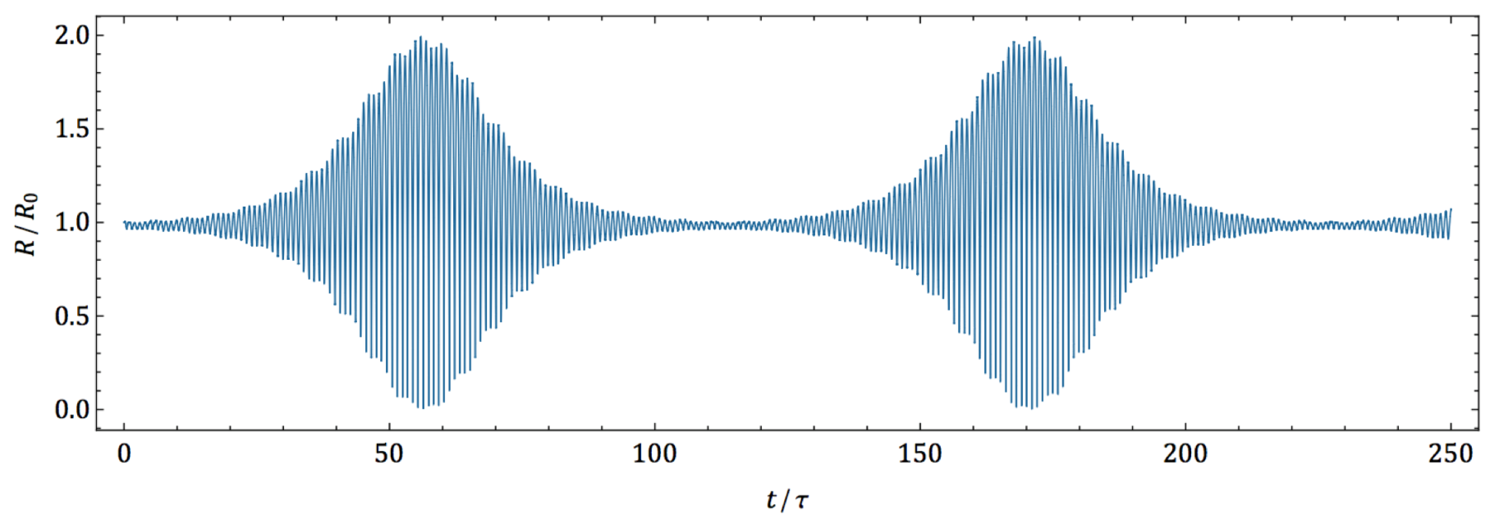

Slide 16
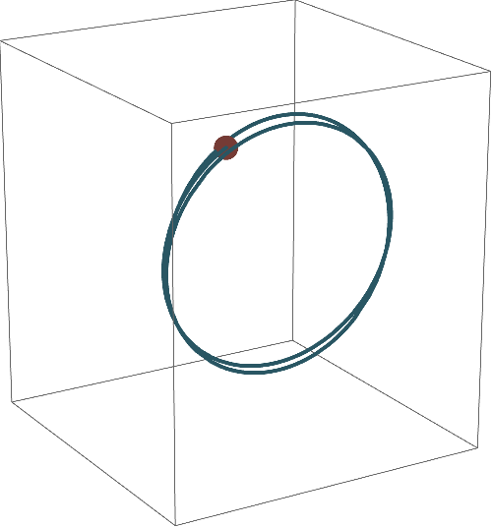
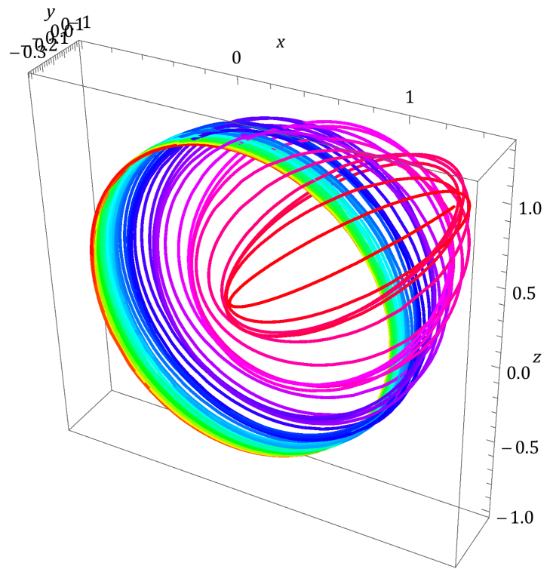
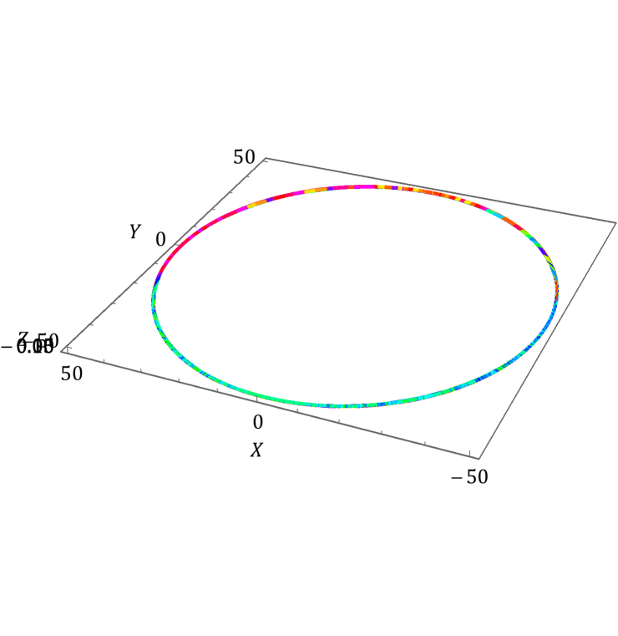

Slide 17

Kozai-Lidov resonance : coherent generation
Interchange between inclination and eccentricity
|J|=const.
|J₂|=const.
|J₁|∝(1-e²)^{1/2}
J₂
J₂
J
J
I
I
J₁
J₁
highly inclined
highly eccentric

Slide 18
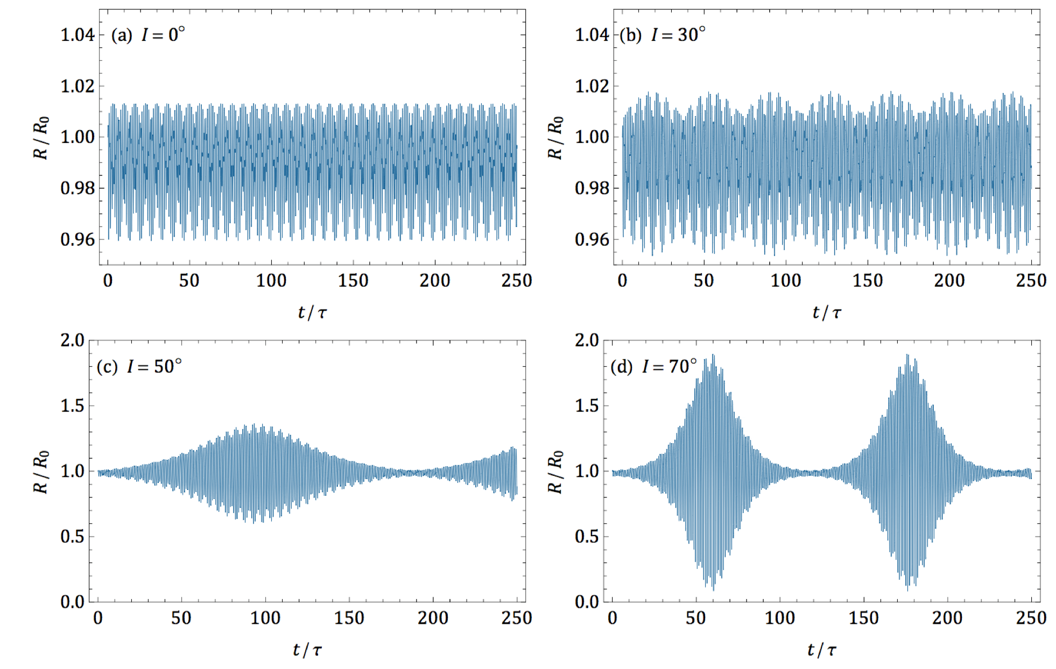
Critical Angle for Eccentricity to Develop Need High Inclination

Slide 19
Does eccentricity survive to LIGO?
Tidal modulation increases or decreases e
KL rate slower than orbital frequencies
  Many orbits while e develops
But GW always decreases it
Need tidal effect to work fast enough that GW won’t erase it
Want tidal modulation frequency greater than circularization from GW rate

Slide 20


Tidal Sphere of Influence
Comparing rates of GW-circularization and tidal generation of eccentricity
Sufficiently large a : tidal modulation fast enough. Find critical separation—after GW dominates
<1
>1

Slide 21

So how much e remains?
Enters LIGO window
Compare to binary orbit size when tidal force no longer dominates
Method I: Follow inspiral to LIGO a due to GW analytically
In first paper needed “initial” e distribution: note independent of background density profile so just one function
Then can find how much e lost as it inspirals

Slide 22
Second paper: analytical solution
Analytical solution at least in principle lets us relate measurable quantity (e) directly to parameters of environment in which BBH formed
Distribution of e depends on initial parameters
With solution, don’t need to numerically scan over all parameters
Can directly relate to density distribution
Key difference is included PN correction

Slide 23
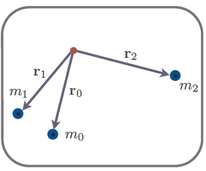
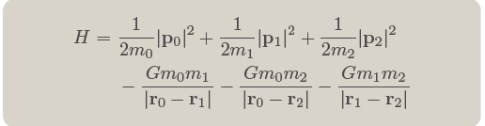
Three-Body Systems
Perturbative: hierarchical triples

Slide 24
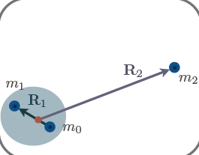
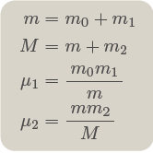
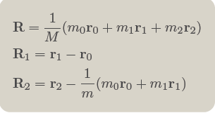
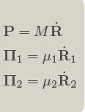
Jacobi Coordinates: Hierarchical

Slide 25
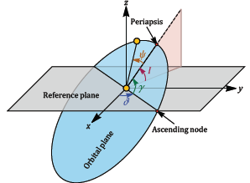
Quadrupole Approx: Integrable System
Angles to characterize both orbits
Angles to characterize relative orbital planes
Average over orbits (integrate out fast modes)

Slide 26
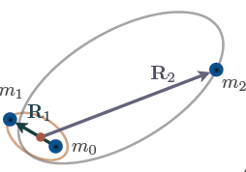
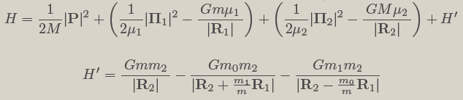
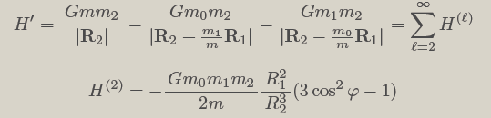
Exploit Hierarchy: Orbit-Orbit Coupling and Multipole Expansion

Slide 27

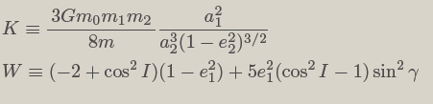
Averaged Hamiltonian Interaction

Slide 28


Aside: Delauney Variables
Set of variables in which H1, H2 can be written entirely in terms of one variable
Tells us that in this set of variables a perturbation will induce slow change in orbit
This is what happens and how it is calculated

Slide 29
Analytical Computation of Final e
Need to include also PN correction
PN effect destroys resonance and allows GW to take over
  No longer in tidal sphere of influence
Want to know how much eccentricity remains
First we calculate merger time
Let’s consider examples to see how to do that
Then we see how it helps for calculating eccentricity

Slide 30
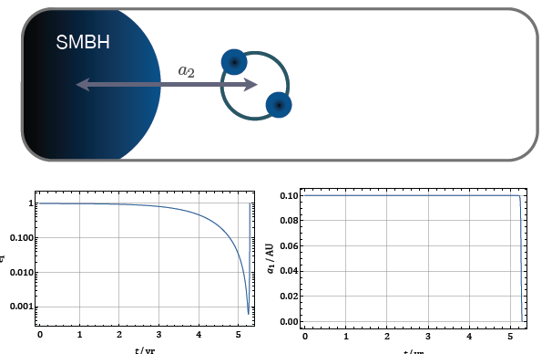
Case I: fast merger

Slide 31
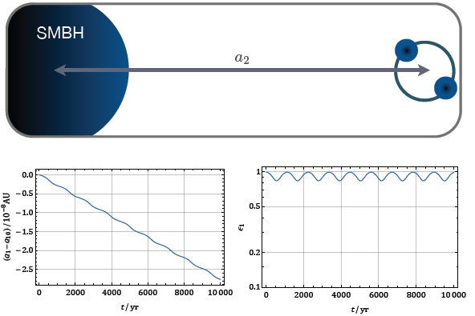
Opposite extreme: isolation limit

Slide 32
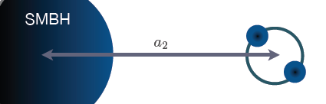
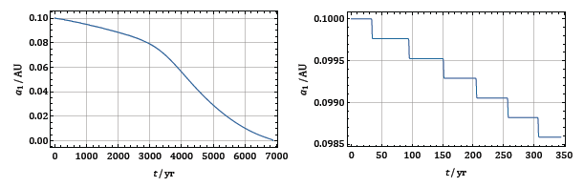


We calculate:
KL-boosted (but several cycles)
Find lifetime of fictitious binary with the max e
Correct for amount of time spent with that e

Slide 33
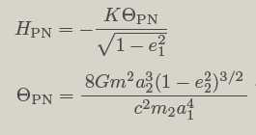
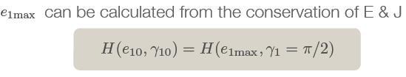

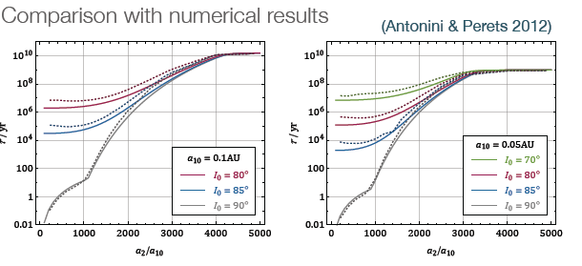
Merger Time
Use sum of tidal and PN Hamiltonians
Works well!!

Slide 34
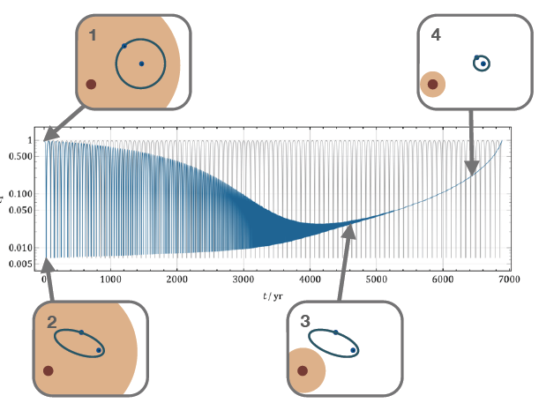
What about eccentricity?
Now that we know merger time can postulate an isolated binary with that same merger time, mass, and same initial semi-major axis
Eccentricity distribution follows that of the isolated one in the end-- where KL turned off

Slide 35
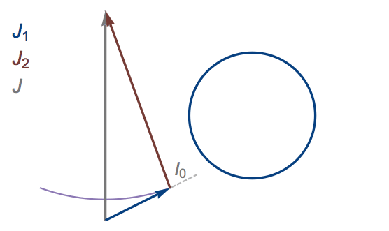

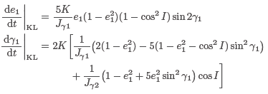
KL: Interchange
Conserved:
Dynamical conjugate Use Delauney
Then rewrite
Argument of periapsis

Slide 36


Including precession of periapsis, GR
Precession: incoherent with KL
GR: back reaction GW (Peters Equation) as before: E, J no longer conserved
Critical to calculation that change in orbital radius dominated by large eccentricity region

Slide 37
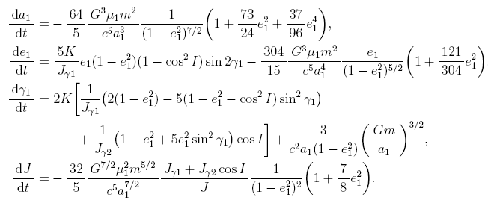
Summary
Used to generate numerical solutions

Slide 38

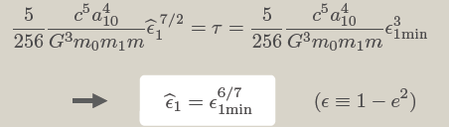
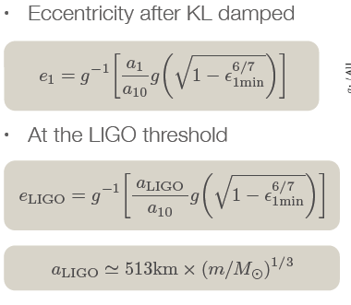
Use changes occurring at largest e
Take fictitious binary; same m1, m2, a1,tmerger
emax
From PN and KL, tslow GW
With equivalent e
Use gw

Slide 39
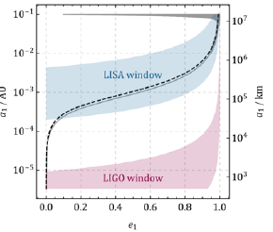
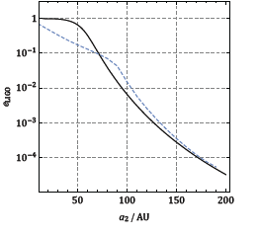
Comparison to numerical results
Works well away from large e

Slide 40
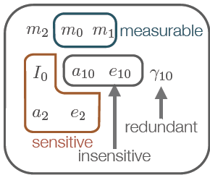

What to do with this result?
Lots or parameters
Only a few relevant
Make some assumptions: hopefully test in the end
thermal
Distribution in a2 tells us about density distribution of black holes--origin
Core vs cusp:

Slide 41
Additional constraints:
Evaporation and Tidal Disruption
This was all for an isolated binary in presence of BH
In reality, binary inside galaxy
Evaporation can occur: depends on L
To date, competition done with simulation
In first analysis we used a cutoff L beyond which evaporation dominates
Now with analytical result, we can compare to analytical result for evaporation
We also require no tidal disruption from SMBH

Slide 42

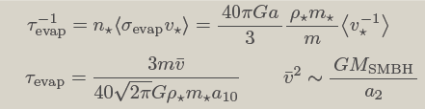


Evaporation and disruption
Evaporation of binaries by scattering with ambient matter: require merge, not evaporate
Tidal disruption constraint:

Slide 43
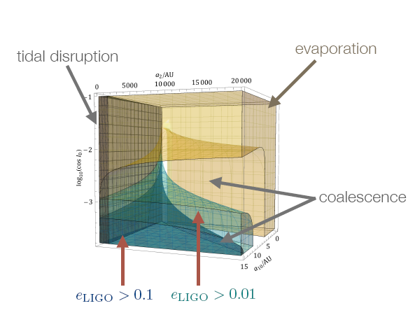
Sample Result with all Constraints
Cusp model: e>.01: 5% (25%) for solar mass (10 solar mass) objects
Should occur at measurable rate

Slide 44


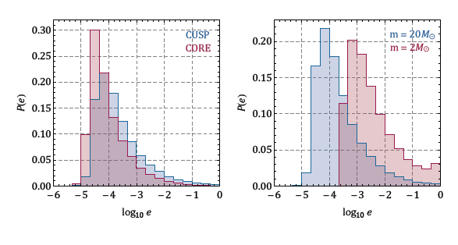
Can in principle use to distinguish different density distributions
Eg Core vs Cusp, Different masses
Background and bh distributions: bh number density, background matter density
Cusp: α=7/4, β=2;
Core: α=.5, β=.5
α=7/4, β=2, α=7/4, β=7/4
,

Slide 45



Also some analytical understanding of dependencies
Big initial e, small final e
Very large I
Vs smaller I and suppressed PN
Interesting that m, a dependence reversed
In end, first case dominates: stronger dependence and more of parameter space

Slide 46
Early stages but promising
Analytical result means we don’t have to calculate e distribution numerically
Only numerics is integrating over initial parameters
  No Monte Carlo
Will however require lots of statistics in end
Also sometimes near SMBH, sometimes isolated (natal kicks), sometimes GN
We want to find ways to distinguish options
Or disentangle components
Clearly LISA can help
First observe ---then follow
Constraint on when e generated

Slide 47
At least as interesting…
LISA observes events for a few years
For certain parameter ranges, can monitor time evolution
Study change in orbital parameters
Direct probe of ambient density distribution

Slide 48
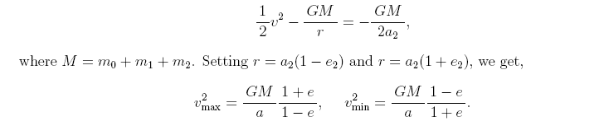
Longitudinal Doppler Shift
For now, consider orbit along line of slight
Velocity variation sum of min max velocities
Use energy conservation

Slide 49


Doppler Shift
Need visible shift f Δv
Need period < time in LISA window
  Large f to improve resolution? Small a1

Slide 50
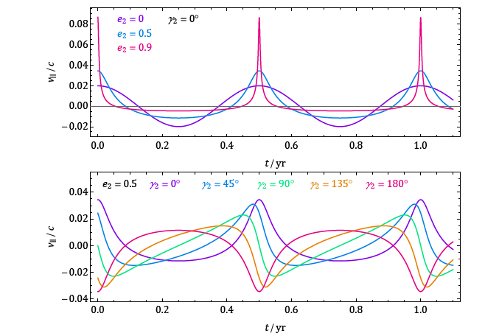
Sample results

Slide 51


Real-time Eccentricity Generation
Can do similar analysis with e
Favors large a1

Slide 52


Results

Slide 53
Conclusions
Clearly information is there
  Want to know where black holes come from
  Distributions of matter surrounding them
  Ultimately is it standard or nonstandard
Goal to retrieve the information
Early stages so hopeful!

Slide 54
The probability p(e) of finding a binary BH by LIGO with eccentricity e in a galactic nuclei, computed with assuming e²-distribution at the sphere-of-influence-exit and with outer cutoff from evaporation.

Slide 55
m=M☉
m=10M☉
The probability p(e>0.1) assuming n=0 as a function of the distance between the binary system and the center of a SMBH of mass 10⁶ M☉

Slide 56
Effects of varying the e-distribution.
f_{t}(e)=e², e, 1
} e_{min}=0.1
} e_{min}=0.5
The probability p(e>e_{min}) of observing a binary BH in galactic nuclei with eccentricity larger than a given value e_{min} by LIGO, as a function of cutoff distance L_{cut}. Distribution probably weighed to larger n since easier merger—bigger probability

Slide 57


Mass segregated: r⁻²
Core
The probability of observing a binary BH in galactic nuclei with eccentricity e located at a distance L from the central BH. Evap, KL both most effective in central region. Outer region bigger volume but distribution falling.

Slide 58
Conclusions
Insights into understanding magnitude of eccentricity
Ultimate goal to scan through matter and BH profiles
Eccentricity distribution can be determined in relatively simple way
More work to get analytic understanding of e distribution before GW and also cutoff
Ultimately want to determine fast, slow mergers
GNs, globular clusters
High low eccentricities
One of most exciting programs on horizon
Very promising!

