Slide 1
Solar neutrino physics with Borexino and beyond
Davide Franco
Habilitation à Diriger des Recherches
May 12th, 2016

Slide 2
My Activities
2000 | 2004 | 2008 | 2012 | 2016
Master
PhD
PostDoc
Chercheur
Milano U.
MPI-K
Milano U.
APC
Borexino: solar and geo neutrinos
SOX: sterile neutrinos
DoubleChooz: reactor neutrinos
DarkSide: direct dark matter search

Slide 3
My Activities
2000 | 2004 | 2008 | 2012 | 2016
Master
PhD
PostDoc
Chercheur
Milano U.
MPI-K
Milano U.
APC
Borexino: solar and geo neutrinos
SOX: sterile neutrinos
NuToPs: neutrino tagging with o-Ps in scintillators
DoubleChooz: reactor neutrinos
Ice/water detector sensitivity to the mass hierarchy
DarkSide: direct dark matter search
ARIS: liquid argon response with a small scale TPC
ARGO: liquid argon detector sensitivity to solar neutrinos

Slide 4
Tutoring
2000 | 2004 | 2008 | 2012 | 2016
Master
PhD
PostDoc
Chercheur
Milano U.
MPI-K
Milano U.
APC
M2
M2
C. G.
BX
L3
L3
SOX
M2
T. H.
NuToPs
S. P.
PostDoc
DC
M2
PhD
M2: stage/laurea
Ice/water detector
M2
P. A.
L3: stage/laurea
DS
M2
L2
L2: internship
Q. R.
ARIS
ARGO

Slide 5
Activities mentioned in the HDR
2000 | 2004 | 2008 | 2012 | 2016
Master
PhD
PostDoc
Chercheur
Milano U.
MPI-K
Milano U.
APC
BX
SOX
NuToPs
DC
Ice/water detector
DS
ARIS
ARGO

Slide 6
Outline
Solar neutrino physics
Borexino
Examples of “technical” contributions to Borexino:
the Monte Carlo
the energy calibration
Contributions to the solar neutrino analyses:
⁷Be and pp neutrinos
Low threshold ⁸B neutrino analysis
pep and CNO neutrinos:
the three-fold coincidence
NuToPs: the o-Ps pulse shape discrimination
The future of Borexino and of solar neutrino physics:
SOX: sensitivity to sterile neutrinos with Borexino
ARGO: Solar neutrino physics with a liquid argon detector

Slide 7
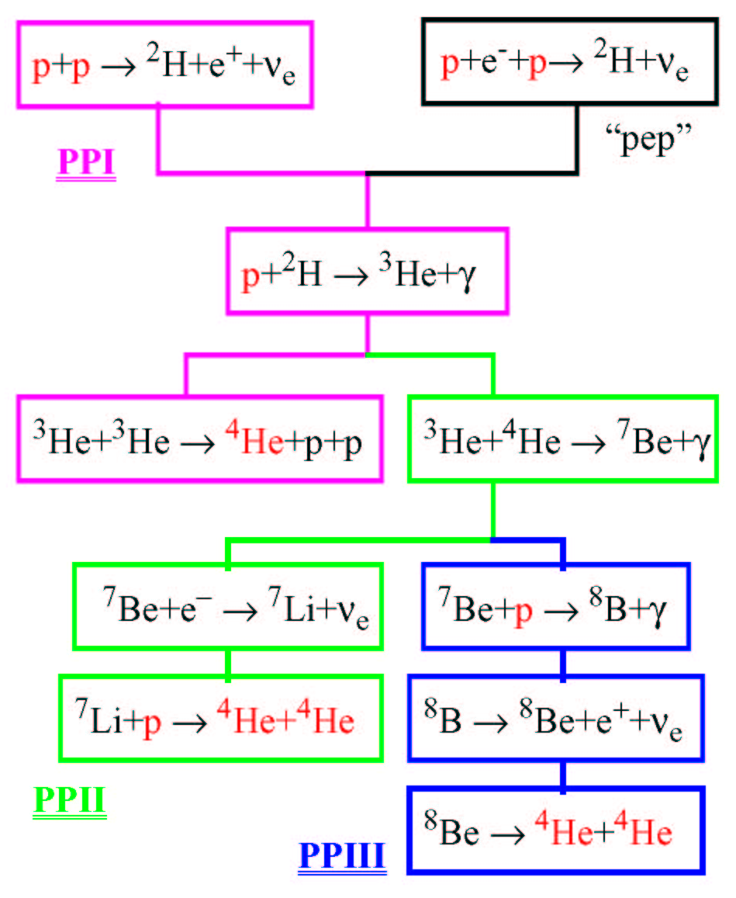
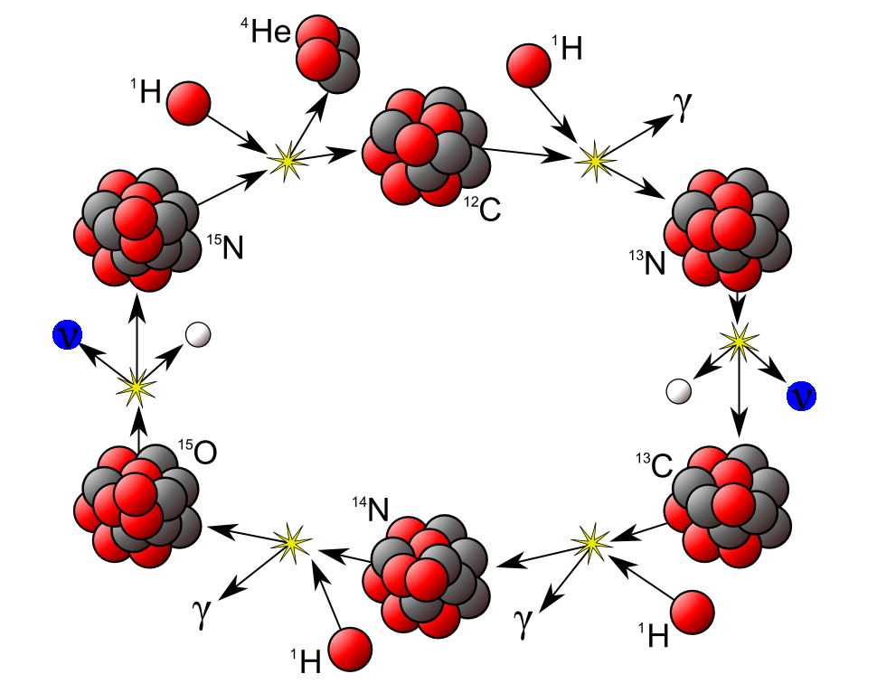
Neutrino production in the Sun
pp chain: pp, pep, ⁷Be, hep ,and ⁸B ν
CNO cycle: ¹³N, ¹⁵O, and ¹⁷F ν

Slide 8
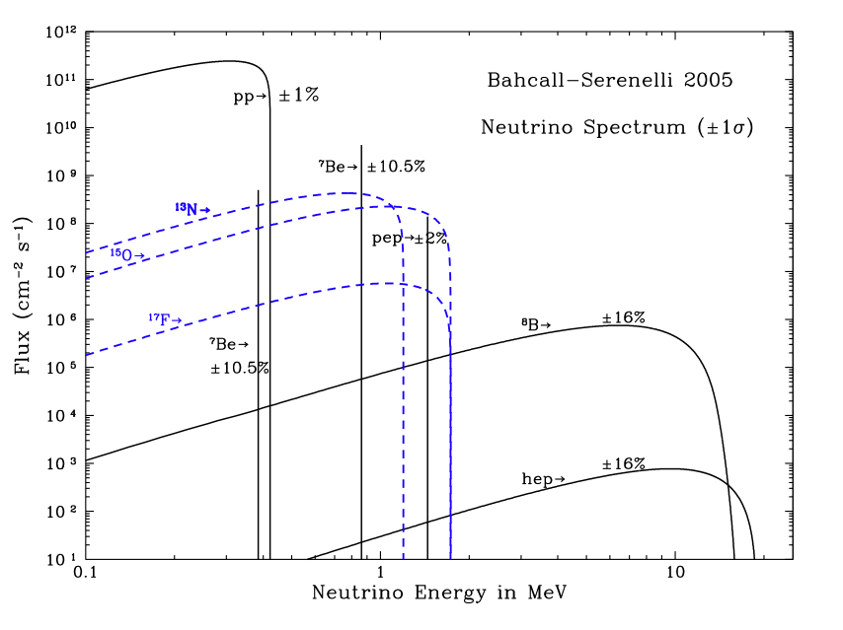
Solar Neutrino Spectra
Gallex
GNO
Sage
Homestake
SNO
SuperK
(real time)
Borexino (real time)
Notes:
5

Slide 9
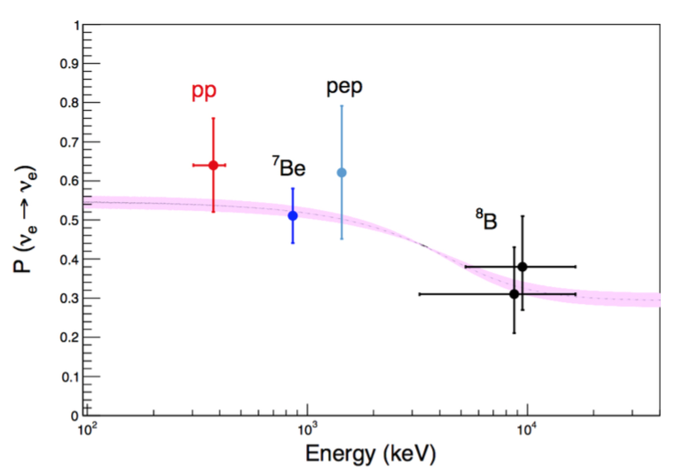
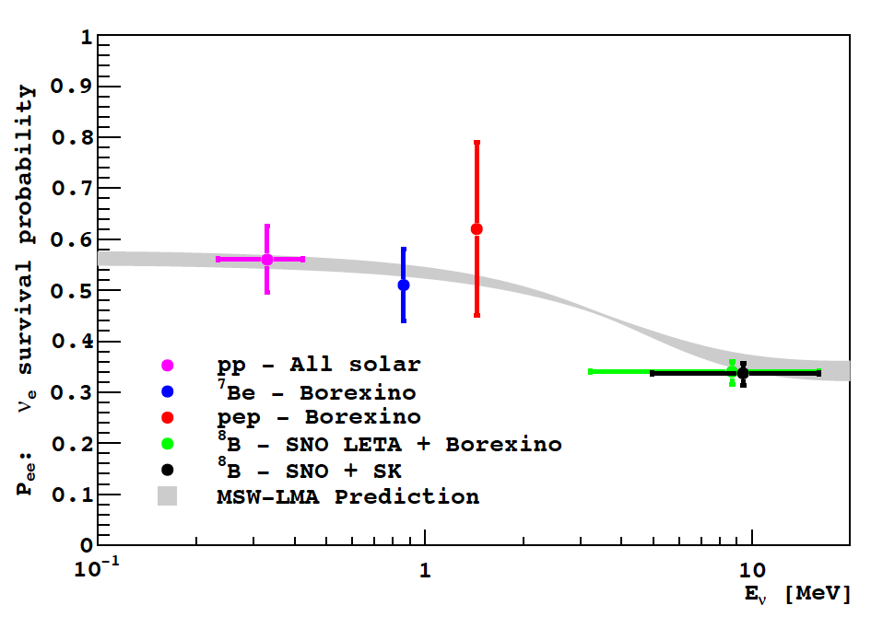
The Experimental Status
Borexino only
Notes:
5

Slide 10
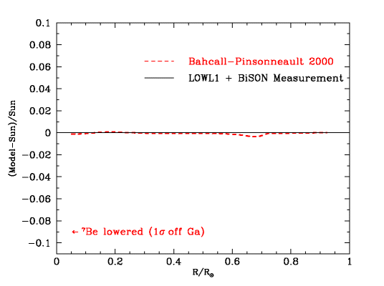
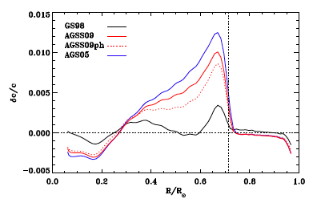
The Standard Solar Model before/after 2004
The Standard Solar Model, based on the old metallicity derived by Grevesse and Sauval (Space Sci. Rev. 85, 161 (1998)), was in agreement within 0.5 in % with the solar sound speed measured by helioseismology.
< 2004
> 2004
Latest work by Asplund, Grevesse and Sauval (Nucl. Phys. A 777, 1 (2006)) indicates a lower metallicity by a factor ~2. This result destroys the agreement with helioseismology

Slide 11
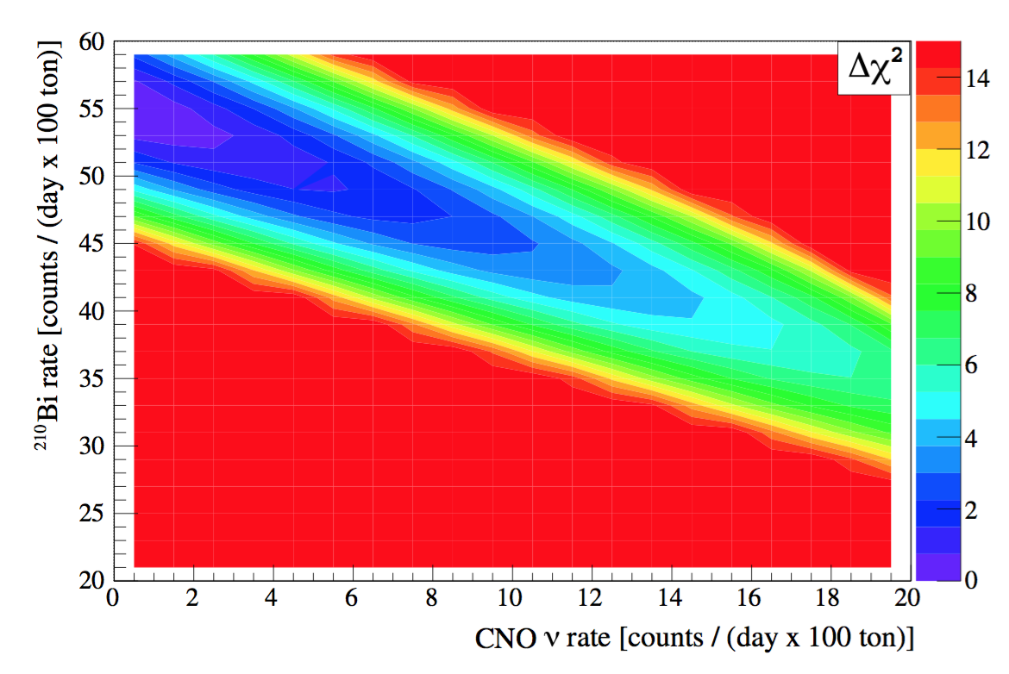
What about neutrinos?
[cm⁻² s⁻¹] | pp (10¹⁰) | pep (10¹⁰) | hep (10³) | ⁷Be (10⁹) | ⁸B (10⁶) | ¹³N (10⁸) | ¹⁵O (10⁸) | ¹⁷F (10⁶)
GS98 | 5.97 | 1.41 | 7.91 | 5.08 | 5.88 | 2.82 | 2.09 | 5.65
AGS09 | 6.03 | 1.44 | 8.18 | 4.64 | 4.85 | 2.07 | 1.47 | 3.48
Δ | -1% | -2% | -3% | -9% | -18% | -27% | -30% | -48%
Never observed
Borexino: <7.9 10⁶ cm⁻² s⁻¹(95% CL)
CNO neutrino (via elastic scattering) and ²¹⁰Bi have similar shapes: strong correlation in spectral fits
Borexino

Slide 12
Borexino physics goals
First ever observations of sub-MeV neutrinos (⁷Be) in real time
pep neutrinos
Low energy (3-5 MeV) ⁸B neutrinos
pp neutrinos
Test of the matter-vacuum oscillation transition with ⁷Be, pep,⁸B and pp
Day/night effect
Limit on the neutrino magnetic moment
SNEWS network for supernovae
Observation (>5σ) of geoneutrinos
(Non) superluminal neutrinos
limits on Pauli Exclusion Principle violation, invisible nucleon decay, axions from the Sun, electron decay, etc.
CNO neutrinos (direct indication of metallicity in the Sun core)
Sterile neutrinos

Slide 13
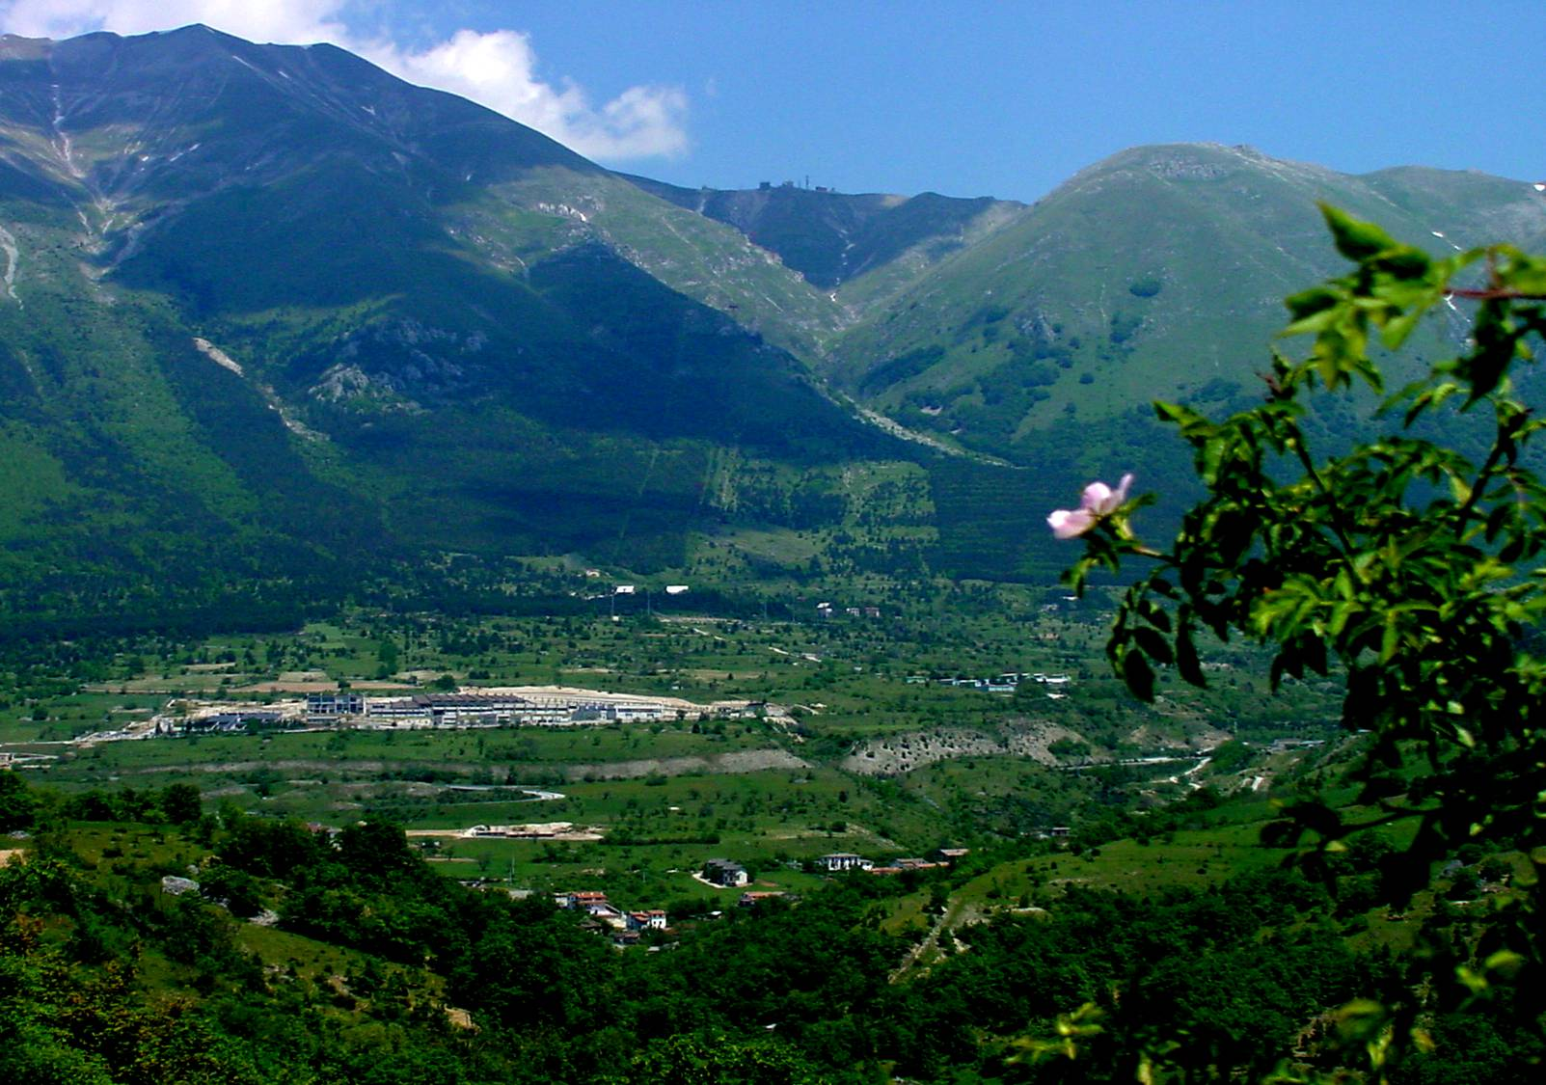
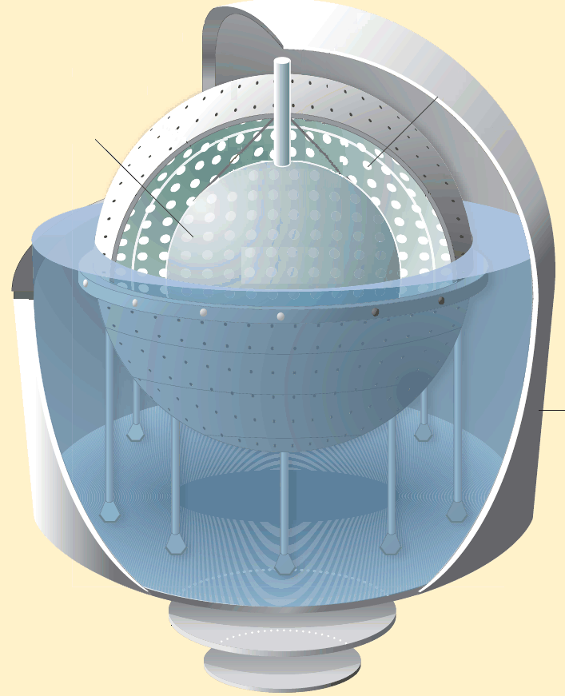
The Detector at LNGS
Stainless Steel Sphere:
2212 PMTs
1350 m³
Scintillator:
270 t PC+PPO in a 150 μm
thick nylon vessel
Nylon vessels:
Inner: 4.25 m
Outer: 5.50 m
Water Tank:
γ and n shield
μ water Č detector
208 PMTs in water
2100 m³
External Lab
Carbon steel plates

Slide 14
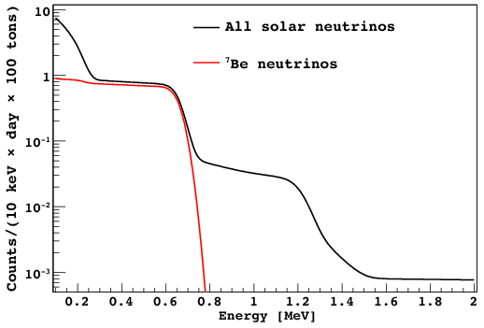
Detection principles and ν signature
Borexino detects solar ν via their elastic scattering off electrons in a volume of highly purified liquid scintillator
Detection via scintillation light:
Very low energy threshold
Good position reconstruction
Good energy resolution
BUT…
No direction measurement
The ν induced events can’t be distinguished from other b events due to natural radioactivity
Extreme radiopurity of the scintillator is a must!

Slide 15
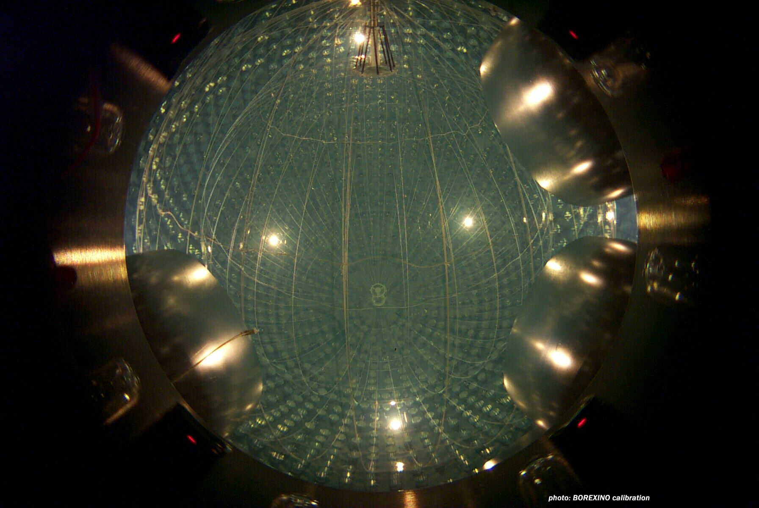
May 15, 2007

Slide 16
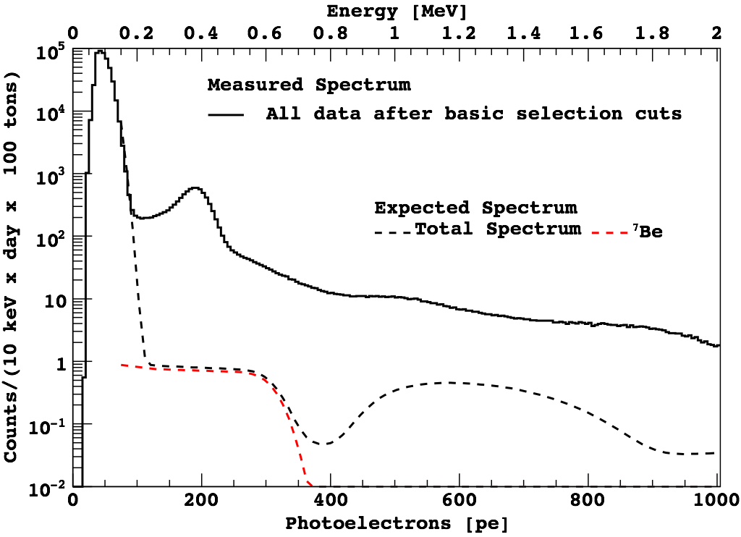
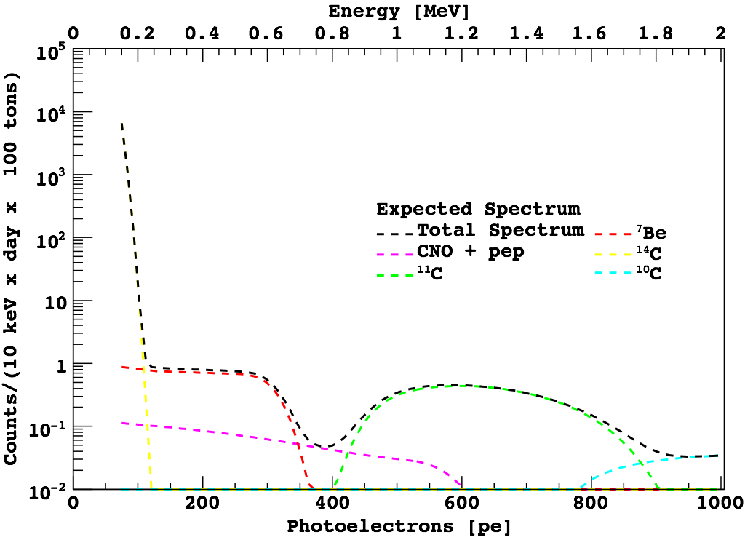
The Spectrum

Slide 17
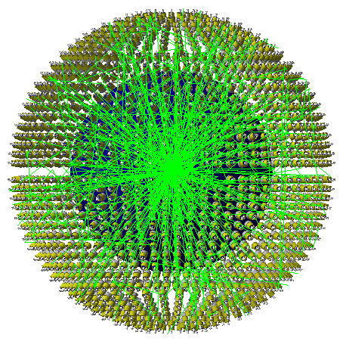
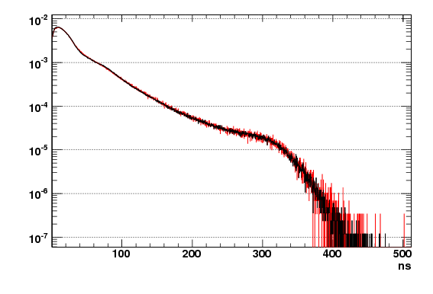
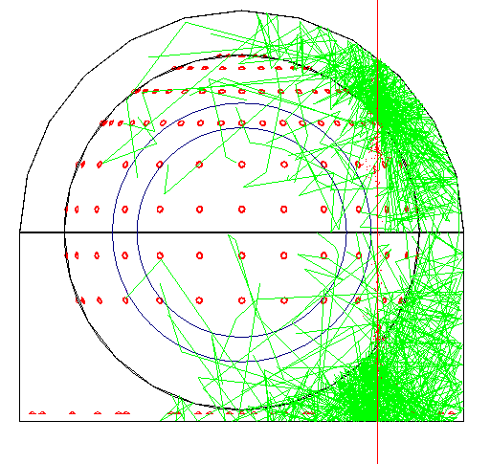
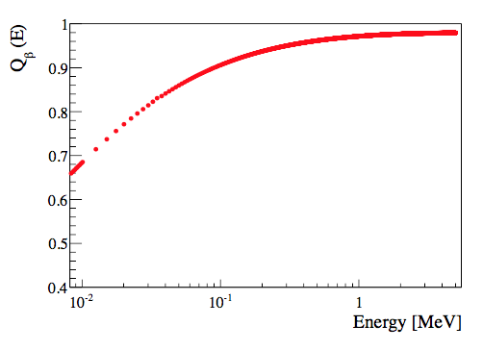
The Monte Carlo
~20 event generators
Solar neutrinos
Cosmic muons
Neutrons from the rock
Neutrinos from CNGS
Muon cascades from FLUKA
¹⁴C forbidden decay
etc.
MC-G4Bx
Data
e⁻
Pulse shape of ¹⁴C events
Physics
Electromagnetic interaction
Optical processes
Hadronic processes
Isotope production
Custom made:
Scintillation process
Quenching effect
μ
Geometry and materials
Inner and outer detectors
Surrounding rocks
The OPERA detector in Hall C
β-quenching model

Slide 18
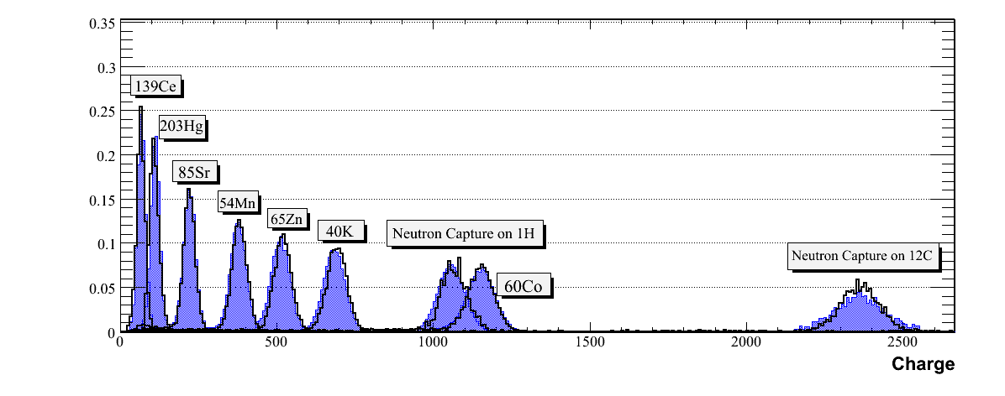
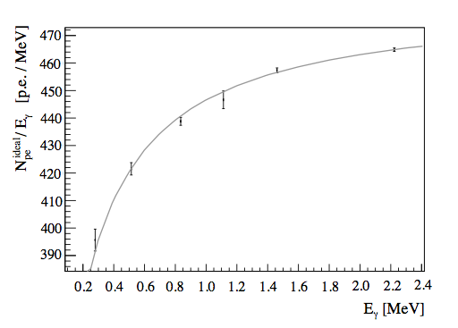
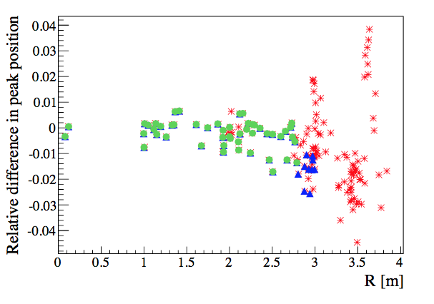
The Energy Calibration
Data-MC comparison in the detector center
kB = 1.15x10⁻² cm/MeV
Gamma sources: MC quenching model vs data
Borexino, Phys. Rev. D89 (2014) 112007

Slide 19
The Background
RadioIsotope |  | Concentration or Flux |  | Strategy for Reduction
Name | Source | Typical | Required | Hardware | Software | Achieved
μ | cosmic | ~200 s⁻¹ m⁻² | ~ 10⁻¹⁰ | Underground | Cherenkov signal | <10⁻¹⁰
 |  | at sea level |  | Cherenkov detector | PS analysis | (overall)
Ext. g | rock |  |  | Water Tank shielding | Fiducial Volume | negligible
Int. g | PMTs, SSS |  |  | Material Selection | Fiducial Volume | negligible
 | Water, Vessels |  |  | Clean constr. and handling
¹⁴C | Intrinsic PC/PPO | ~ 10⁻¹² | ~ 10⁻¹⁸ | Old Oil, check in CTF | Threshold cut | ~ 10⁻¹⁸
²³⁸U | Dust | ~ 10⁻⁵-10⁻⁶ g/g | < 10⁻¹⁶ g/g | Distillation, Water Extraction |  | ~ 5 10⁻¹⁸
²³²Th | Organometallic (?) | (dust) | (in scintillator) | Filtration, cleanliness |  | ~ 4 10⁻¹⁸
⁷Be | Cosmogenic (¹²C) | ~ 3 10⁻² Bq/t | < 10⁻⁶ Bq/ton | Fast procurement, distillation | Not yet measurable | ?
⁴⁰K | Dust, | ~ 2 10⁻⁶ g/g | < 10⁻¹⁴ g/g scin. | Water Extraction | Not yet measurable | ?
 | PPO | (dust) | < 10⁻¹¹ g/g PPO | Distillation
²¹⁰Pb | Surface contam. |  |  | Cleanliness, distillation | Not yet measurable | ?
 | from ²²²Rn decay |  |  |  | (NOT in eq. with ²¹⁰Po)
²¹⁰Po | Surface contam. |  |  | Cleanliness, distillation | Spectral analysis | ~ 6
 | from ²²²Rn decay |  |  |  | a/b stat. subtraction | < 0.01 c/d/t
²²²Rn | air, emanation from | ~ 10 Bq/l (air) | < 1 c/d/100 t | Water and PC N₂ stripping, | Delayed coincidence | < 0.02 c/d/t
 | materials, vessels | ~100 Bq/l (water) | (scintillator) | cleanliness, material selection
³⁹Ar | Air (nitrogen) | ~17 mBq/m³ (air) | < 1 c/d/100 t | Select vendor, leak tightness | Not yet measurable | ?
⁸⁵Kr | Air (nitrogen) | ~ 1 Bq/m³ in air | < 1 c/d/100 t | Select vendor, leak tightness | Spectral fit | ~1
 |  |  |  | (learn how to measure it) | fast coincidence | < 7

Slide 20
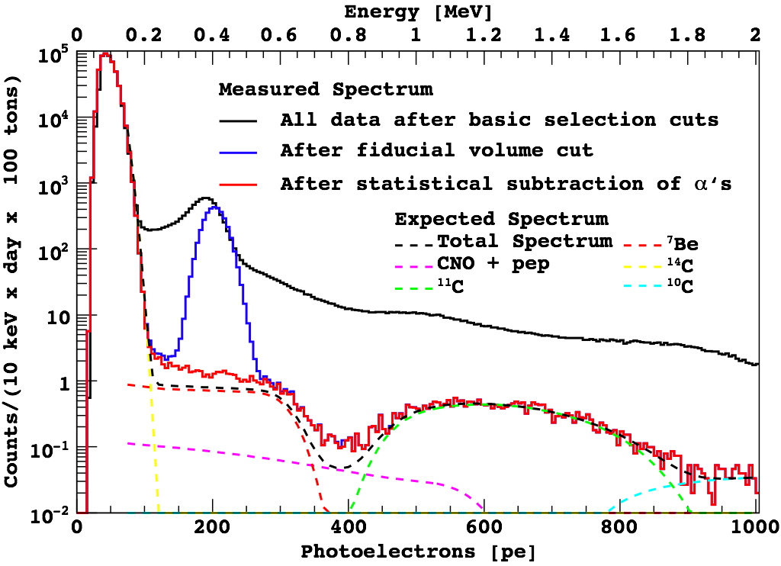
After the selection cuts

Slide 21
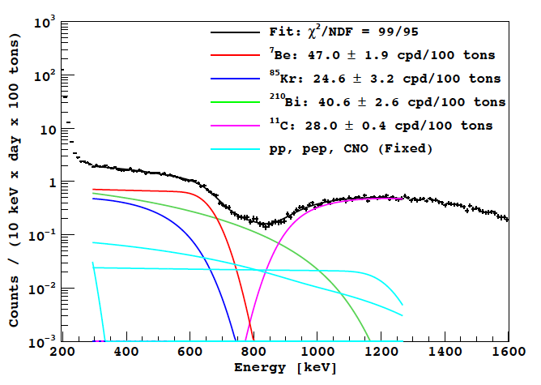
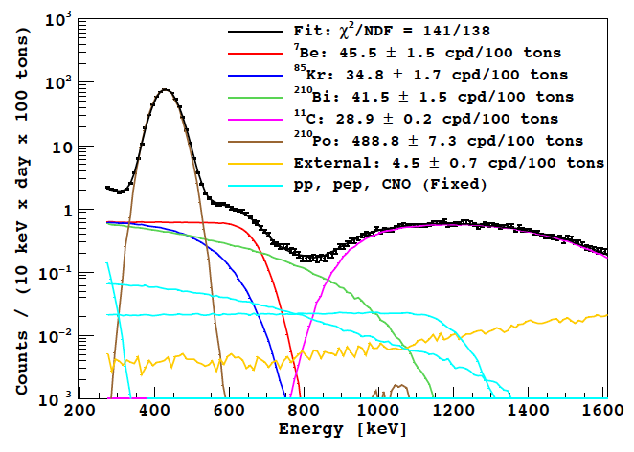
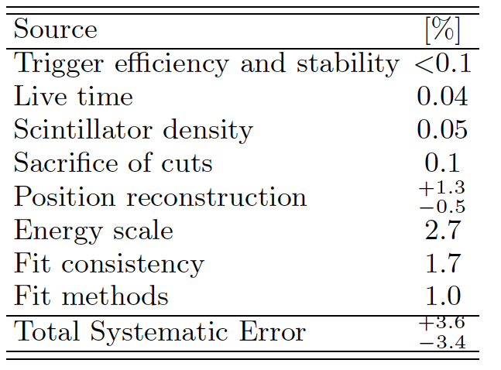
⁷Be-ν analysis: 740 days of statistics
Analytical Model
MC Model
Borexino, Phys. Rev. D89 (2014) 112007
Borexino, Phys. Rev. Lett. 107 (2011) 141302
Borexino, Phys. Lett. B658 (2008) 101-108

Slide 22
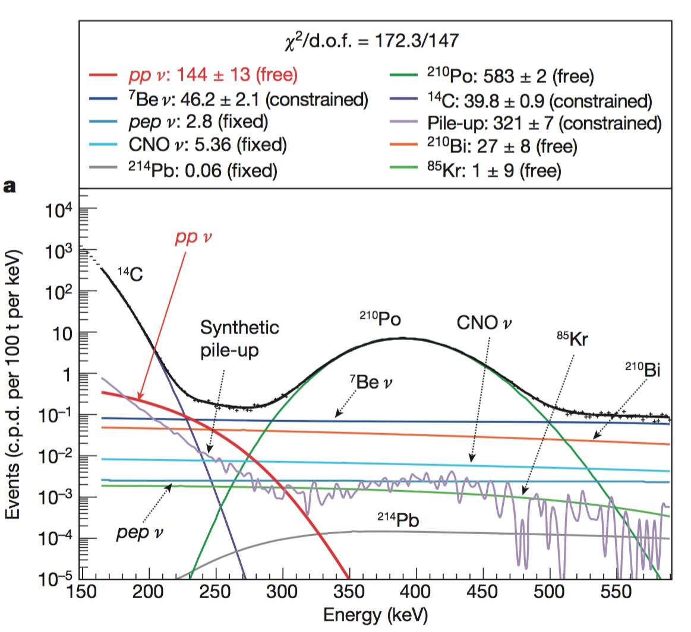
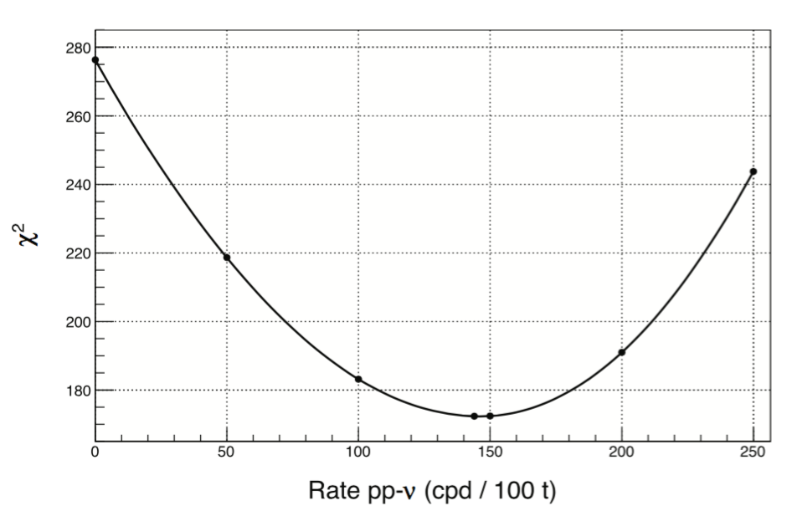
pp-ν analysis: 408 days of statistics
The pile-up problem is fixed with the “synthetic pile-up”: mixing real data trigger without selection cuts with random gates
Measured Rate = 144 ± 13 (stat.) ±10 (syst.) cpd/100 ton
Measured Flux = (6.6 ± 0.7) x 10¹⁰ cm⁻² s⁻¹
Expected Flux = 5.98 x (1 ± 0.006) x 10¹⁰ cm⁻² s⁻¹
Borexino, Nature 512 (2014) 7515, 383.

Slide 23
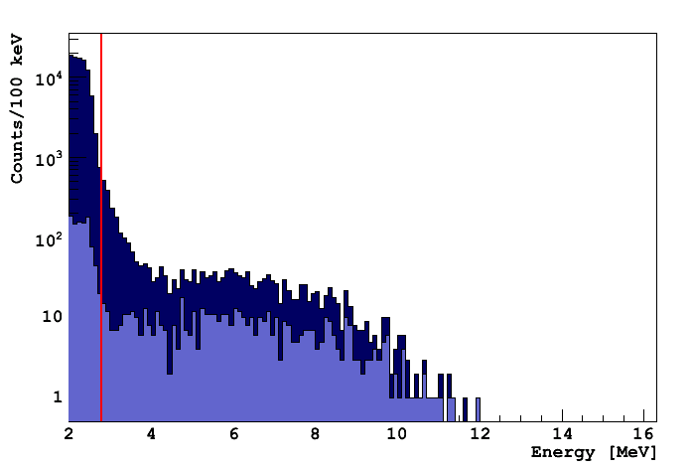
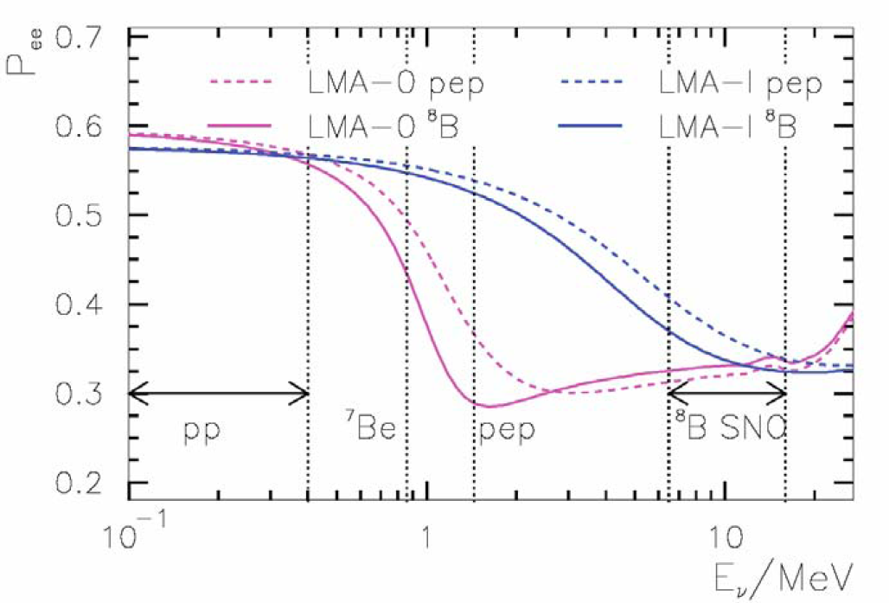
⁸B neutrinos with the lowest threshold: 3 MeV
Expected ⁸B ν rate in 100 tons of liquid scintillator above 3.0 MeV:
0.26±0.03 cpd/100 t
2.6 MeV γ’s from ²⁰⁸Tl on PMT’s and in the buffer
All volume
R < 3 m (100 tons)
Energy spectrum in Borexino
(after μ subtraction)
A. Friedland 2005
Borexino, Phys.Rev. D82 (2010) 033006.

Slide 24
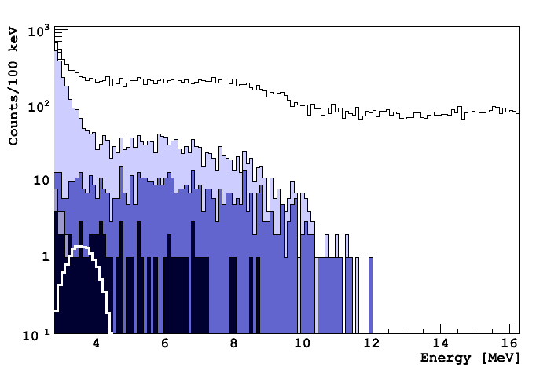
Background in the 3-16.3 MeV range
live-time: 246 days
Cosmic Muons
External background
High energy gamma’s from neutron captures
²⁰⁸Tl and ²¹⁴Bi from radon emanation from nylon vessel
Cosmogenic isotopes
²¹⁴Bi and ²⁰⁸Tl from ²³⁸U and ²³²Th bulk contamination
raw spectrum
μ cut
FV cut
cosmogenic, neutron, ²¹⁴Bi and ¹⁰C cuts
²⁰⁸Tl
Count-rate: 1500 c/d/100 ton
S/B ratio < 1/6000!

Slide 25
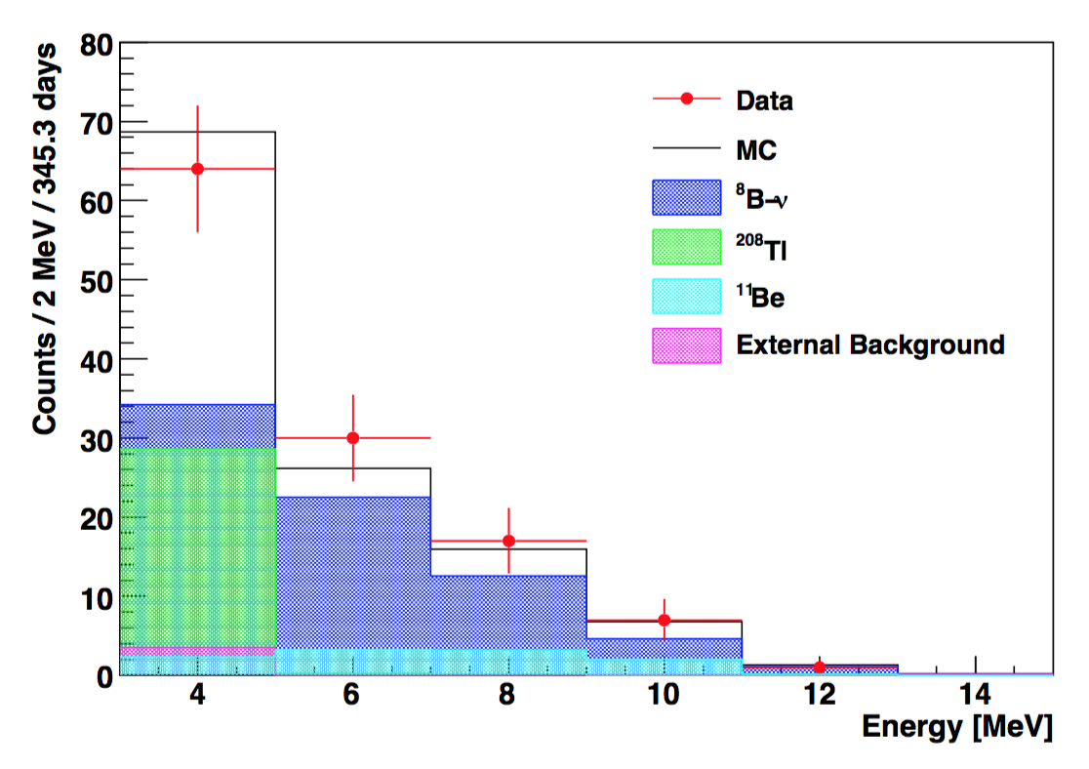
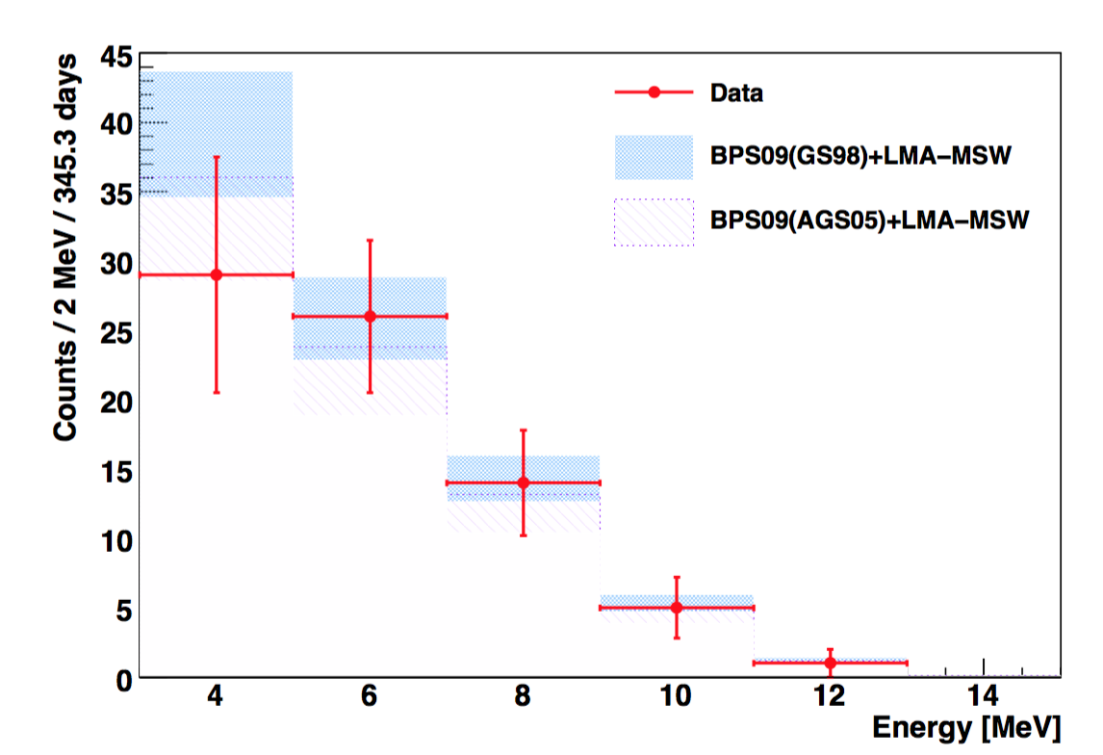
Result on the ⁸B neutrino rate
Cut | Counts >3 MeV | Counts > 5 MeV
None | 1932181 | 1824858
Muon cut | 6552 | 2679
FV cut | 1329 | 970
Cosmogenic cut | 131 | 55
¹⁰C removal | 128 | 55
²¹⁴Bi removal | 119 | 55
²⁰⁸Tl and ¹¹Be sub. | 75 + 13 | 46 + 8
Measured ⁸B-ν | 75 + 13 | 46 + 8
BPS09(GS98) ⁸B-ν | 86 + 10 | 43 + 6
BPS09(AGS05) ⁸B-ν | 73 + 7 | 36 + 4
*MSW-LMA: Δm²=7.69×10⁻⁵ eV², tan²θ=0.45
Systematic errors:
3.8% from fiducial mass
3.5% (5.5%) uncertainty from the energy threshold at 3.0 MeV (5.0 MeV)
P_{ee}(⁸B) = 0.29 ± 0.10 (8.6 MeV)

Slide 26
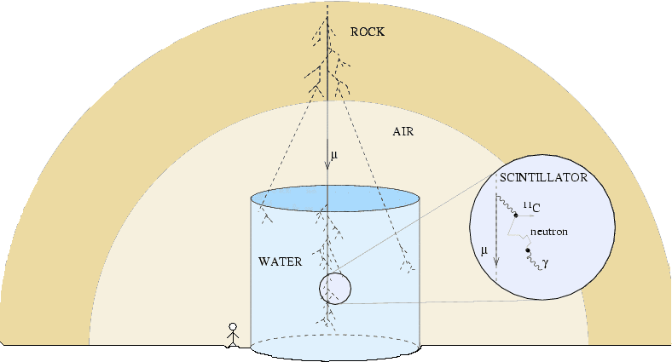
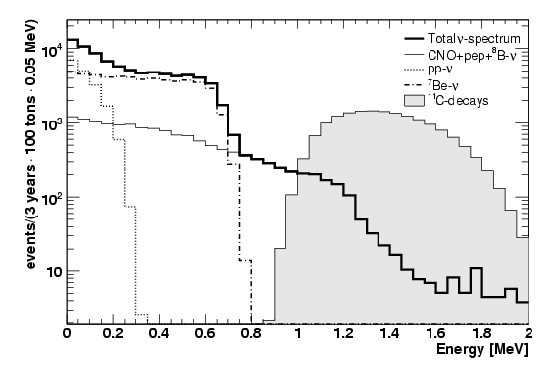
pep neutrinos: the ¹¹C background
μ + ¹²C → μ + ¹¹C + n
+ p → d + γ
→¹¹B + e⁺ + ν_{e}
Expectations in [0.8-1.4] MeV:
- pep-ν ~0.01 cpd / t
- ¹¹C ~ 0.3 cpd / t
Required ¹¹C rejection factor: > 30

Slide 27
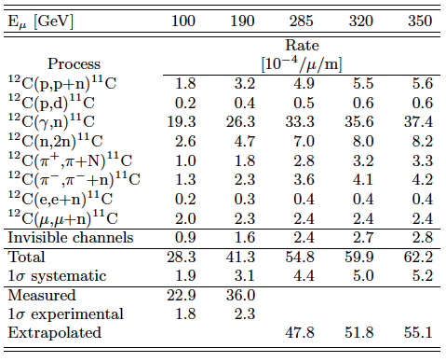
¹¹C rejection: the three-fold coincidence
Coincidence among the muon father, the neutron capture and the ¹¹C decay
problem 1: ¹¹C meanlife ~30 min
problem 2: ~5% of ¹¹C production without neutron emission (invisible channels)
μ
PC+PPO
¹¹C
n
γ
Borexino (DF corresponding author), Phys. Rev. C74 (2006) 045805
C. Galbiati, D. Franco, et all., Phys. Rev. C71 (2005) 055805

Slide 28
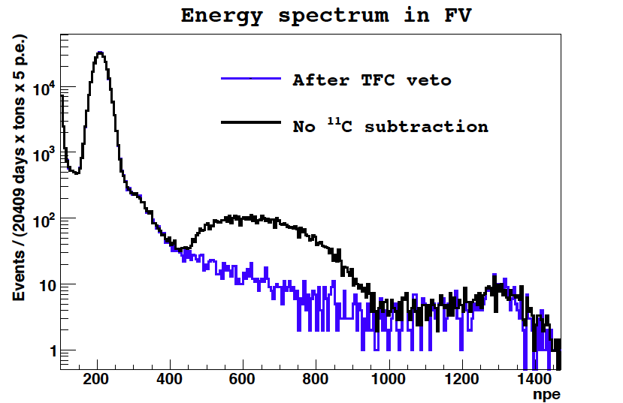
pep neutrinos after the TFC

Slide 29
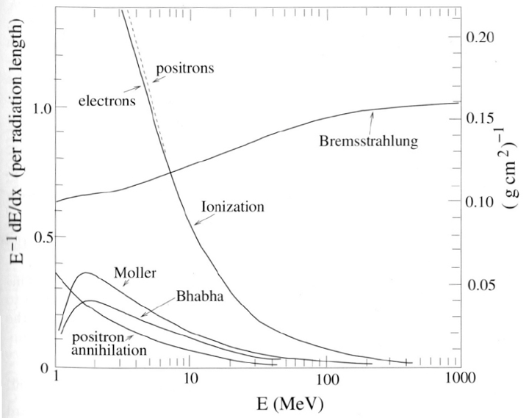
¹¹C rejection: a new PSD
Pulse Shape Discrimination (PSD) for e⁺/e⁻ may meet a general interest in the neutrino community
However scintillators have almost equal response to e⁺/e⁻ in the energy region of interest (<10 MeV)
standard PSD can not be applied!!
Positron
Electron
Ionization
In matter positrons may either directly annihilate or form a positronium state
In matter o-Ps (tau ~ 140 ns in vacuum) has a shorter mean life, mainly because of spin-flip and pick off
Even a short delay (few ns) in energy depositions between positron (via ionization) and annihilation gammas (via Compton scattering) can provide a signature for tagging (a subset of) positrons

Slide 30
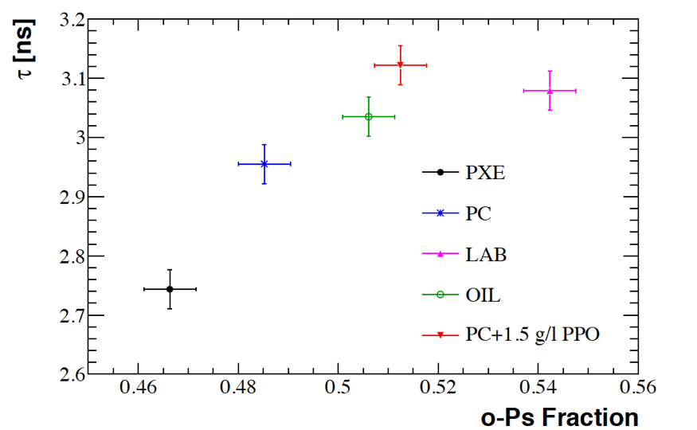
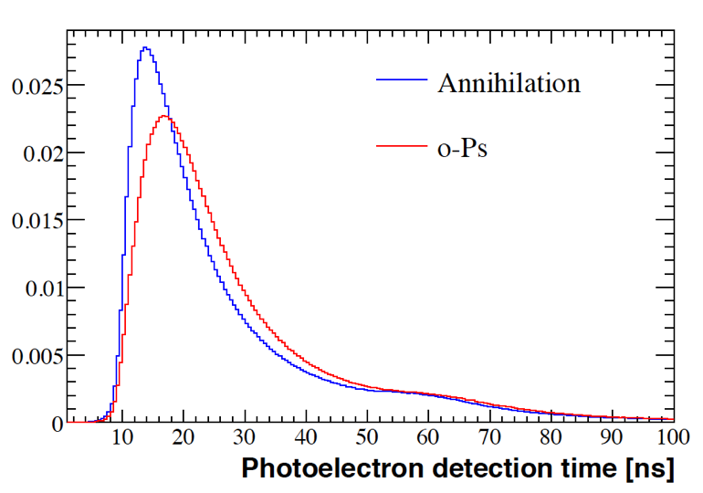
o-Ps in scintillators
D. Franco, G. Consolati, D. Trezzi, Phys. Rev. C83 (2011) 015504
MC
NuToPs (ANR-JCJC): Neutrino Tagging with o-Ps
G. Consolati, D. Franco, et al., NIM A 795 (2015) 364
G. Consolati, D. Franco, et al., Phys. Rev. C88 (2013) 065502
Double Chooz, JHEP 1410 (2014) 032.

Slide 31
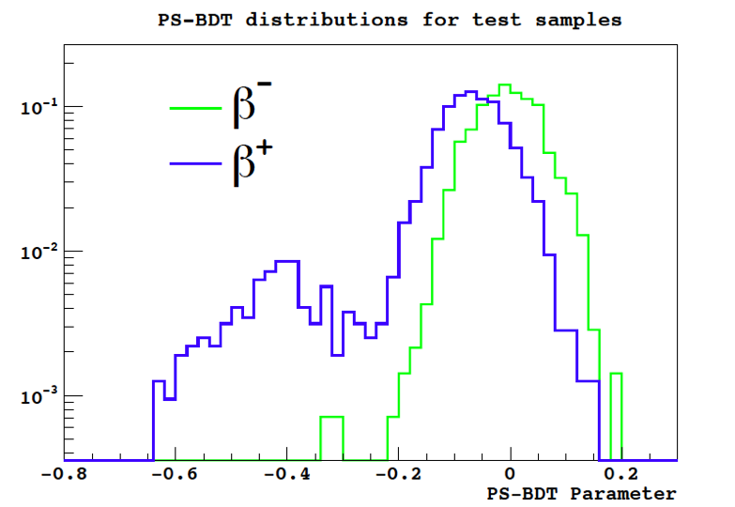
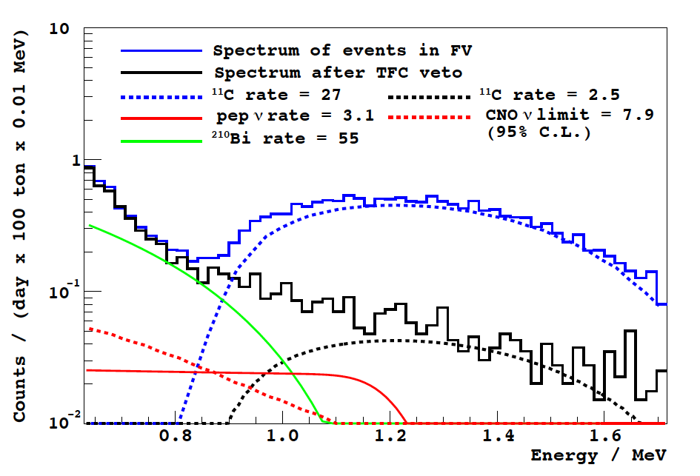
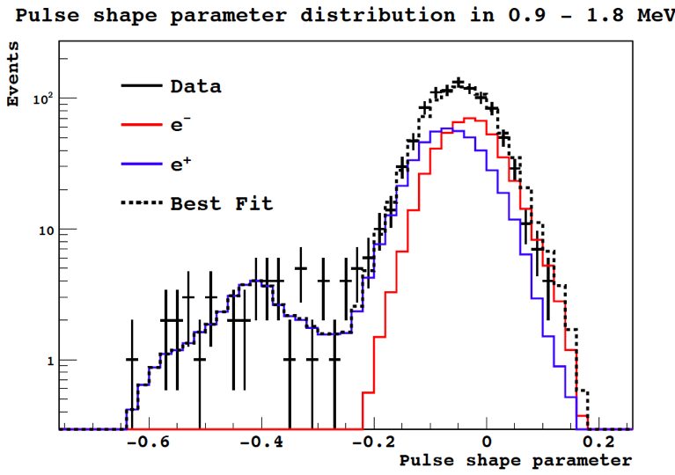
The o-Ps technique in Borexino
Training on the TFC sample
The final result on pep and CNO neutrinos
Fit of the “survived” events
pep flux = (1.6 ± 0.3)x10⁸ cm⁻² s⁻¹
CNO flux < 7.4x10⁸ cm⁻² s⁻¹
Borexino, Phys. Rev. D89 (2014) 112007
Borexino Phys. Rev. Lett. 108 (2012) 051302

Slide 32
The Borexino solar neutrino spectroscopy

Slide 33
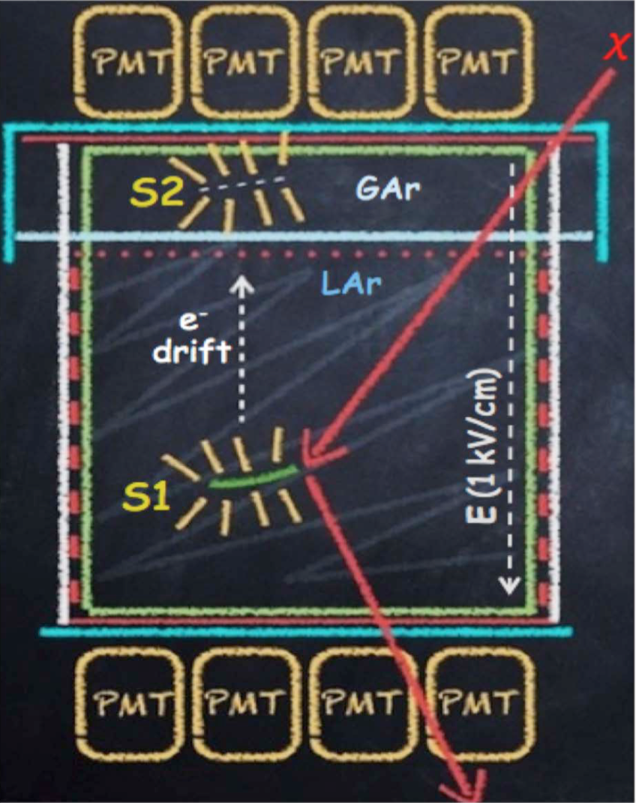
Solar neutrinos with a two-phase LAr TPC
Liquid Argon:
Excellent scintillator: 40,000 photons / MeV
It does not bond with chemical species
It can be easily purified both in liquid and in gas phases
Higher intrinsic radio-purity wrt organic liquid scintillators
Scalable to multi-ton (hundreds of ton) mass targets
Exceptional PSD
Two-phase TPC:
Excellent 3D position reconstruction
Excellent identification and rejection of multiple interactions
Already planned for Direct Dark Matter Search
Ideal to observe CNO neutrinos via elastic scattering
D. Franco et al., arXiv:1510.04196 (2015).

Slide 34
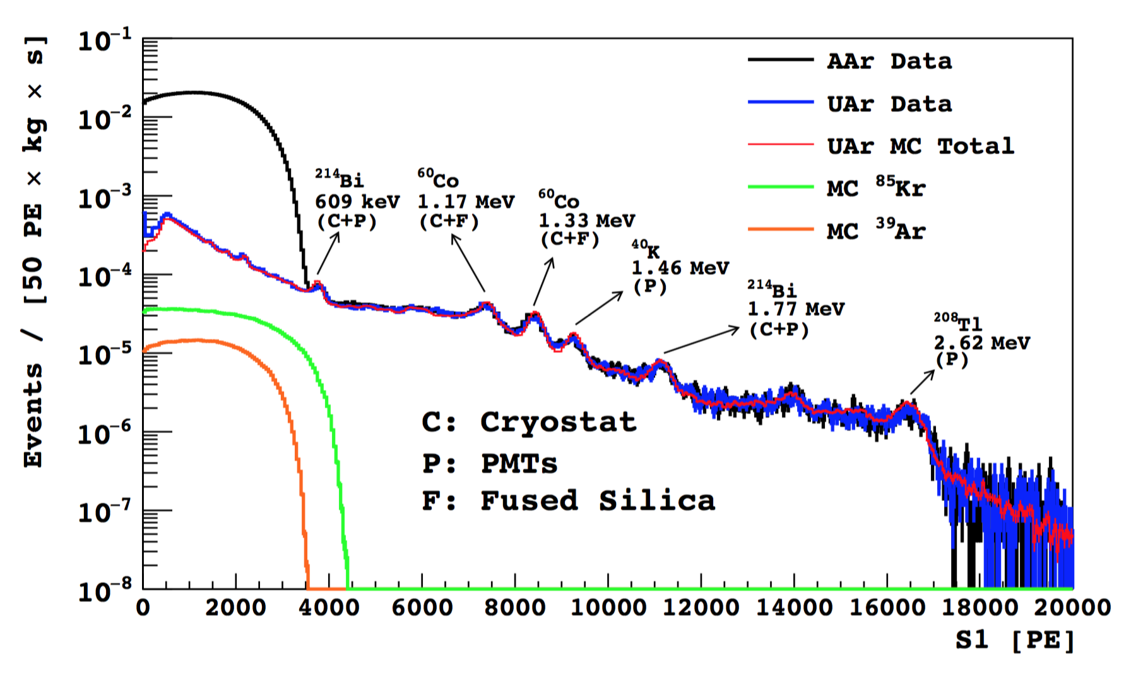
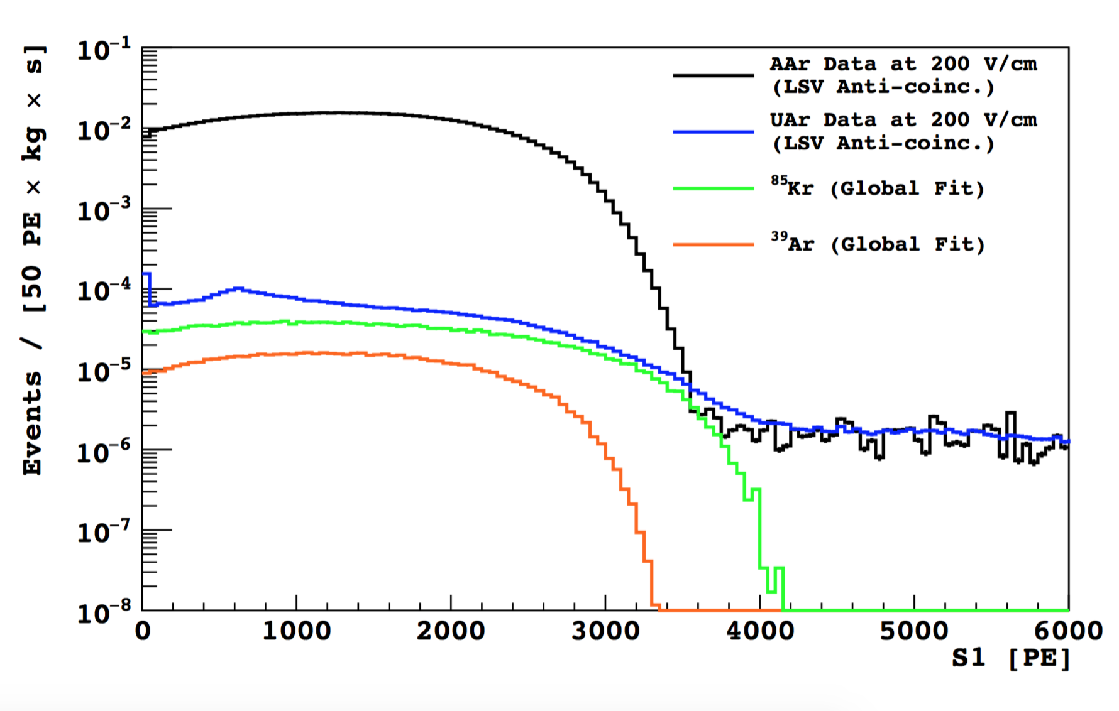
The ³⁹Ar issue after DS50
Atmospheric Ar:
³⁹Ar/⁴⁰Ar = 8 x 10⁻¹⁶
Rate ~ 1 Bq/kg
Field-Off
Underground Ar:
Rate ~ 0.7 mBq/kg
Atmospheric Ar
Depletion factor ~ 1400
Underground Ar
Field-On
This measurement came after this work. We used the old limit of ³⁹Ar < 6.5 mBq/kg (arXiv:1204.6011) equivalent to a depletion factor of 150
³⁹Ar
⁸⁵Kr
DarkSide, Phys. Rev. D 93 (2016) 081101
DarkSide, Phys. Lett. B 743 (2015) 456.

Slide 35
Detector Assumptions
Assumed ³⁹Ar activity: 6 mBq / kg (³⁹Ar Q-value: 565 keV)
RoI: > 600 keV
(0 ³⁹Ar events expected in 400 tonne year)
Energy resolution
DS50: ~7,000 pe/MeV@200 V/cm
DS50: ~8,500 pe/MeV@0 V/cm
MicroCLEAN: ~6,000 pe/MeV@0 V/cm
Conservative LY assumed in this work: 6,000 pe/MeV @200 V/cm
MicroCLEAN has demonstrated linear energy response within 2% above 40 keV
Full capability to discriminate multiple interactions if Δz > 2 mm

Slide 36
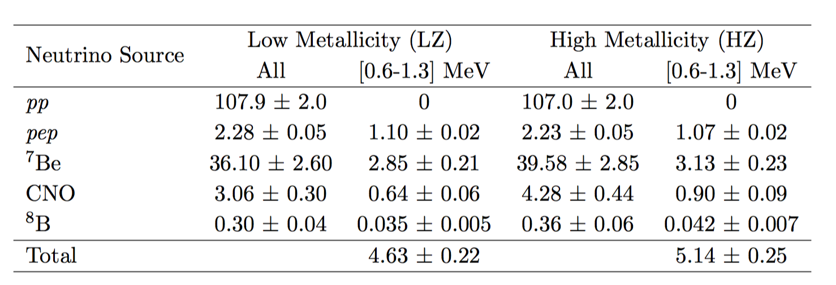
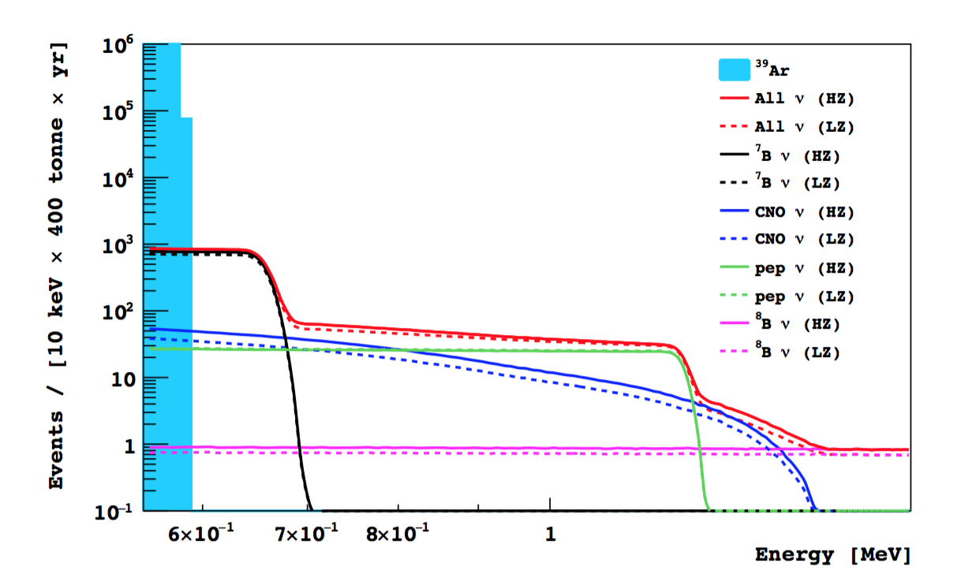
Solar Neutrino Rate
cpd / 100 tonne
In 400 tonne year in the RoI:
⁷Be: ~4,400 events
pep: ~1,600 events
CNO: ~1,100 events

Slide 37
Cosmogenics
Simulations:
Assuming at LNGS
Isotopes production with FLUKA: known to be accurate within a factor 2
Generated 3 m above the tank, through 0.7 m of rock
Muon showers and short lived isotopes (<1 ms) vetoed
Production of 84 isotopes
Each of them tracked with Geant4
0.733 cpd / 100 tonne
S/B ~ 7

Slide 38
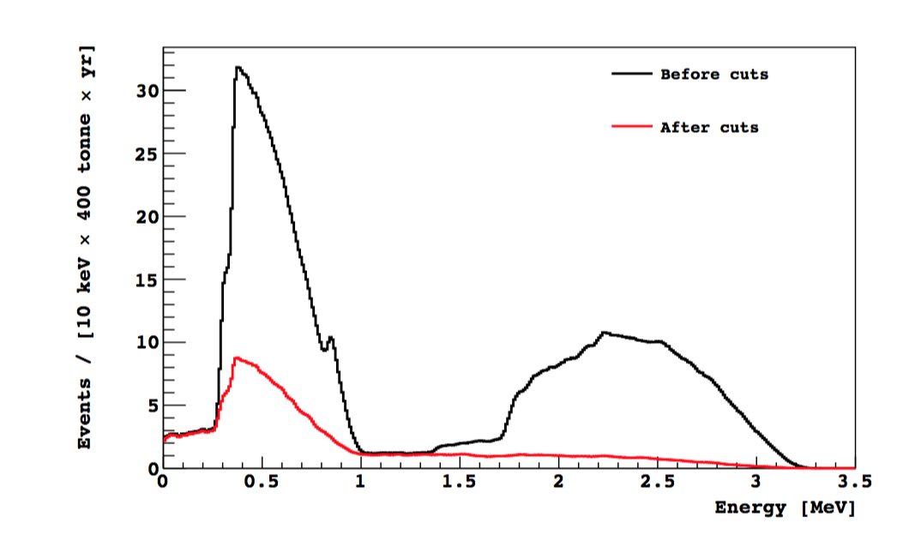
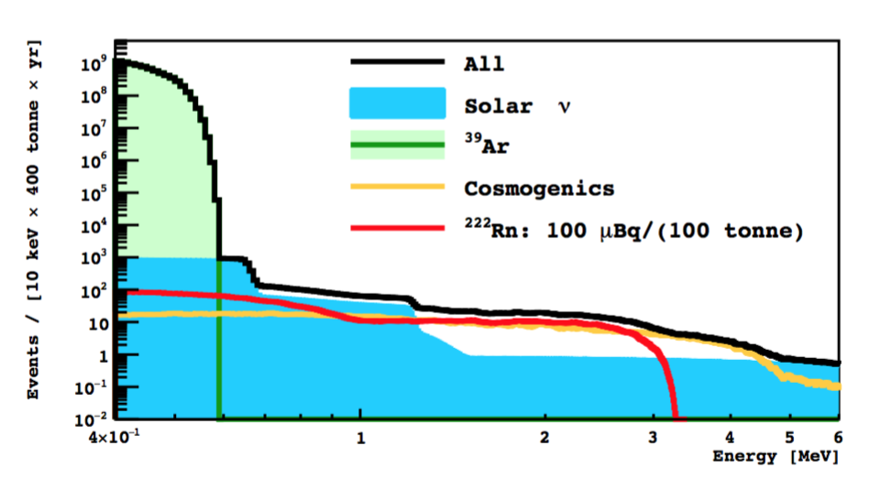
Radon and External Background
Radon:
²²²Rn diffuses by purification loop of the cryogenic and gas handling system
Cold-charcoal traps: fractions of the μBq in 1 m³ in GAr
Potentially, with cryogenic adsorption technique: < 1 mBq/100 tonne
Alpha’s efficiently rejected with PSD
6.9% of ²¹⁴Pb and 5.9% of ²¹⁴Bi survive to the cuts
²¹⁴Bi-Po coincidence is here assumed with 60% efficiency
External Background: only ⁶⁰Co is an issue
Assuming the lowest ⁶⁰Co activity in literature in stainless steel (6.6 mBq/kg) => 1.7 cpd / tonne expected in the FV after the cuts
Definitive solution to ⁶⁰Co is a titanium cryostat

Slide 39
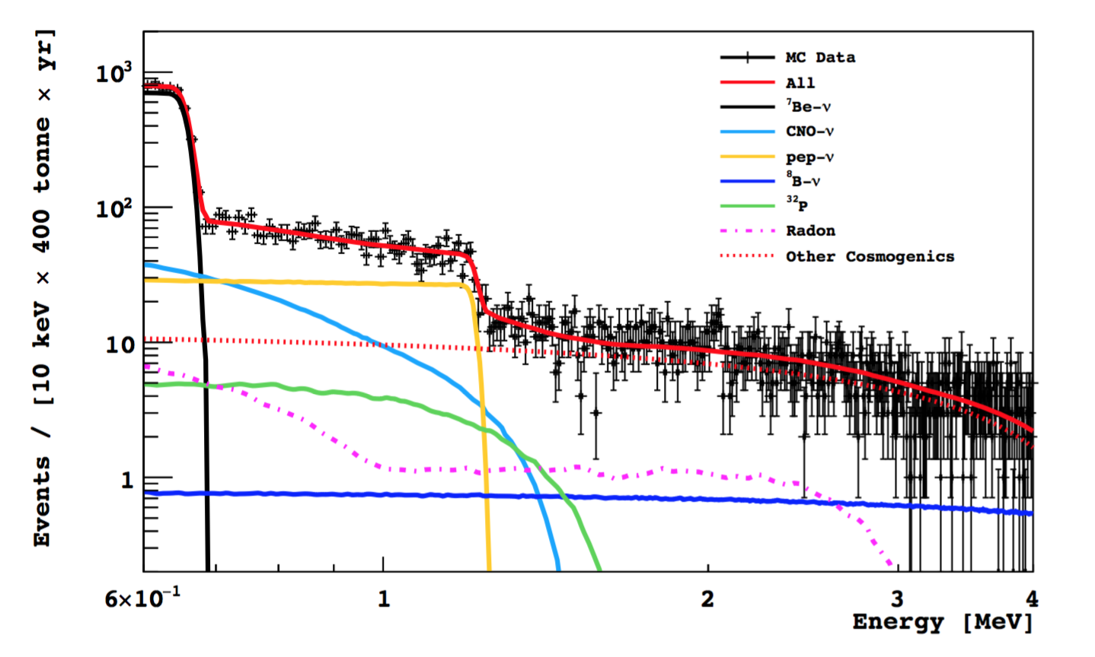
Results from the toy MC fits
²²²Rn: 10 μBq/100 tonne
Systematics:
Negligible systematics from the fit procedure
~1% from FV
~1% from energy calibration
Potential Goals:
⁷Be@2%, pep@10% and CNO@15%
Observation of CNO (>5σ)
C and N content in the Sun at 16.5% level (currently at 25%)
S17 (⁷Be(p,γ)⁸B) precision from 12% to 8%
Good potential in the metallicity model discrimination

Slide 40
Short distance Oscillations with BoreXino
6.5% effect (~3 σ)
<R>=0.85 ±0.05 (~3 σ)
Reactor anomaly
Gallium anomaly

Slide 41
A neutrino/anti-neutrino source in Borexino
The physics
Neutrino magnetic moment
Neutrino-electron non standard interactions
ν_{e}- e weak couplings at 1 MeV scale
Sterile neutrinos at 1 eV scale
Neutrino vs anti-neutrino oscillations on 10 m scale
The location
A: underneath - D = 825 cm - No change to present configuration
B: inside - D = 700 cm - Need to remove shielding water
C: center - Major change - Remove inner vessels
Borexino/SOX Collaboration, JHEP 1308 (2013) 038.

Slide 42
Neutrino or anti-neutrino?

Slide 43
The Icarus pit

Slide 44
Sensitivities
10 MCi ⁵¹Cr source
Toy MC approaches including backgrounds and systematics
75 kCi ¹⁴⁴Ce source

Slide 45
SOX today
~100 kCi ¹⁴⁴Ce at 8.25 m from the detector center
Source activity measured with two calorimeters (@1.5%)
The source will be delivered early next year
1.5 years of data taking
Borexino calibration at the end of the year
Data taking in early 2017

Slide 46
Conclusions
Borexino has reached a rich set of results in:
Solar physics
Geo physics
Neutrino physics
We entered in the “precision” phase of Borexino:
Very large statistics
additional calibrations
Temperature stabilization
A new purification (maybe)
SOX can close the “sterile” neutrino puzzle
ARGO after Borexino? A liquid argon detector for both direct dark matter search and solar neutrino, with a strong potential in CNO neutrinos

Slide 47
Thank You!

Slide 48
The Counting Test Facility
CTF is a small scale prototype of Borexino:
~4 tons of scintillator
100 PMTs
Buffer of water
Muon veto
Vessel radius: 1 m

Slide 49
The Energy Calibration
Data-MC comparison: ²¹⁴Po a-peak vs position
Data
MC
Disagreements:
Inside the FV (r<3 m) at <1%
Outside the FV (r>3m) at <4%

Slide 50
Muon rejection
Muon pulse shape identification: rejection factor > 10³
PSD
μ
Borexino, JINST 6 (2011) P05005

