Slide 1
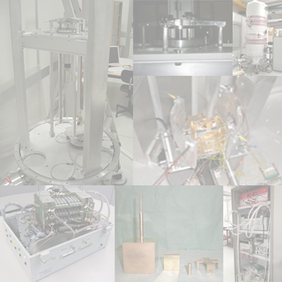
PeTeR: a hardware simulator for LISA PF TM-GRS system
L. Marconi and R. Stanga
Università degli Studi di Firenze & INFN Firenze
M. Bassan, F. De Marchi, G. Pucacco and M. Visco
Università di Roma “Tor Vergata” & INFN Roma 2

Slide 2
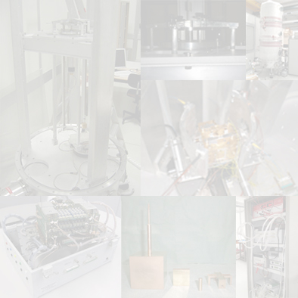
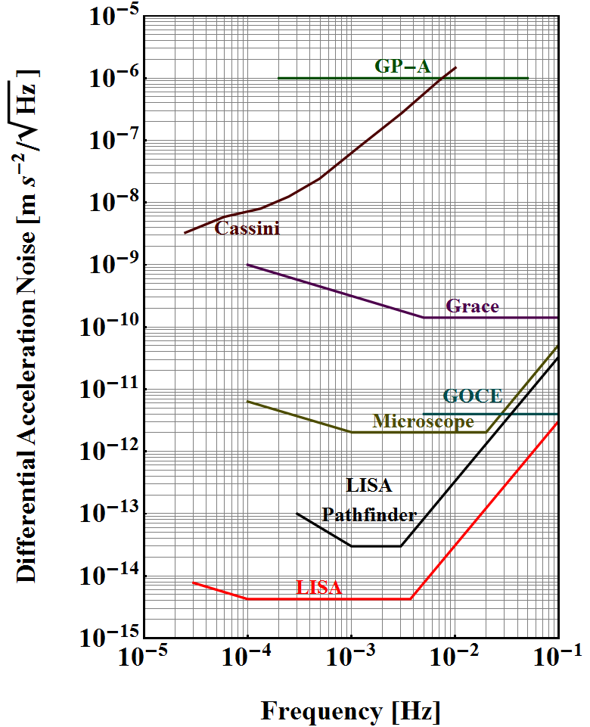
Motivations
We intend to investigate the spurious forces that may act on the LISA PF TM, with a TM in quasi free-fall along 2 DoF.
With a TM in free fall conditions on 2 DoFs we can:
analyze cross talks between two soft DoFs,
evaluate the effects on one DoF, when we apply feedback to the second DoF.

Slide 3
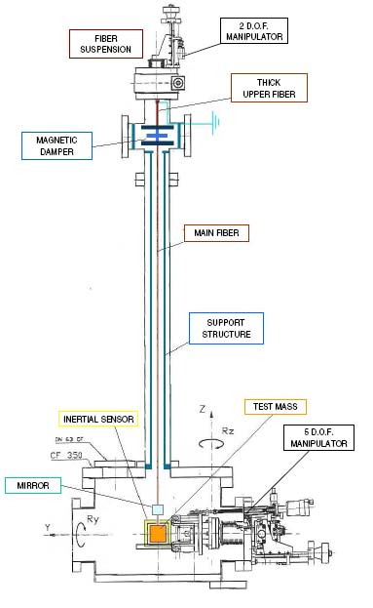
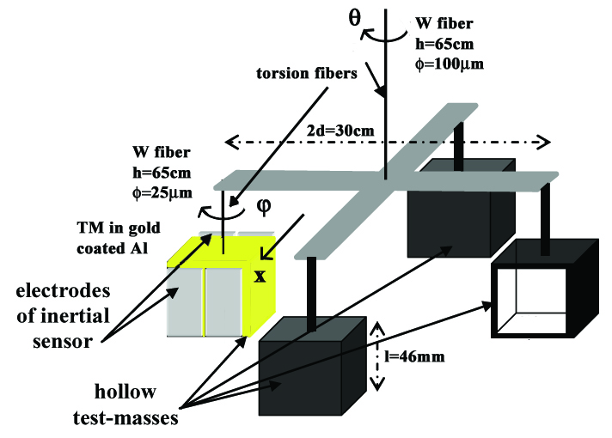
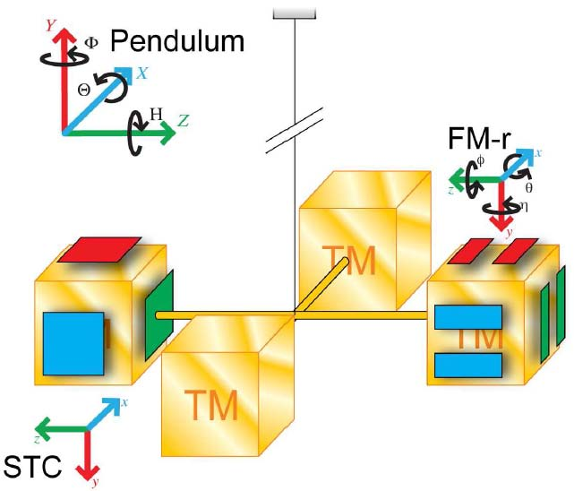
The experimental scheme
1 DoF rotational
+
1 DoF translational.
+
1 DoF rotational.
1 DoF translational.

Slide 4
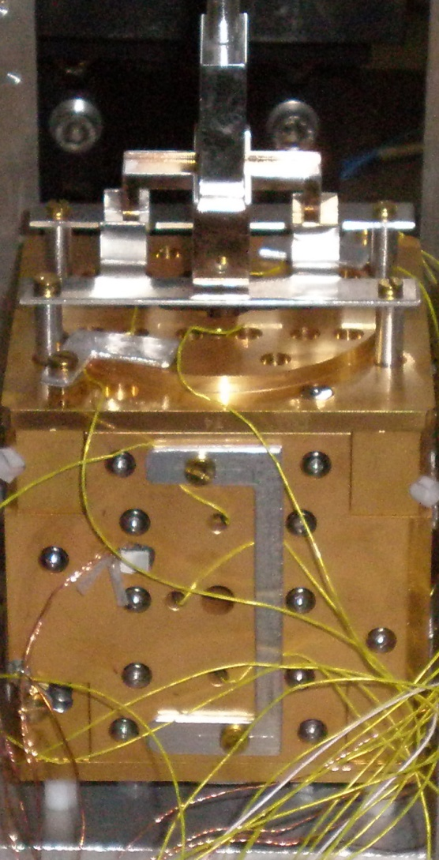
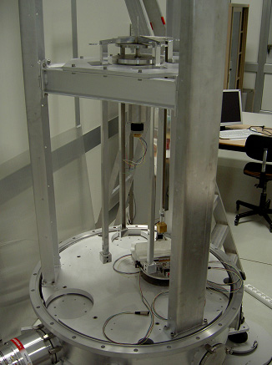
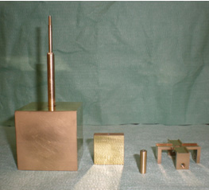
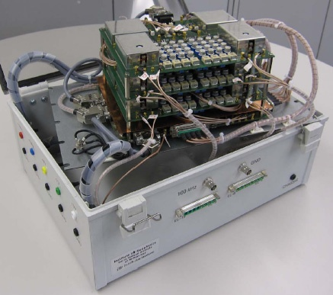
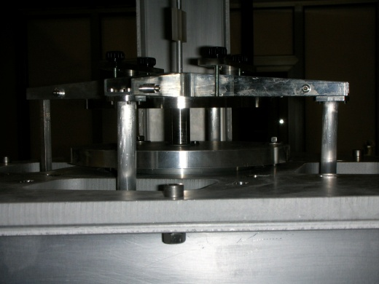
The experimental setup in Firenze
We are using, from Trento University, a 4mm gap sensor in Mo and SHAPAL and a hollow 46mm TM in Al, that matches the flight model geometry.
The double pendulum is enclosed in a vacuum tank (residual pressure lower than 10⁻⁴ Pa).

Slide 5
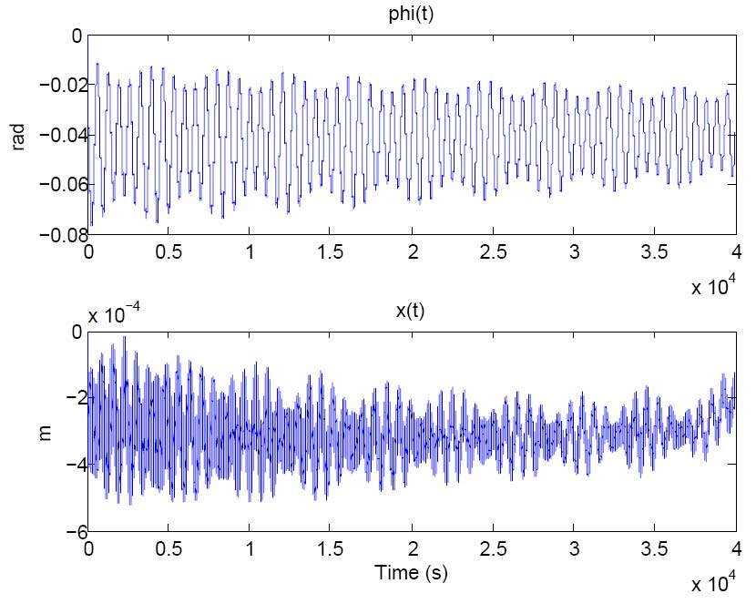
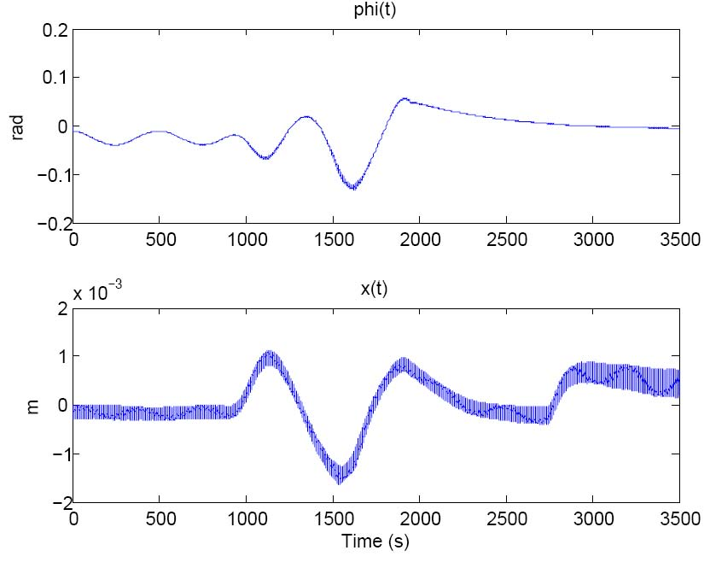
It works!
Free oscillations of the 2 DoFs.
Control of the 2 DoFs.

Slide 6
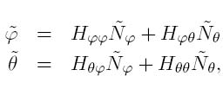
Sensitivity: thermal noise of the W fibers
Dynamical equations for a 2 DoFs system:
Using the fluctuation-dissipation theorem:

Slide 7
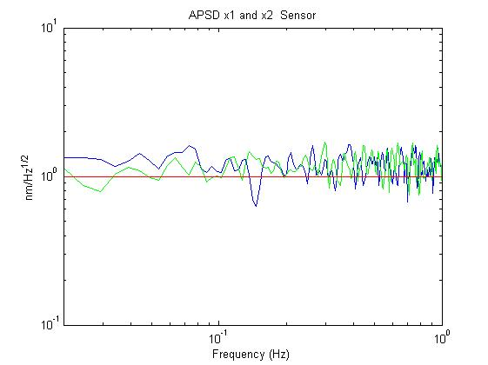
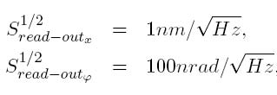
Sensitivity:
capacitive read-out noise
ETH Zurich made for us a replica of the flight model capacitive read out electronics,
each channel is read with a capacitive-inductive resonant bridge at 100kHz,
the electronics generates also the waveform for the actuation.

Slide 8
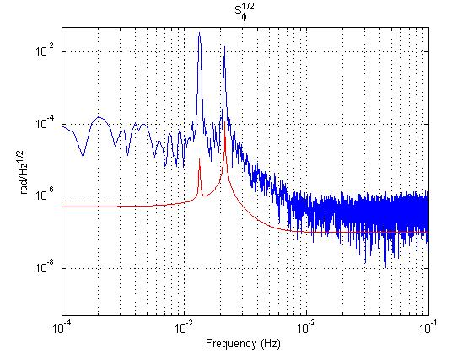
Noise spectrum - DoF ϕ

Slide 9
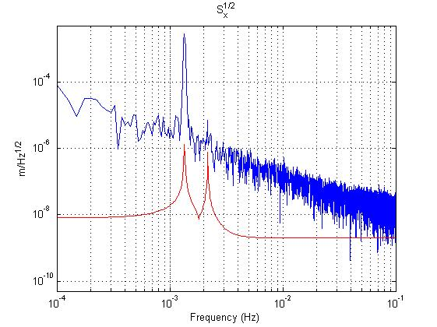
Noise spectrum - DoF x
The capacitive x signal is coupling directly to the seismic noise of the laboratory .

Slide 10
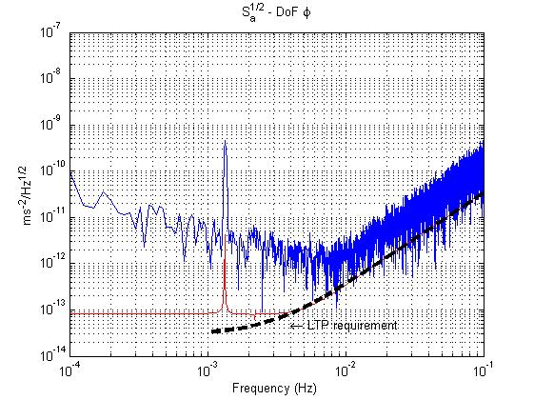
Residual acceleration noise DoF ϕ
Using the two time series, with the dynamical equations of the system, we compute the total torque noise on ϕ.
Considering a:
- m_{TM}= 2kg,
- l=0.02m,
we obtain the residual acceleration.

Slide 11
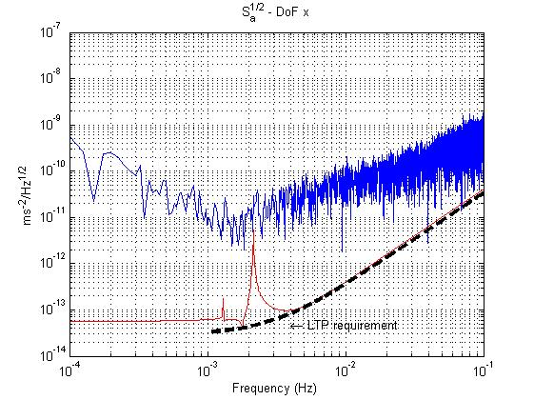
Residual acceleration noise DoF x
Using the two time series, with the dynamical equations of the system, we compute the total torque noise on x.
Considering a :
- m_{TM}= 2kg,
- l=0.15m,
we obtain the residual acceleration.

Slide 12
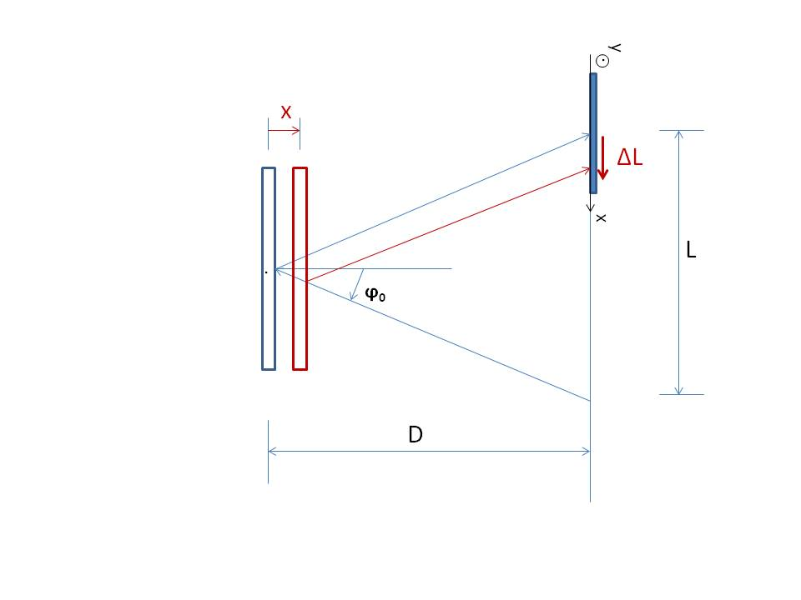
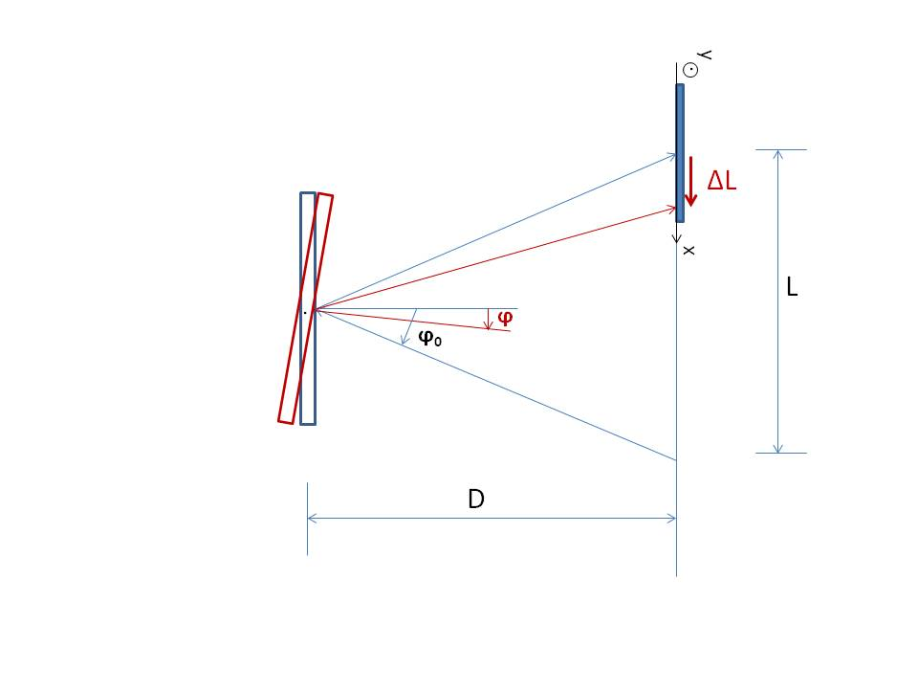
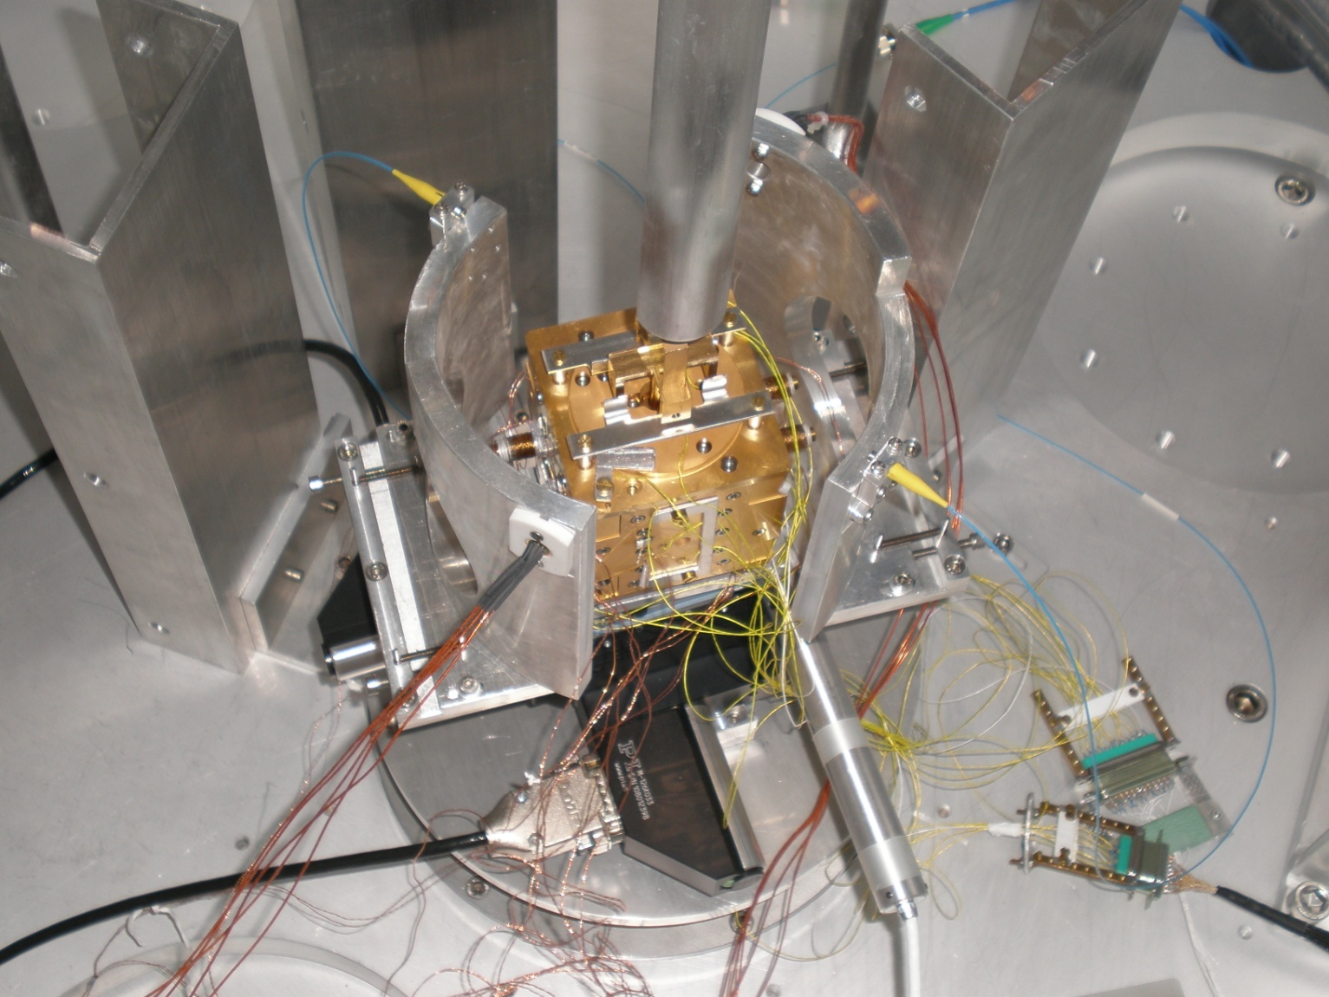
The optical read-out (ORO)
For more details see the Luciano Di Fiore’s talk:
“Development of an Optical Read/Out system for the LISA/NGO GRS: a status report” (INFN Napoli)

Slide 13
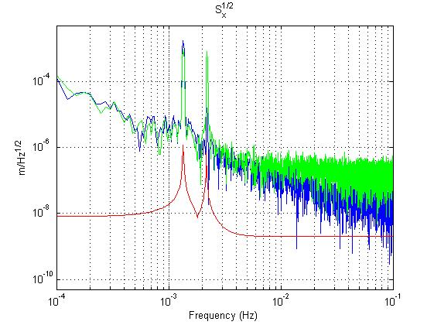
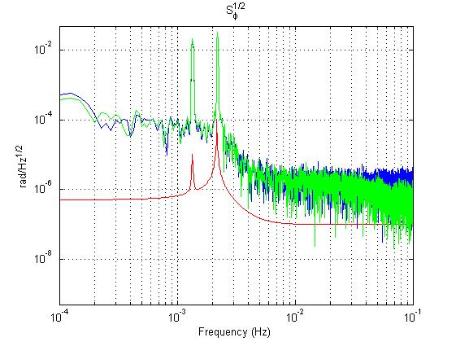
…using the ORO

Slide 14
8 DoFs model
We developed also a more realistic 8 DoFs model which reproduces the frequency observed:
For more details see tomorrow ’s talk:
“Analytic Model for the Rototranslational Torsion Pendulum”,
by Fabrizio De Marchi (Università di Roma “Tor Vergata”).
DoF | central fiber (Hz) | lateral fiber (Hz)
rotational | 1.343·10⁻³ | 2.171·10⁻³
simple pendulum | 0.435 | 0.614
boucing | 10.393 | 7.926

Slide 15
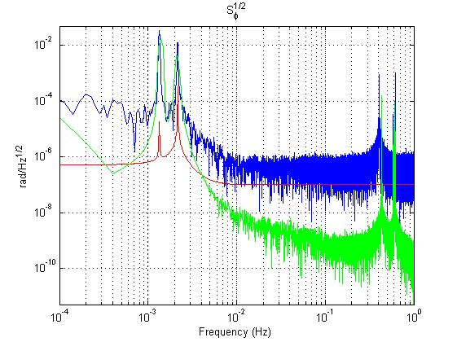
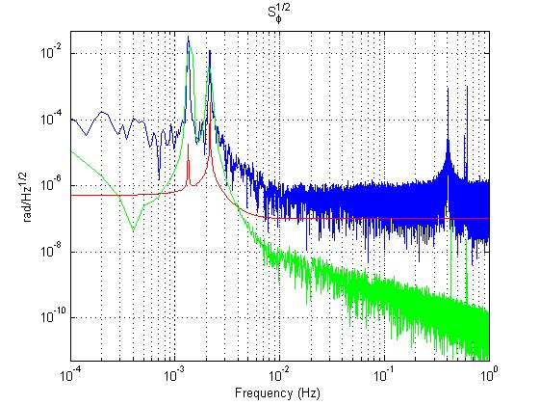
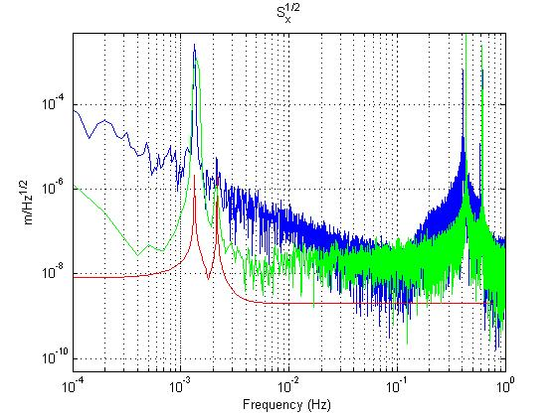
8 DoFs model
measured simulated

Slide 16
1 DoF free, 1 DoF controlled
With our apparatus we can, for the first time, simulate the influence of the drag-free system of LISA PF on the sensitivity axis.

Slide 17
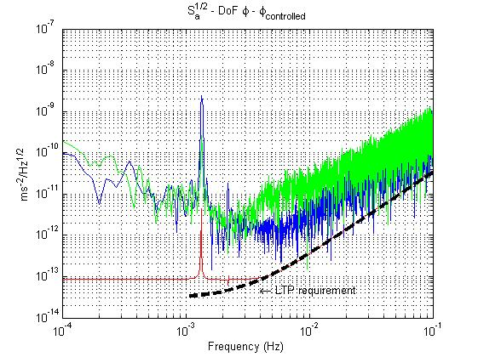
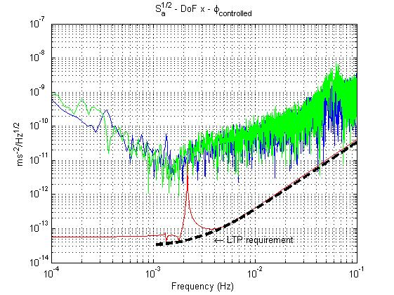
x free, ϕ controlled

Slide 18
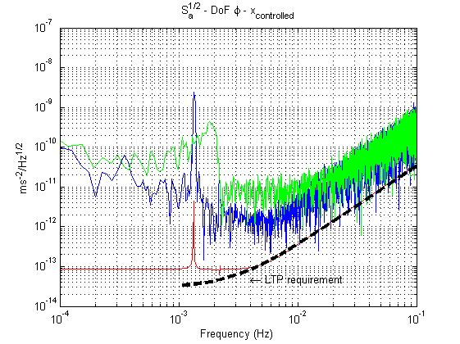
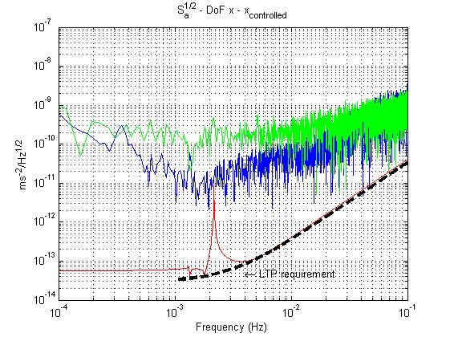
ϕ free, x controlled

Slide 19
DC bias measurement
Stray DC bias related to spatially varying DC surface potentials couplings with the residual TM charge (q) are expected to be a significant noise source (Antonucci et al, 2012):
Any spurious DC bias distribution generates a Δ_{x} (Δ_{ϕ}) that couples to the charged test mass producing a force (torque).

Slide 20
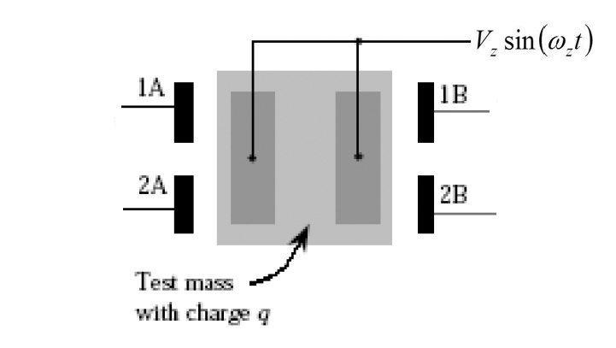
DC bias measurement:
simplified model
The DC bias effect can be measured by simulating a modulated test mass charge applying a sinusoidal signal to z electrodes,
assuming for all the x-electrods a uniform potential, the force and the torque produced at the first harmonic of the voltage modulation frequency ω_{z}, for a TM centered, can be written as:

Slide 21
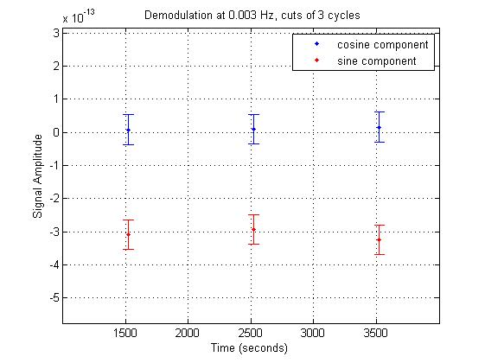
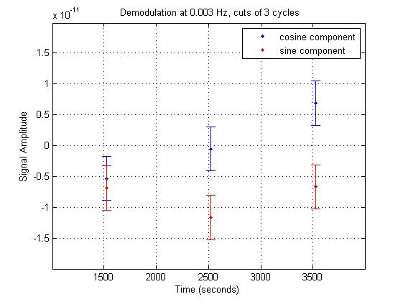
DC bias measurement:
preliminary results
Modulation parameters:
V_{z} = 6V
f_{z} = 3mHz

Slide 22
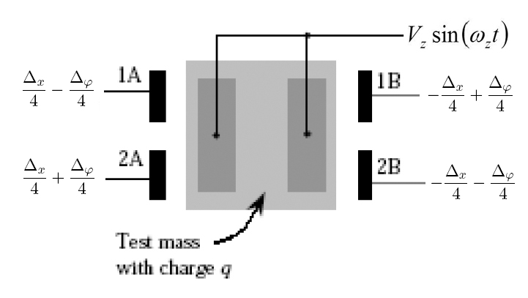
DC bias measurement:
compensation
The residual stray DC bias Δ_{ϕ}, Δ_{x} must be less than 100mV (LISA PF requirement).

Slide 23
q measurement
Applying to x-electrods the V_{COMP} + V_{MOD}sin(ω_{MOD}t), with V_{MOD}=5V and f_{MOD}=3mHz, following the table:
we can demodulate the force and the torque:
obtaining:

Slide 24
Next steps
Direct measurement of the rotation of the central fiber, to have an independent evaluation of x,
Installation of a tip-tilt stage, to better align TM with GRS and with the optical readout.
Measurement of the residual magnetic moment of the TM and the cross-bar,
realization of a controlled thermal box surrounding the vacuum chamber to operate at constant temperature,
investigate the correlation with the seismic noise.
Analyze the cross-talk between 2 soft DoFs.

Slide 25
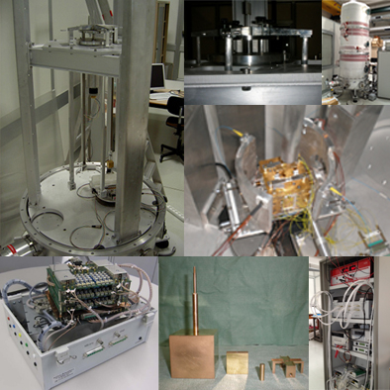
Thank you!

