Slide 1
Possible Periodic Orbit Control Maneuvers for the LISA Mission
Peter L. Bender
JILA, University of Colorado and NIST
9th International LISA Symposium
May 21 – 25, 2012 Paris

Slide 2
LISA Orbits with no Earth Perturbations
Arm length variations:
D₁₂ = √12 ea { 1 + 15/32 e cos(L-120°) + 1/32 e cos3L }
D₂₃ = √12 ea { 1 + 15/32 e cos L + 1/32 e cos3L }
D₃₁ = √12 ea { 1 + 15/32 e cos(L+120°) + 1/32 e cos3L }
For 1 x 10⁶ km arm lengths:
L = mean longitude of the antenna
e = 1.93 x 10⁻³ ; a = 1 AU
angle variations = 60° ± 0°.0898
arm length variations = ± 965 km
Drift-away heliocentric orbits
2 year mission lifetime

Slide 3
Arm Length Accelerations due to the Earth
Accelerations:
₂₃ = 2√3K cos² L ; ₁₂ = 2√3K cos² (L – 120°) ₃₁ = 2√3K cos² (L + 120°)
For 1 x 10⁶km arm length and 12° from Earth:
K = 7.0 x 10⁻⁹m/s²
Leaving out the constant parts:
₂₃ = √3K cos 2 L ₁₂ = √3K cos 2 (L – 120°) ₃₁ = √3K cos 2 (L + 120°)

Slide 4
Cancellation of Extra Arm Length Accelerations
Assume R₁, R₂, R₃ are applied radial accelerations out from the center of the triangle for the 3 spacecraft to cancel one-half of the extra accelerations:
R₁ = K cos 2 L ; R₂ = K cos 2 (L + 120°)
R₃ = K cos 2 (L - 120°)
Assume similar applied tangential accelerations T₁, T₂, T₃ in the clockwise direction around the center of the triangle:
T₁ = K sin 2 L ; T₂ = K sin 2 (L + 120°)
T₂ = K sin 2 (L - 120°)
A simulation of this approach is needed. However, it appears that these accelerations would cancel out the extra accelerations.

Slide 5
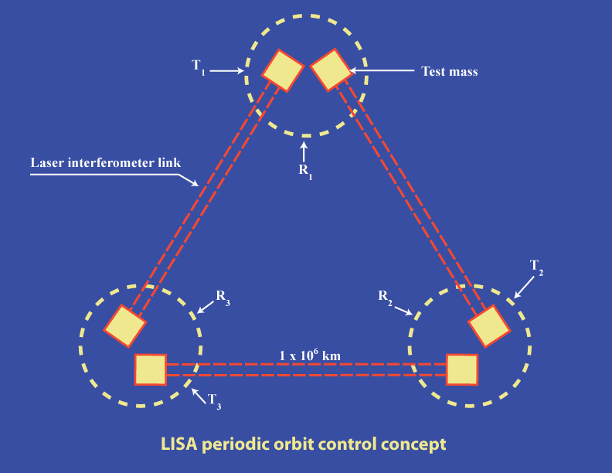

Slide 6
One Mission Option for Cancellation
Drift-away orbit:
6° per year drift rate
12° from Earth initially. (However, some extra ΔV is required to achieve this.)
At 12° from Earth:
K = 7.0 x 10⁻⁹ m/s²
Over 6 days, ΔV = 3.6 x 10⁻³ m/s
Assume 80 micro-N thrust is available in each in-plane direction, and 70 micro-N can be used for orbit maintenance, with 600 kg spacecraft:
8.6 hr of thrust is needed every 6 days to achieve ΔV cancellation initially
6.1 hr is needed every 6 days after 3 month commissioning period
2.6 hr is needed every 6 days after 1 year

Slide 7
Conclusions
Orbit control to prevent the increase of angle variations beyond 0.°1 for a LISA-type mission with 10⁶ km arm lengths appears to be feasible. This would considerably simplify the in-field guiding system for compensating for the angle changes.
If 80 micro-N maximum thrust is available in both the radial and transverse directions, and a drift-away orbit that starts 12° from the Earth can be used, the maximum lost time for science after the commissioning period would be about 4%.
The maximum voltage applied to the GRS electrodes during thrusting would be about 40 V RMS, which is within the “wide range” of voltages available on the GRS.

