Slide 1
Development of an Optical Read-Out system for the LISA/NGO gravitational reference sensor: a status report
Rosario De Rosa, Luciano Di Fiore, Fabio Garufi,
Aniello Grado, Leopoldo Milano and Giuliana Russano¹⁾
This R&D activity is supported by INFN Commission II
1) Present address: University of Trento

Slide 2
Talk overview
goal of the activity
proposed ORO set-up
tests on sensitivity
  Bench top
  Suspended
layout for implementation in LISA
next steps for space qualification

Slide 3
Goal of the R&D activity
development of an optical read-out (ORO) system for the LISA (NGO) inertial sensor, to be integrated in the present design of the GRS, together with the capacitive sensor.
the motivations are:
risk reduction: a back-up sensor in case the capacitive one fails after the launch ➔ this becomes still more important for NGO because in this case, with only two arms, the failure of a single Inertial sensor would compromise the mission.
improved sensitivity ➔ relaxed specifications on cross couplings - Present requirement on C.C. is 0.1 % that is a very strong specification!

Slide 4

Goal of the R&D activity (II)
Target sensitivity
For a back-up sensor the sensitivity should be at least comparable with the one of the main sensor
2 nm/Hz^{1/2}
200 nrad/Hz^{1/2}
Of course any improvement in sensitivity is useful but there is not a specific requirement
Factor 2-3 already interesting
Factor 10 more would give big advantage
Limited complexity
We wont to keep everything as simple as possible
(compatibly with requirements)

Slide 5
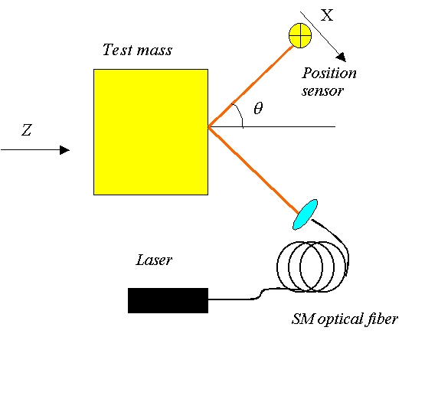
Optical lever sensor
With these requirements in mind we have selected, as a simple solution, the usage of optical levers:
A laser beam is sent trough a SM optical fibre to the test mass and the position of the reflected beam is measured with a position sensor (Quadrant photodiode of PSD)
the sensitivity depends on input power and measurement range (beam size for QPD or detector size for PSD)
with a suitable combination of three beams and sensors we can recover the six DOF of the test mass

Slide 6
The activity was performed in parallel developments
Study of the sensitivity to demonstrate that we can reach the target sensitivity
Test on torsion pendulum in Trento
Design of a sensor layout compatible with the present inertial sensor design
Study of space qualified parts (just started)

Slide 7
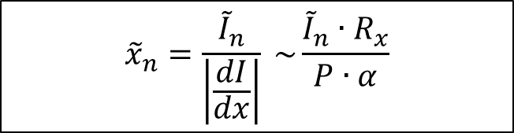
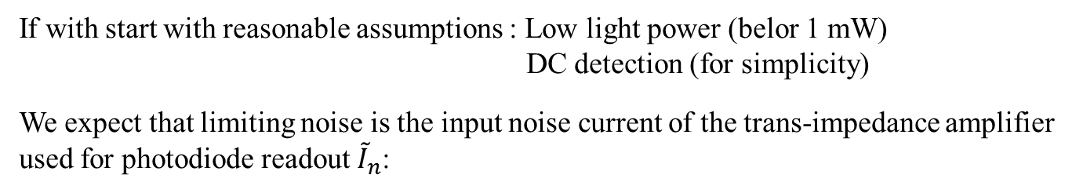
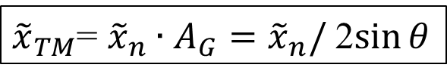
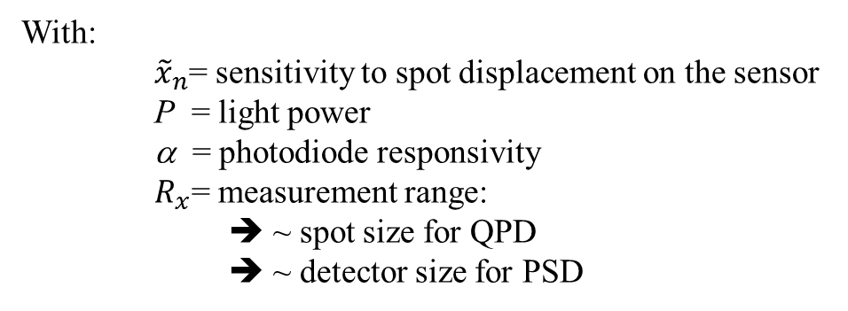
Expected sensitvity
If with start with reasonable assumptions : Low light power (belor 1 mW)
DC detection (for simplicity)
We expect that limiting noise is the input noise current of the trans-impedance amplifier used for photodiode readout ${\tilde{I}}_{n}$:
$${\tilde{x}}_{n}=\frac{{\tilde{I}}_{n}}{\left|\frac{dI}{dx}\right|} \sim \frac{{\tilde{I}}_{n}∙R_{x}}{P∙α}$$
With:
${\tilde{x}}_{n}$= sensitivity to spot displacement on the sensor
P = light power
α = photodiode responsivity
$R_{x}$= measurement range:
➔ ~ spot size for QPD
➔ ~ detector size for PSD
The TM displacement noise is
with A_{G} a geometrical factor
${\tilde{x}}_{TM}$= ${\tilde{x}}_{n}∙A_{G}={\tilde{x}}_{n}/$ 2$\sin{θ}$

Slide 8
Adopted components
Light source: S-LED coupled to SM optical fibers
Spot size ≈ 400 μm
λ ≈ 830 nm (longer wavelength should be OK)
Sensor: Quadrant PD of PSD (Hamamatsu)
Trans-impedance amplifier OP27EP

Slide 9
Electronic noise
Electronic noise (with light-off) agrees with the model according to component characteristics (1/f^{1/2} slope)

Slide 10
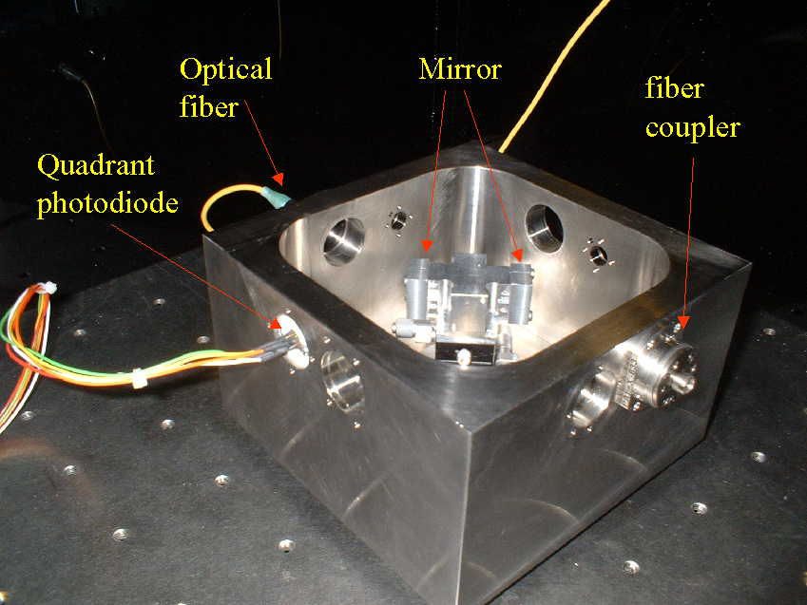
Sensitivity measurement with a rigid set-up
the bench is machined from a single block of stainless-steel and has some interfaces for fiber couplers and sensors.
the "test mass" mounts some mirrors and can be moved for calibration
the system is symmetric for differential measurements
(if necessary)
the whole set-up is closed in a box to reduce thermal variations and prevent effect of air flows etc.

Slide 11
By increasing the power the noise decreases less than expected

Slide 12
Dependence of sensitivity on power
With the QPD we observed en excess noise above about 0.15 mW
With the PSD the noise follows the model up to 0.5 mW

Slide 13
Noise at 1 mHz
m/Hz^{1/2}

Slide 14
Comparison of QPD versus PSD sensitivity
QPD ~ spot size ~ 400 μm
PSD ~ detector size ~ 4.7 mm
Measurement range ➔
NB: with PSD we can still gain a factor 2 (or more) by using a smaller sensor

Slide 15
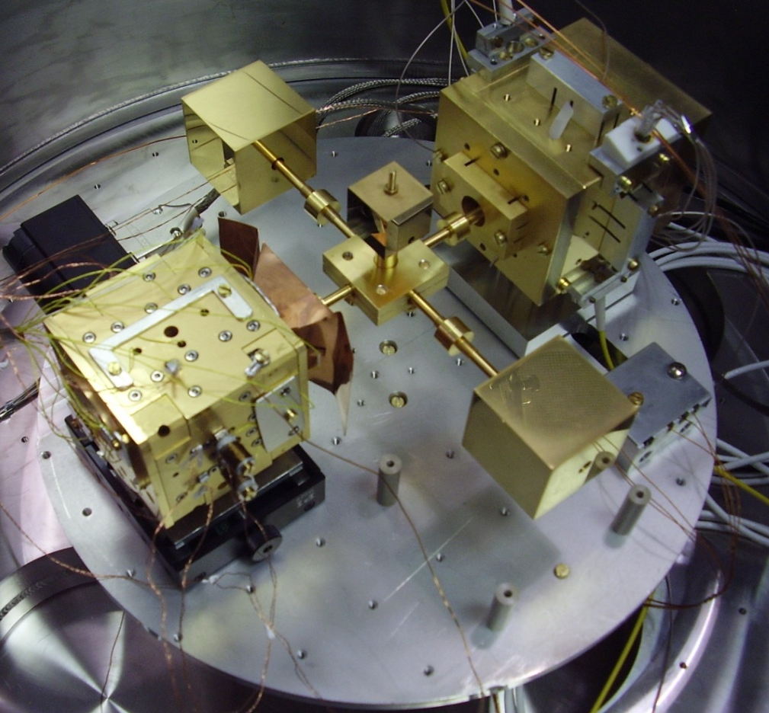
Test on torsion pendulum
(in collaboration with the Trento group)
We implement an optical read-out system on the four masses torsion pendulum in Trento
The goal was
Check of performances, reliability and sensitivity
Check of back action level
Contribute to improve the performance of the facility (if possible)

Slide 16
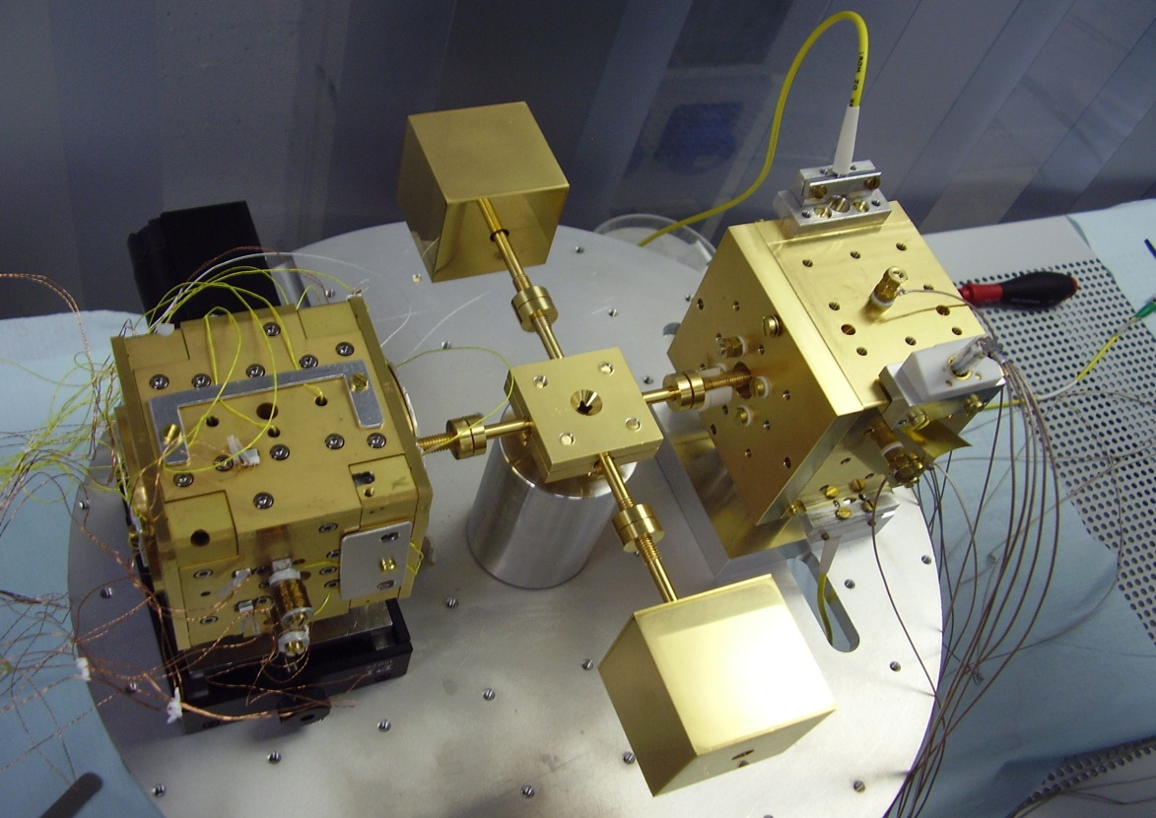
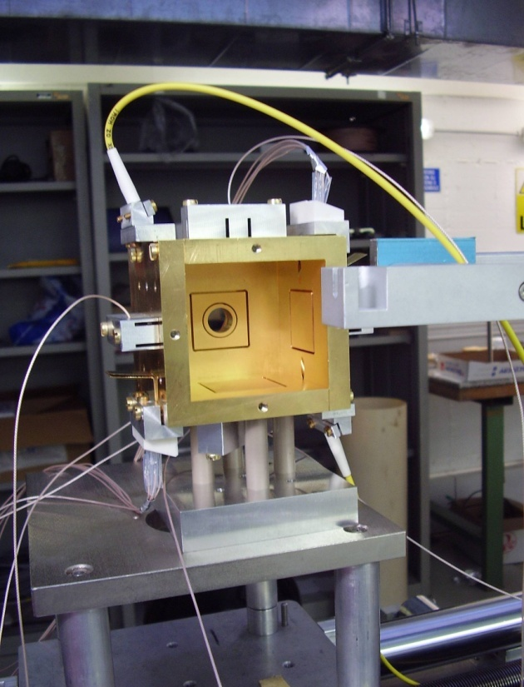
the ORO during the assembling phase

Slide 17
Angular measurement: ϕ (2008)
EM
ϕ =α(Z1 - h Z2)
EM
ϕ =α(Z1 - h Z2)
ORO
ϕ =1/(4lcosθ)·(Δx1 + k Δx2)
ORO sensitivity (~ 2·10⁻⁸ rad/sqrt(Hz)
EM sensitivity ((~ 3·10⁻⁷ rad/sqrt(Hz)

Slide 18
Force measurement (2008)
The ORO signal can be used, as the capacitive one, for putting upper limits to the force noise
ϕ EM
Pendulum thermal noise
ϕ ORO
(Xem – Xstc)
Xoro – Xstc
We get the same (or slightly lower) limit with the ORO

Slide 19
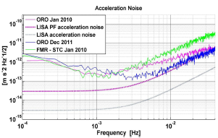
ORO as a readout for torsion pendulum facility
After this test we designed, in collaboration with the Trento group, an auxiliary readout system for the 4 mass torsion pendulum facility based on the same simple technology and using multiple reflections.
See poster by Giuliana Russano
This increases the force readout sensitivity of the facility by almost one order of magnitude

Slide 20
Integration in LISA (eLISA/NGO)
As a starting point, we studied the possible integration of the ORO in the present design of the LISA Pathfinder inertial sensor.
The main problem is the little space left between the electrodes to let the light reach the surface of the proof mass.
the final LISA design should not be different from LISA-PF electrode configuration.

Slide 21
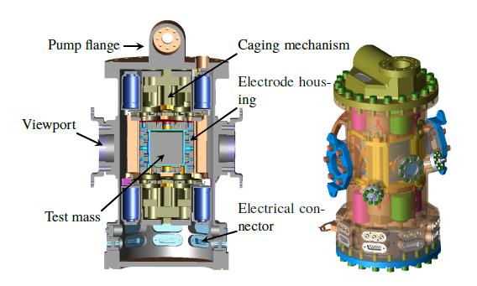
Placing an ORO inside the IS is not an easy task

Slide 22
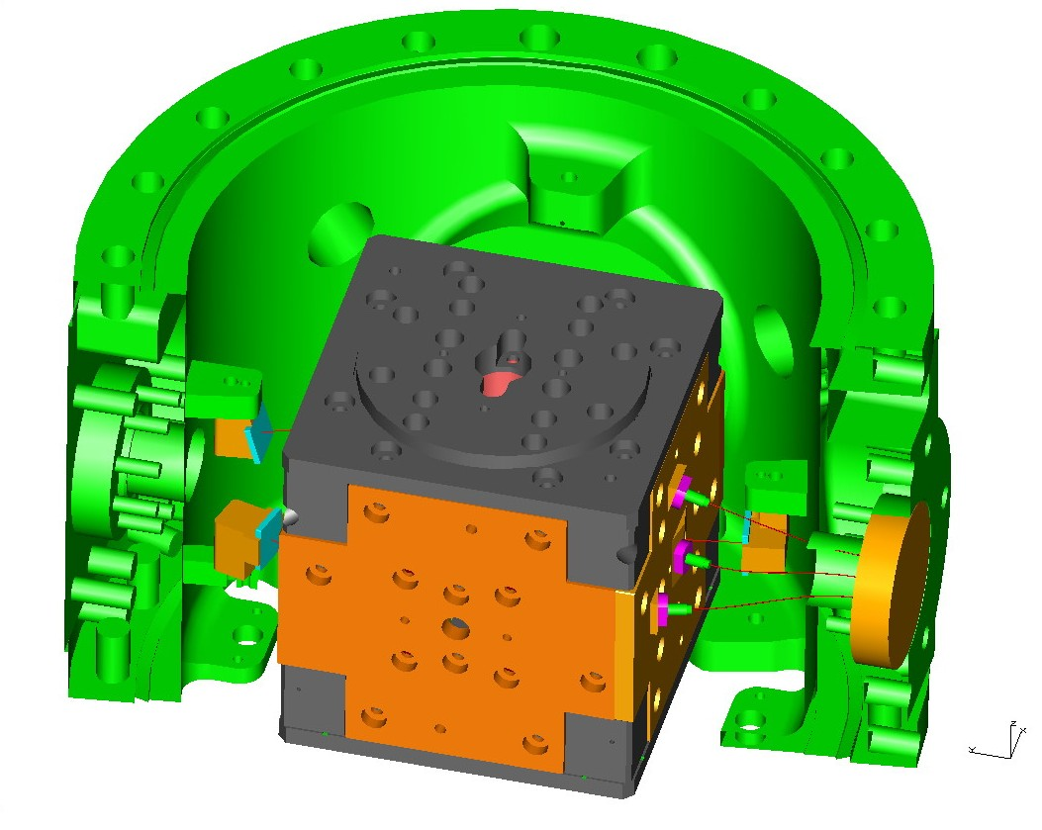
Proposed solution
position
sensors
fiber
couplers

Slide 23
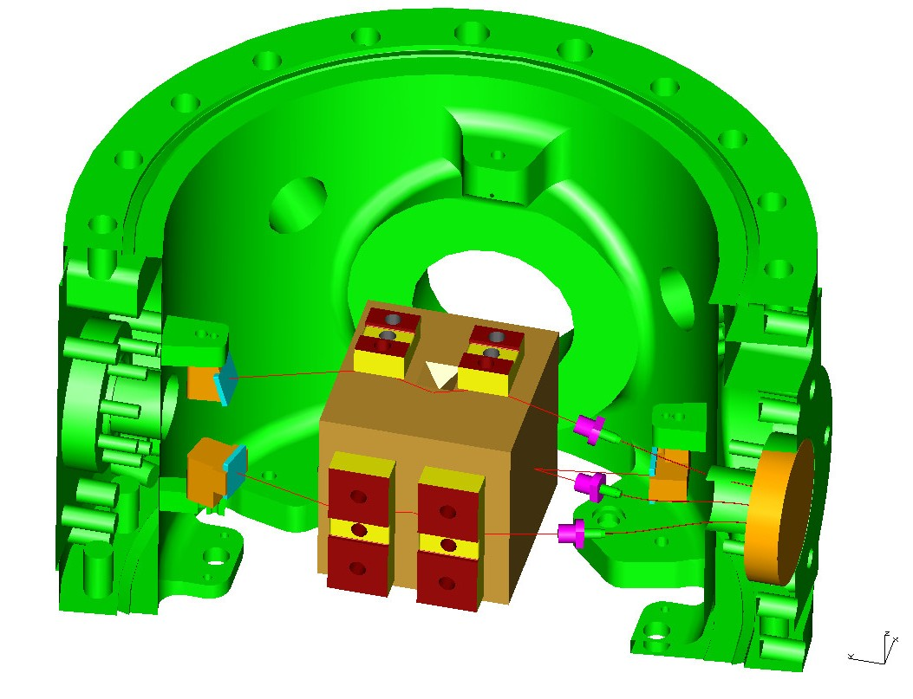
The idea is to use the electrodes as mirrors for directing the beams to the test mass surface and to the sensors

Slide 24
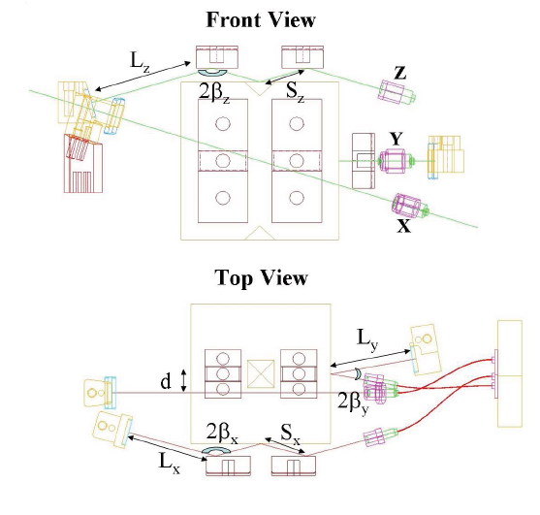
Optical fiber couplers
Position detectors

Slide 25
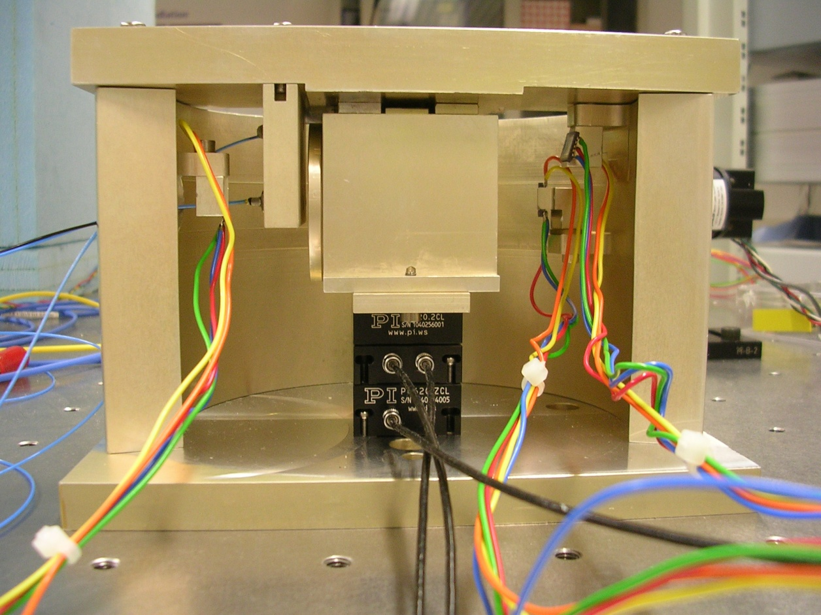
Bench top prototype (with PZT actuation in translation)
Photodiodes
Optical Fibers
Test mass
Calibrated X,Y,Z PZT actuator
Calibrated X,Y,Z PZT actuator
The prototype was assembled successfully, there maximum correcrion necessary for getting the beams at the center of the detectors was of about 0.2 mm, compatible with machining and assembling tolerances

Slide 26
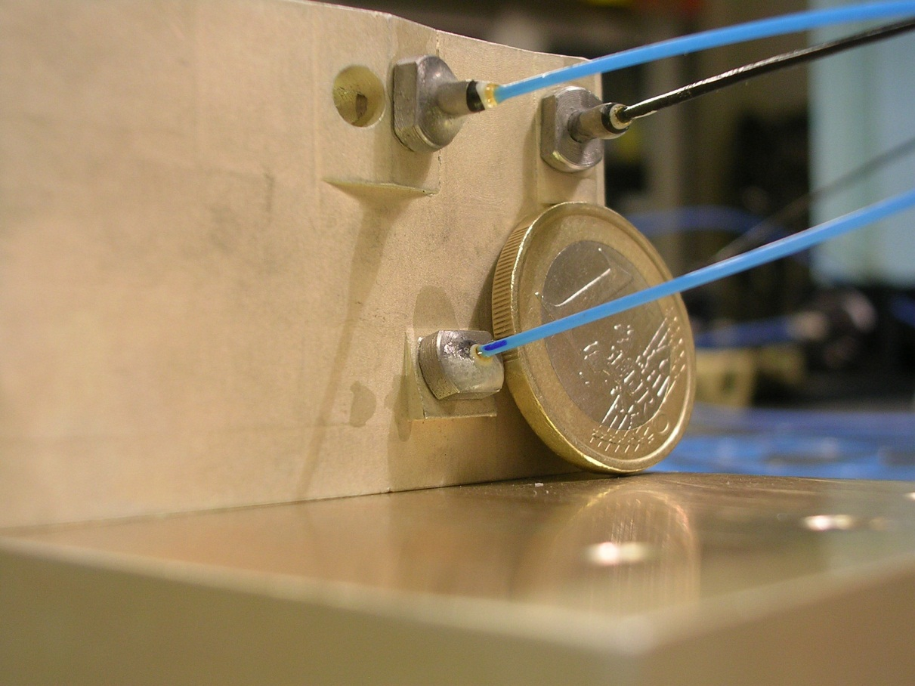
A particular with the plate where the output fiber couplers are attached

Slide 27
Results:
check of the design (passage of the beams etc.).
measurement of the 6X6 sensing matrix in agreement to the analytical model (within few %) ➔ validation of the analytical model
the measurement was only performed for the longitudinal DOFs (18 out of 36 matrix elements) because only a 3 DOF PZT system was available
Measured
Computed with analytical model

Slide 28
Other configurations non using x face
Front view
Top view
3 beams ➔ Z, Y, α, η, θ
2 beams ➔ Z, α, θ

Slide 29
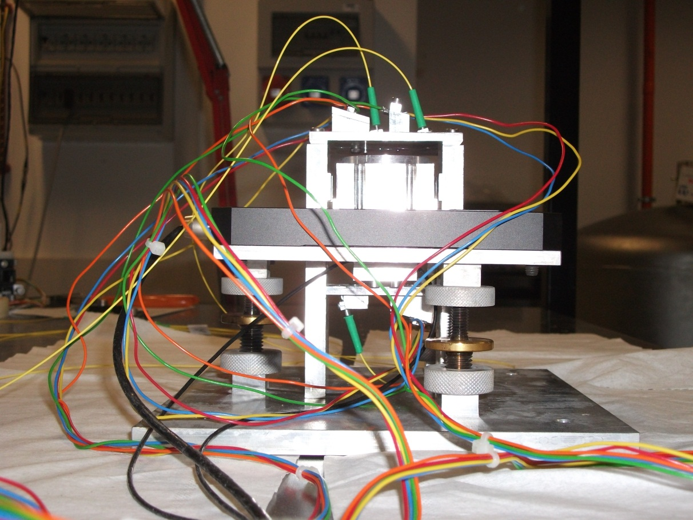
We tested this new configuration with a new prototype. In this case we addes an angular PZT staged so we checked 5 DOFs out of 6 (X, Y, Z, α, θ)
TM with X,Y,Z PZT actuator inside
Calibrated α,θ PZT actuator

Slide 30
Also in this case we measured the sensing matrix (5 DOF) that is in good agreement with the analytical model
Measured
Analytical

Slide 31
Search for space qualified component
We started only recently to work in this direction
It should be clear that we don’t wont to build flight hardware: industries do that
Our goal is to check if they already exist SQ components to be used for the ORO, and to identify possible criticalities
The main points are: electronics
          light sources
          fiber components and collimators
          light detectors

Slide 32
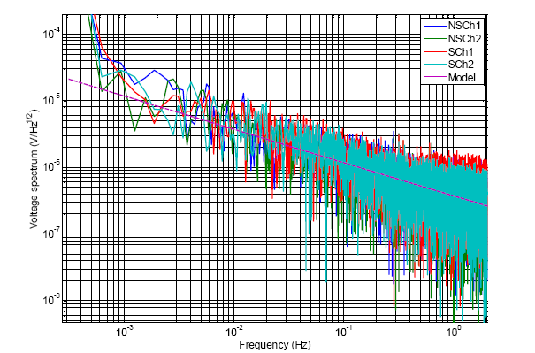
ORO readout- electronics
The electronic used for processing QPD signals is based on OP27EP op-amp.
There is a SQ equivalent component OP27AJ/QMLR.
At the beginning of 2011 we procured some samples and tested them in a photodiode readout card.
The noise performance are exactly the same as the standard components
Il looks that PD readout will not be a problem.
Care must be putted on the rest of electronics (signal processing)
In order to maintain low power consumption

Slide 33
Next steps:
We had some very useful discussion with ESA people. and got so very useful suggestions:
We didn’t yet identified other components, but is seems that:
SQ SLED have been already used in some NASA mission: hard to gat details
QPD and PDS have been used in space (includiong LISA-PF) and should not be a problem
Fiber collimators looks a delicate point, because we cannot use standard component close to the TM so a dedicated development will probably be necessary.
Assembling procedure inside the vacuum chamber needs to be investigated and could result very complex.

Slide 34
Conclusions
Both bench top and suspended tests confirm that the ORO sensitivity can be better than the capacitive one, above 1 mHz
The noise level is well characterized, even if not completely understood and allows to make predictions and trade-off between sensitivity and measurement range
There are possible layouts for the integration in the present design of the inertial sensor, verified with bench-top models.
study of space compatible parts is just started: electronics is non a problem and it looks that there are available component already tested on flight:
Further studies are required.
The ORO is a good candidate as a back-up sensor for the eLISA/NGO inertial sensors, with possible sensitivity improvement.

Slide 35
Thank you for your attention

