Slide 1
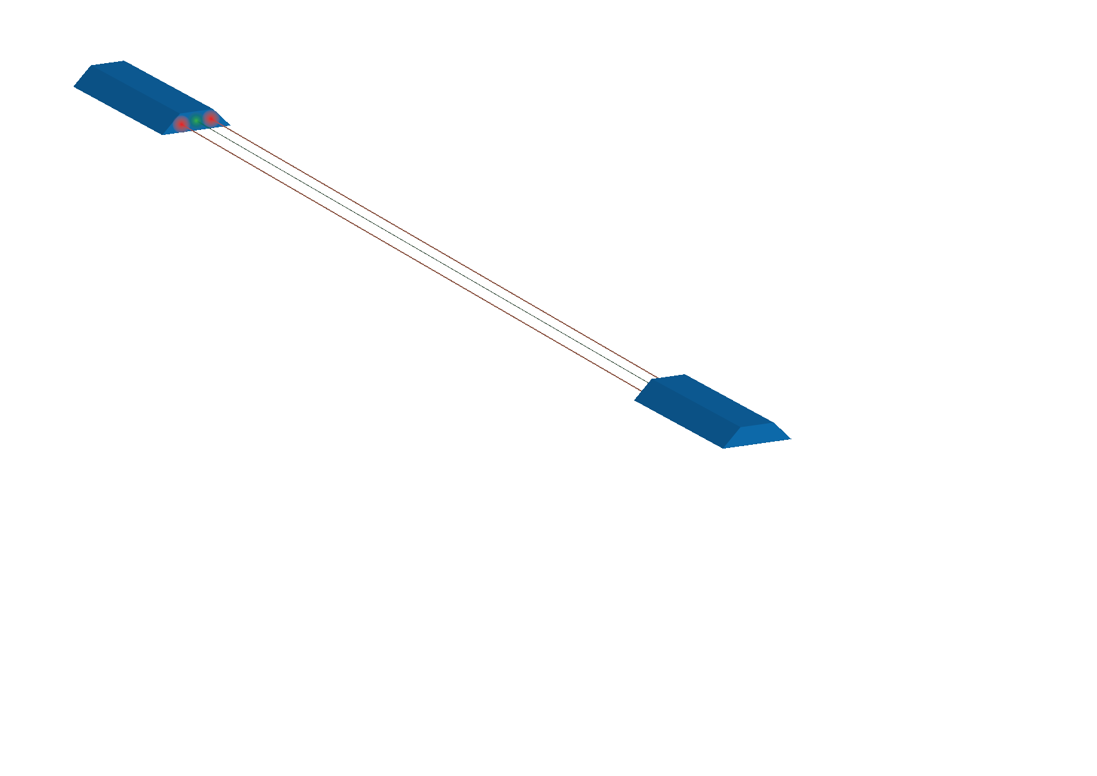
LISA-like laser ranging for
GRACE follow-on
Daniel Schütze, Gunnar Stede, Vitali Müller,
Oliver Gerberding, Christoph Mahrdt, Benjamin Sheard, Gerhard Heinzel, and Karsten Danzmann
LISA Symposium, May 24, 2012

Slide 2
Outline
Introduction
Satellite gravimetry
What is GRACE? What is GRACE follow-on (GFO)?
Progress at AEI: Triple Mirror Assembly (TMA) and Optical Bench (OB)
Test setup for the TMA
OB prototype testing
Summary

Slide 3
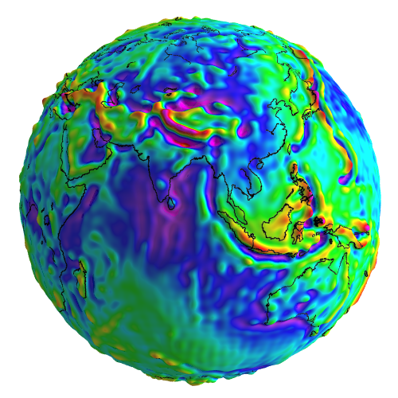
Satellite gravimetry
Mapping the global gravity field
Often expressed as spherical harmonic expansion
Static and dynamic components
Geoscience (glacial/polar ice changes, solid earth deformation, hydrology)
Techniques
Orbit determination and tracking
Satellite-to-satellite tracking (SST)
Gravity gradiometry
Recent gravity field satellites
CHAMP (Germany)
GRACE (US-German collaboration)
GOCE (ESA)
GFZ Potsdam
GFZ

Slide 4
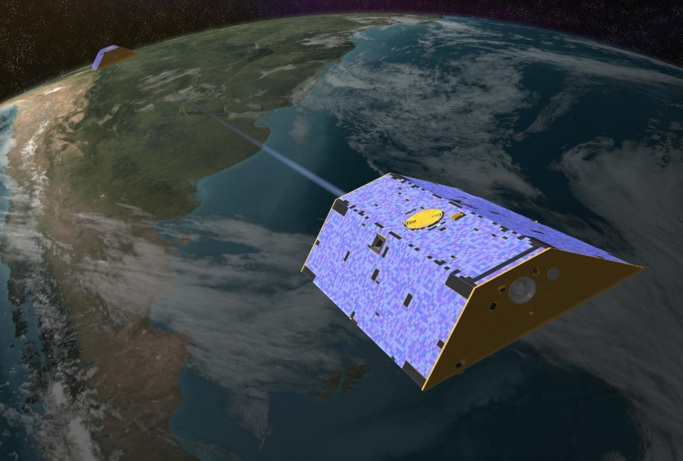
What is GRACE?
CSR

Slide 5
What is GRACE?
CSR

Slide 6
What is GRACE?
CSR

Slide 7
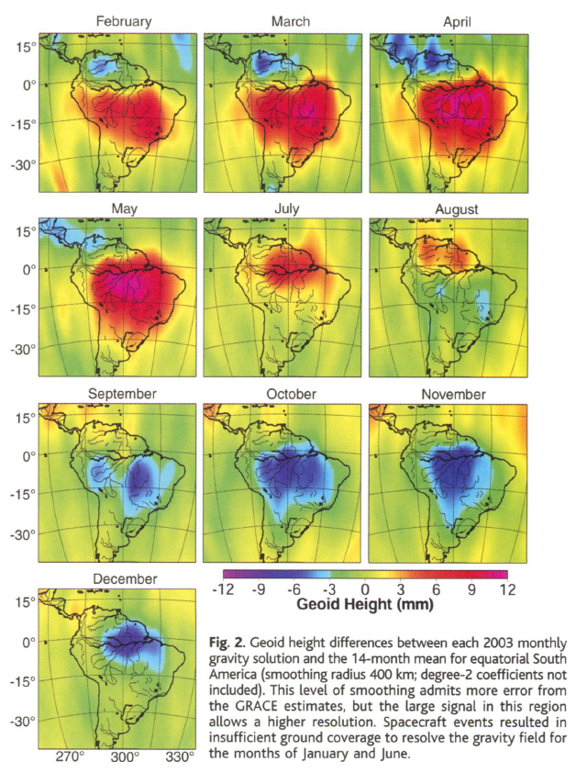
What is GRACE?
CSR
B. D. Tapley et al., “GRACE Measurements of Mass Variability in the Earth System”, Science 305, 503—505 (2004).

Slide 8
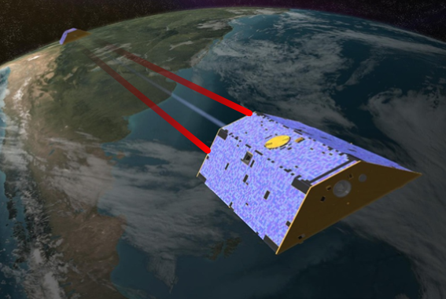
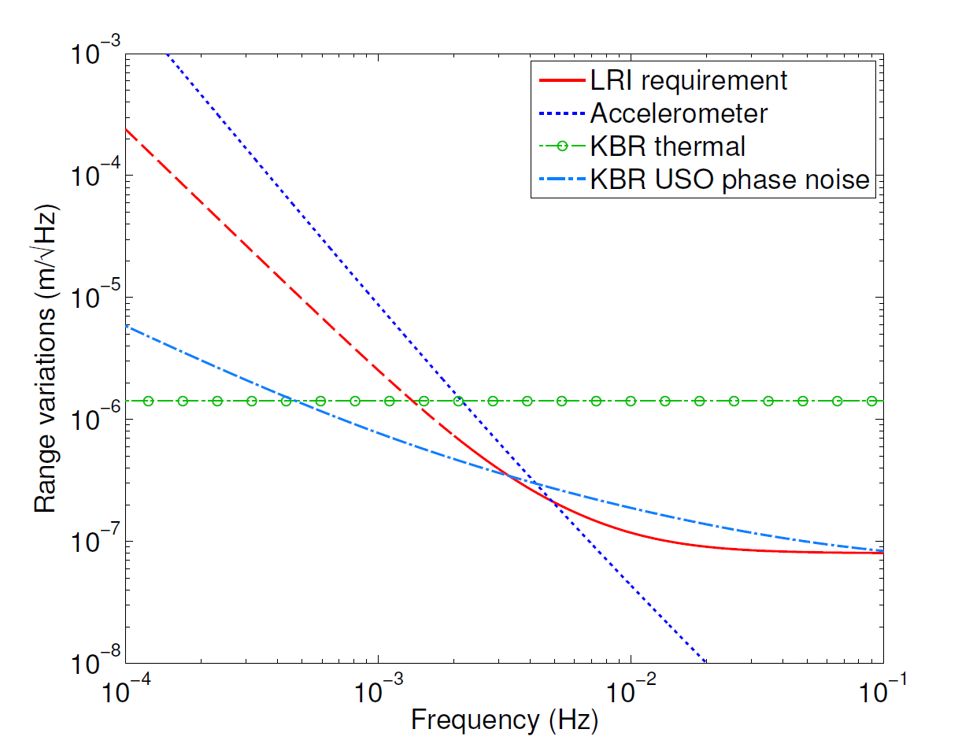
What is GRACE follow-on?
Urgent continuation of GRACE data, launch in 2017
Use basically the same satellites, add Laser Ranging Instrument (LRI) as technology development
LRI offers additional data streams:
LRI inter-satellite distance measurements can be compared to K-band ranging
Satellite pointing information via Differential Wavefront Sensing (DWS)/Steering mirror control can be compared with star tracker data
CSR

Slide 9
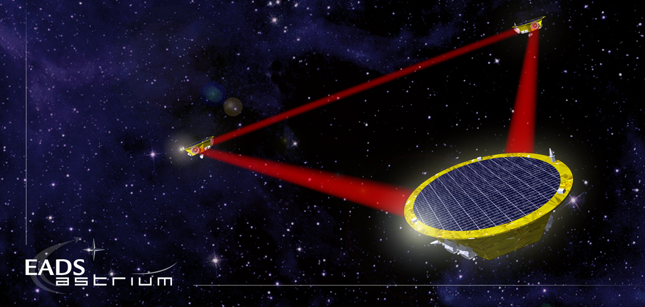
GRACE follow-on & LISA
 | LISA | GFO
Inter-satellite distance measurement | Heterodyne laser interferometry (receiver-transponder) with offset phase-locked lasers and phasemeter readout
Inter-satellite distance | 5 million km | ≈200 km
Orbit | Heliocentric (1 a.u.) | LEO (≈400 km)
Orbit environment | No atmospheric drag, stable thermal environment | Atmospheric drag, large thermal disturbances
Attitude and Orbit Control System | Drag-free using µN thrusters | Attitude control with magnetotorquers & cold gas thrusters
Measurement band | ≈mHz – Hz
Single-link noise | 12 pm/√Hz (× freq. dep.) | ≈50 nm/√Hz (× freq. dep.)
Telescope aperture diameter | 38 cm | ≈1 cm
Transmit beam waist radius | 17 cm | ≈2 mm
Transmit power | 1 W | ≈30 mW
Effective received power (at photodetector) | ≈100 pW
Maximum relative L.O.S. velocity | ±15 m/s | ≤ ±5 m/s (depending on orbits)
CSR

Slide 10
Who is involved in GRACE follow-on?
Joint NASA/GFZ mission
Spacecraft built by Astrium
LRI has different contributions:
AEI: Germany PI, instrument development and testing
JPL: US PI, Laser Ranging Processor (LRP), frequency-stabilized lasers
ANU: Triple Mirror Assembly (TMA)
DLR: hardware contributions (photodiodes, electronics)
Astrium: contributions to system engineering/ testing
STI: instrument manufacturing
CSR

Slide 11
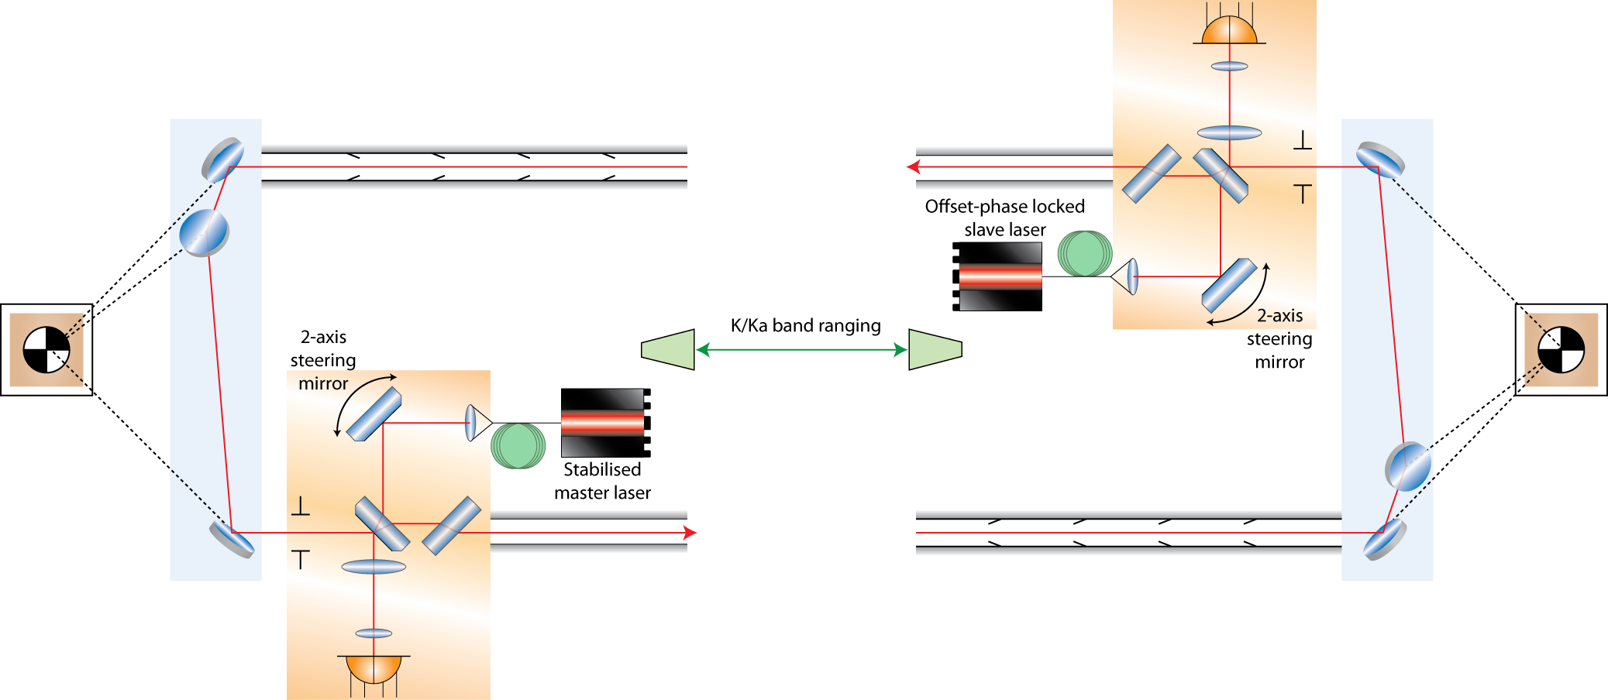
What is GRACE follow-on?

Slide 12
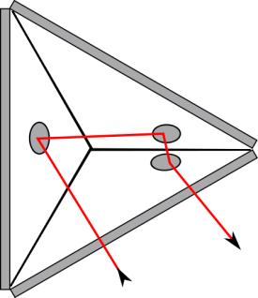
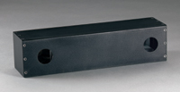
Triple mirror assembly
Lateral Transfer
Hollow Retroreflector™ from PLX

Slide 13
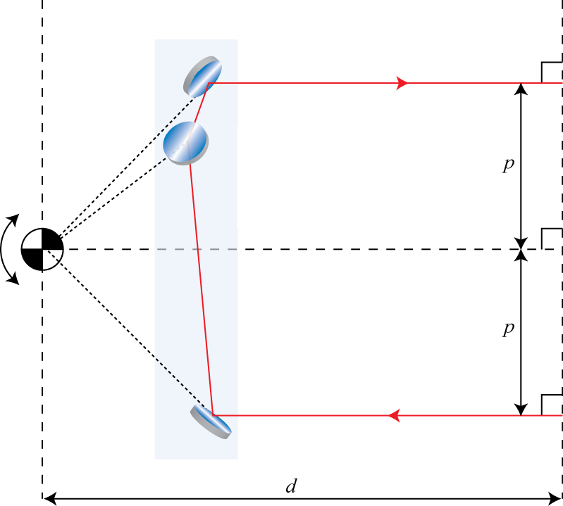
Triple Mirror Assembly - basic properties
Place virtual intersection point inside accelerometer
Rotation around virtual intersection point preserves:
round-trip pathlength d
beams antiparallel
impact parameter p
$\overset{⃑}{PP}$, $\overset{⃑}{V}$

Slide 14
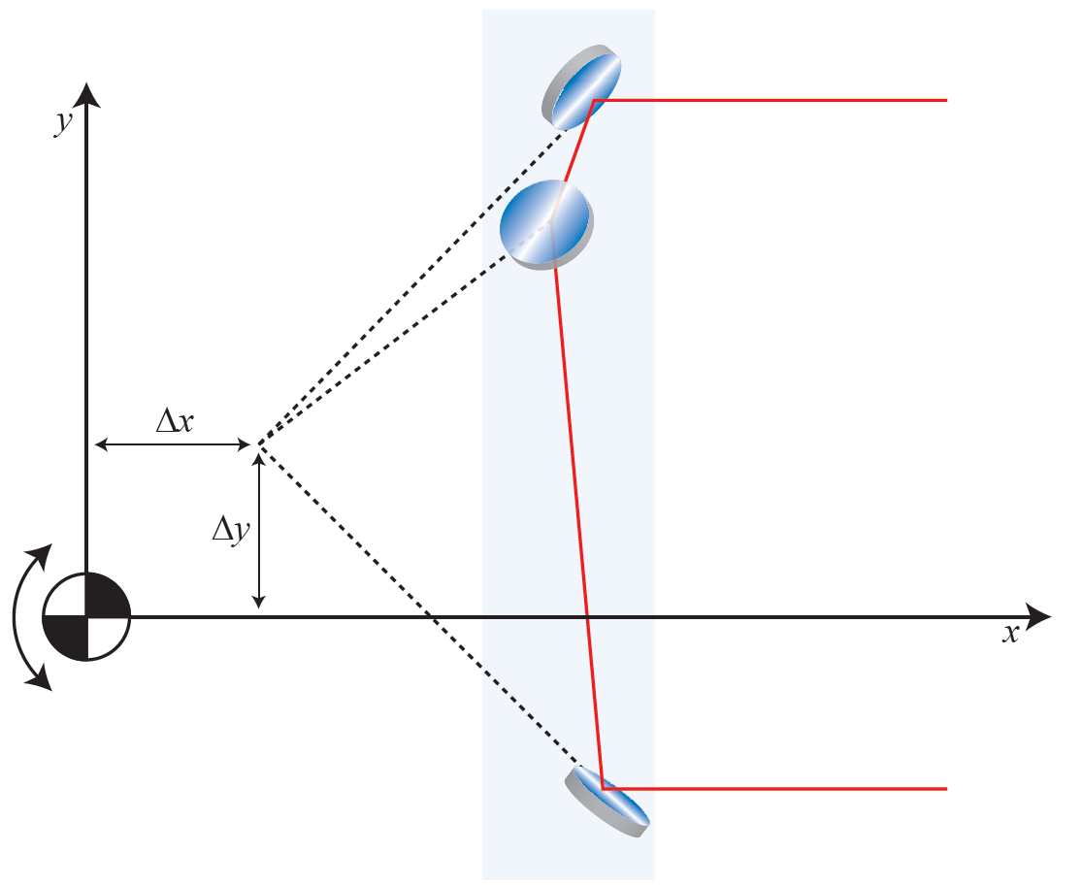
Triple Mirror Assembly - coupling of displacement into length measurement
v
 | Δx | Δy | Δz
u | 0 | 0 | 0
v | 2Δxv | 0 | 2Δz
w | 2Δxw | -2Δy | 0
$$\overset{⃑}{V}$$
w
u
$$\overset{⃑}{PP}$$
Linearize
δL = 2vΔz – 2wΔy

Slide 15
Optical Bench

Slide 16
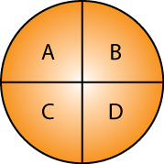
Optical Bench - Differential Wavefront Sensing
Split photodetector results in a phase difference between the heterodyne signals proportional to wavefront tilt:
Quadrant photodetector allows the simultaneous measurement in two independent axes:

Slide 17
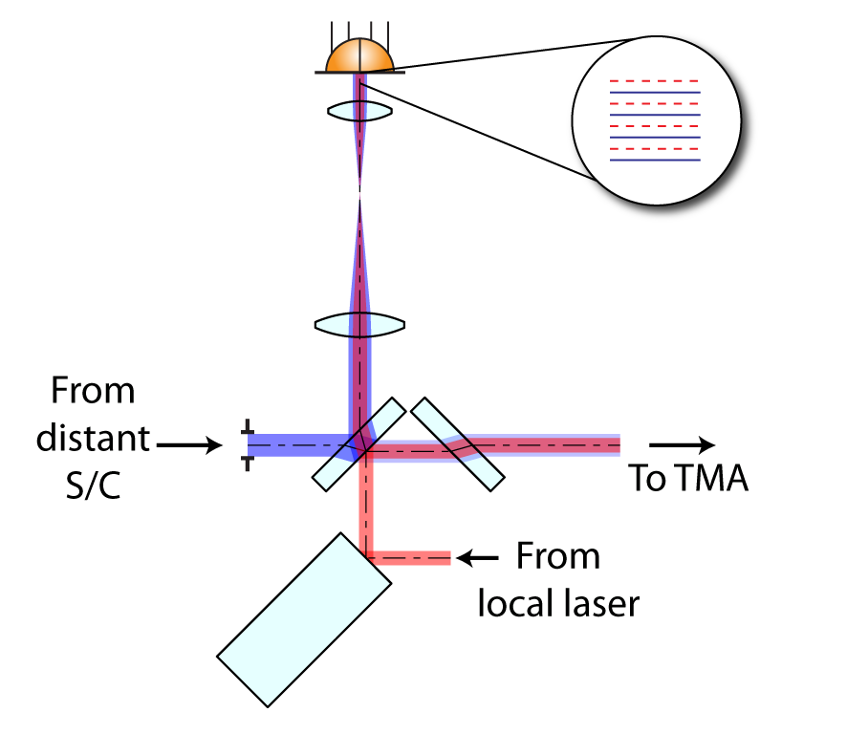
Optical Bench - Differential Wavefront Sensing

Slide 18
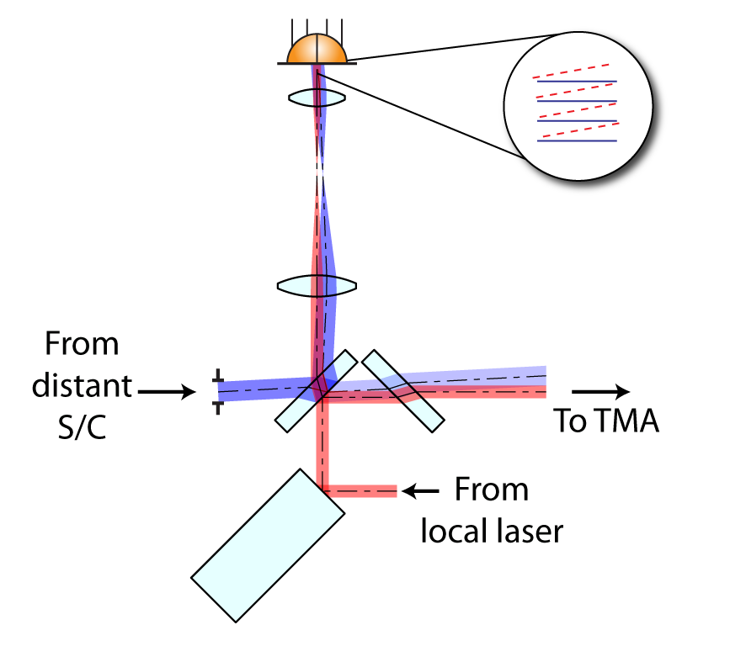
Optical Bench - Differential Wavefront Sensing
When spacecraft rotates the incoming beam is tilted relative to the local beam leading to a non-zero DWS signals, reduction of contrast and misaligned outgoing beam

Slide 19
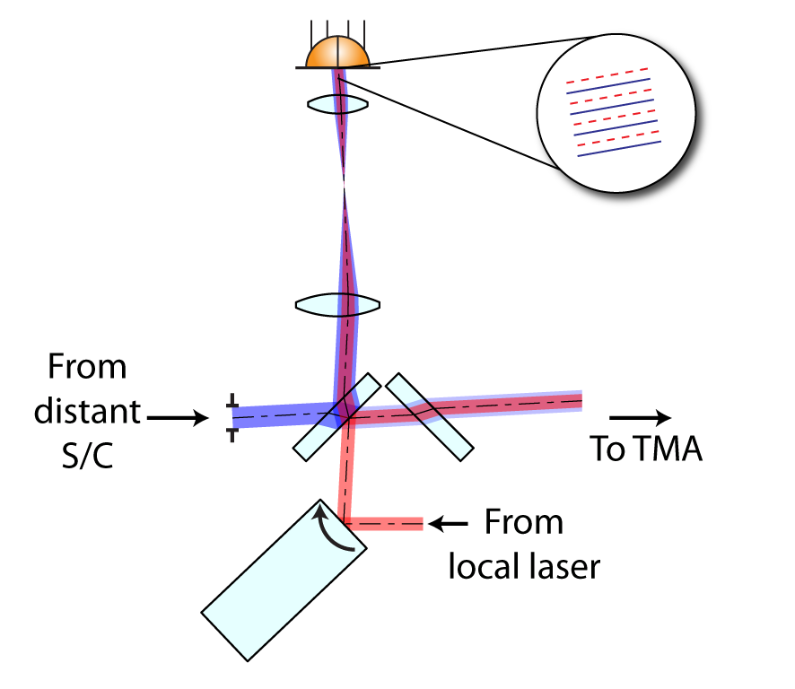
Optical Bench - Differential Wavefront Sensing
Appropriately feeding back the DWS signals to the steering mirror zeros the DWS signals and corrects the outgoing beam direction

Slide 20
Optical Bench - Differential Wavefront Sensing
Appropriately feeding back the DWS signals to the steering mirror zeros the DWS signals and corrects the outgoing beam direction
Acquisition:
Poster by C. Mahrdt

Slide 21
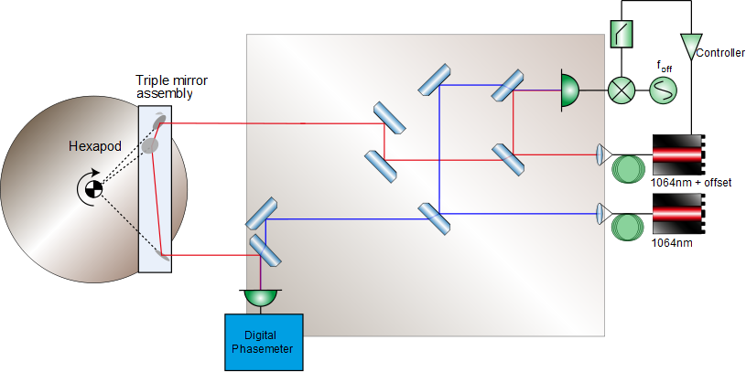
Triple Mirror Assembly test setup
x
z
y

Slide 22
Triple Mirror Assembly test setup - lab picture

Slide 23
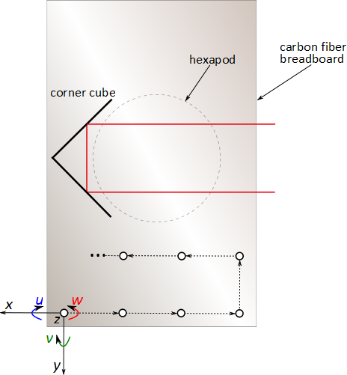
Determine vertex/ point of minimal coupling of TMA
$$\overset{⃑}{V}$$
$$\overset{⃑}{PP}$$
δL = 2v(V^{z}-PP^{z}) – 2w(V^{y}-PP^{y})

Slide 24
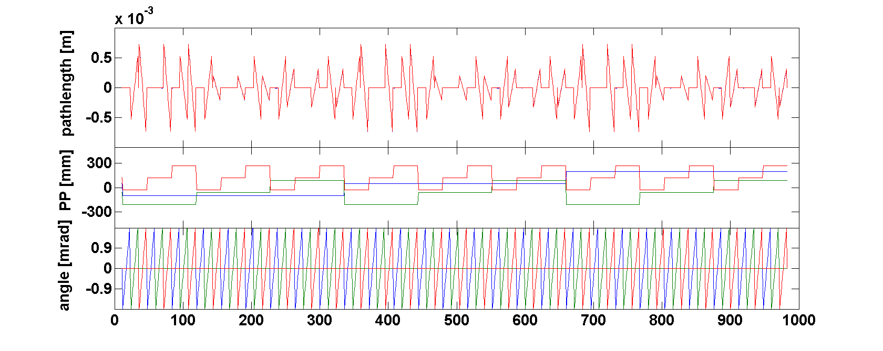
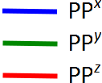
Determine vertex/ point of minimal coupling of TMA
δL = 2v(V^{z}-PP^{z}) – 2w(V^{y}-PP^{y})

Slide 25
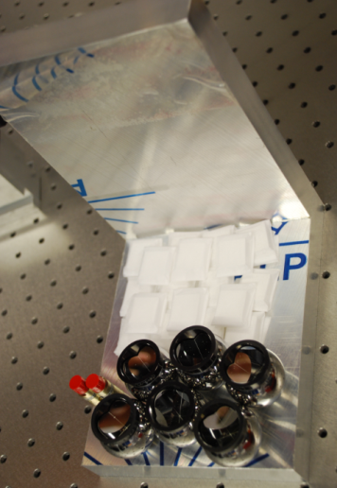
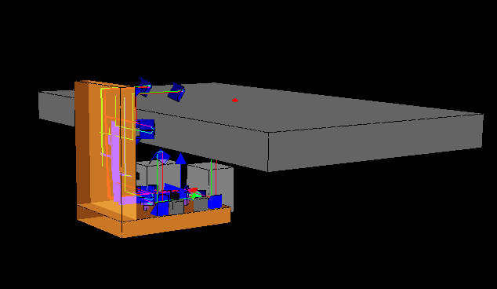
Next step: Hexapod-independent coordinate frame

Slide 26
Next step: Hexapod-independent coordinate frame
Ifocad-Simulations:
Poster by E. Kochkina

Slide 27
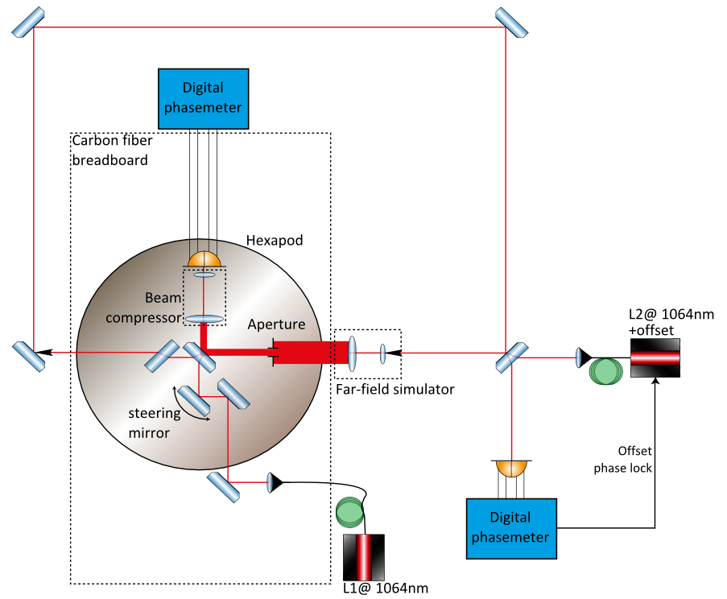
Optical Bench prototype test setup

Slide 28
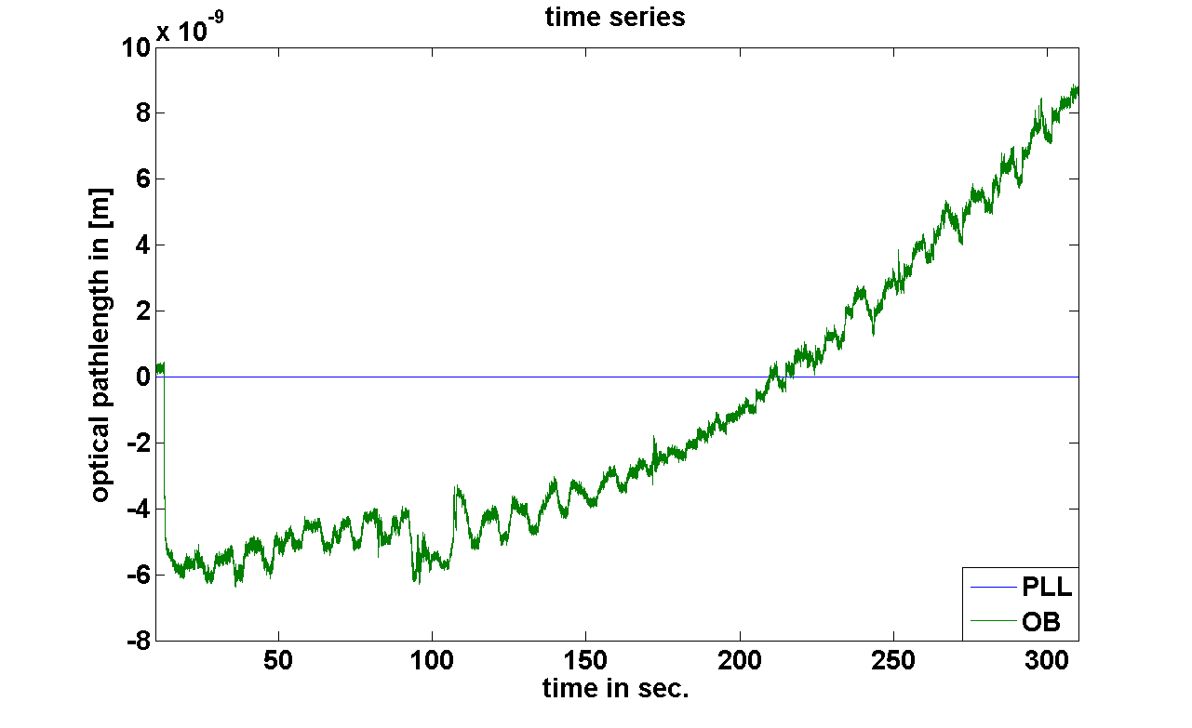
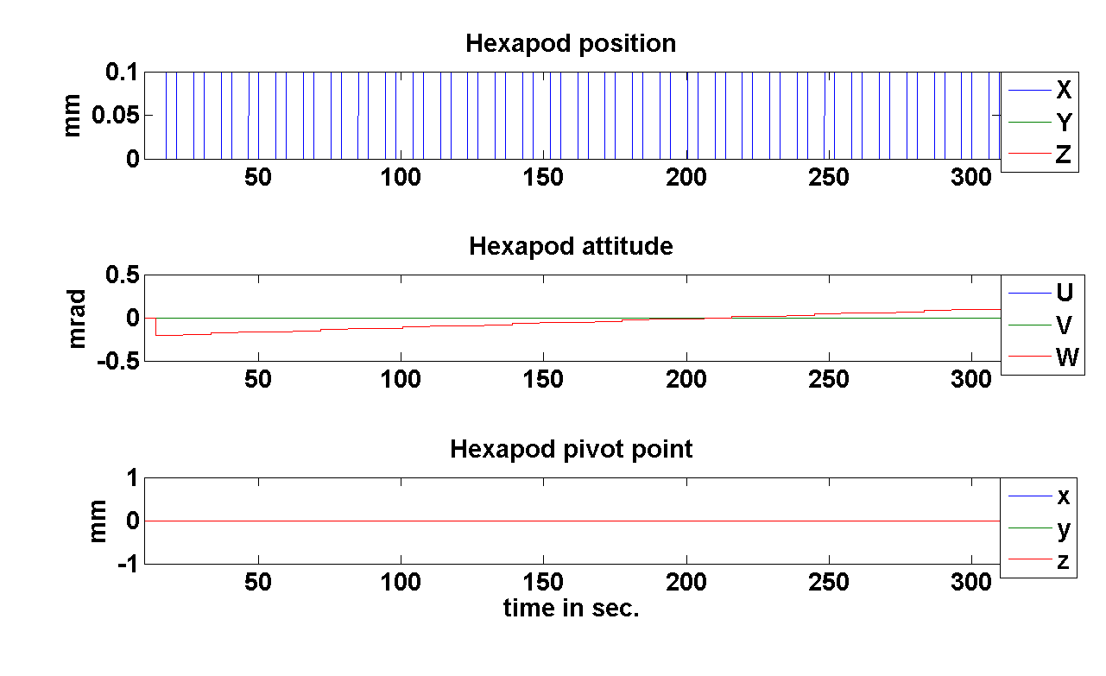
Optical Bench prototype test setup - round-trip pathlength measurement
Demonstrates the inherent immunity of the racetrack design to Optical Bench motion in the round-trip pathlength measurement

Slide 29
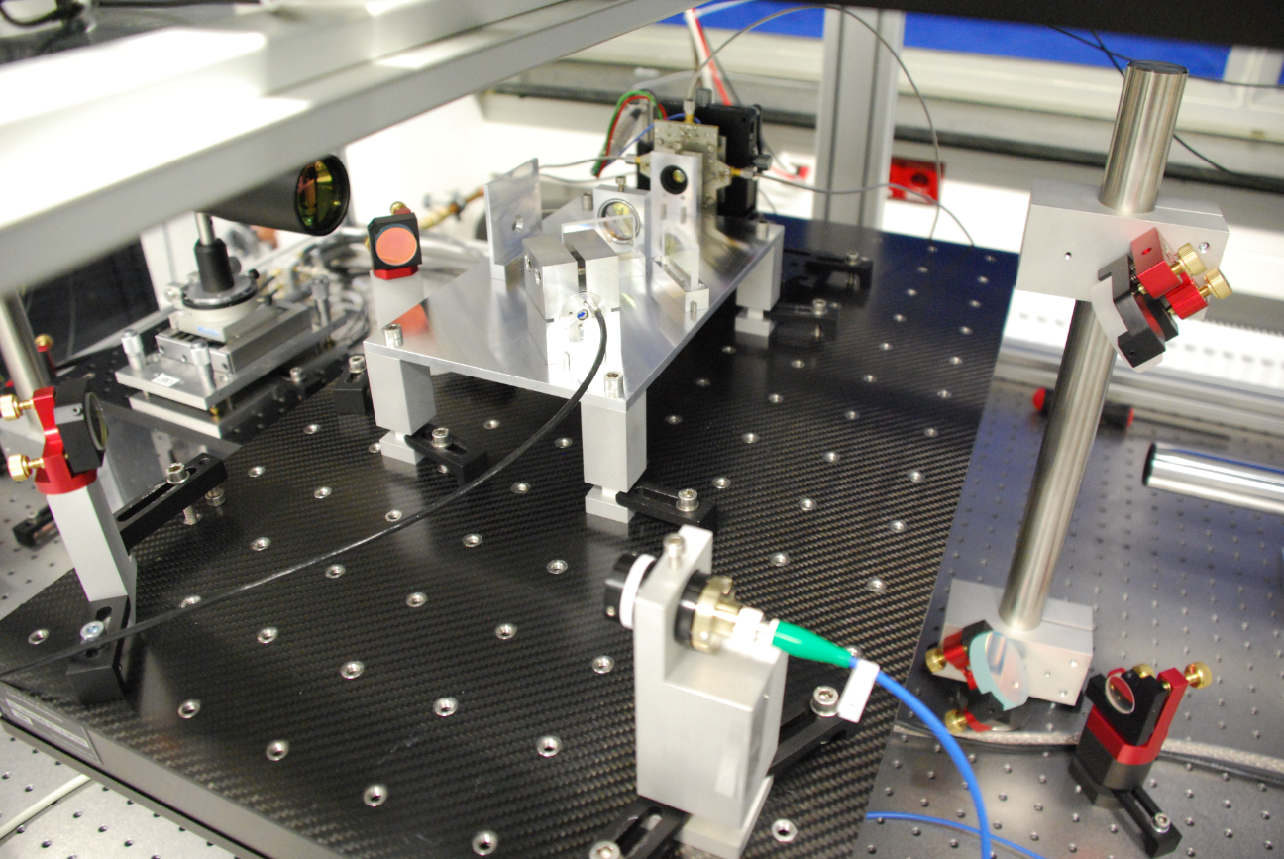
Optical bench prototype test setup - lab picture

Slide 30
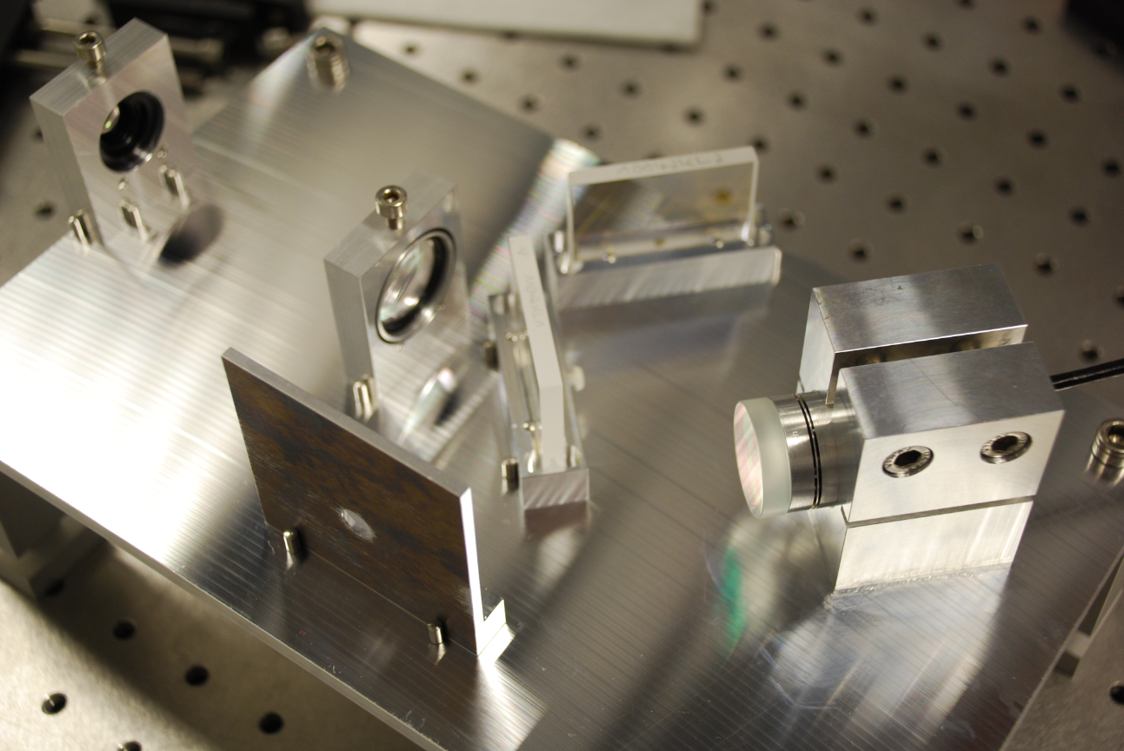
Optical bench prototype

Slide 31
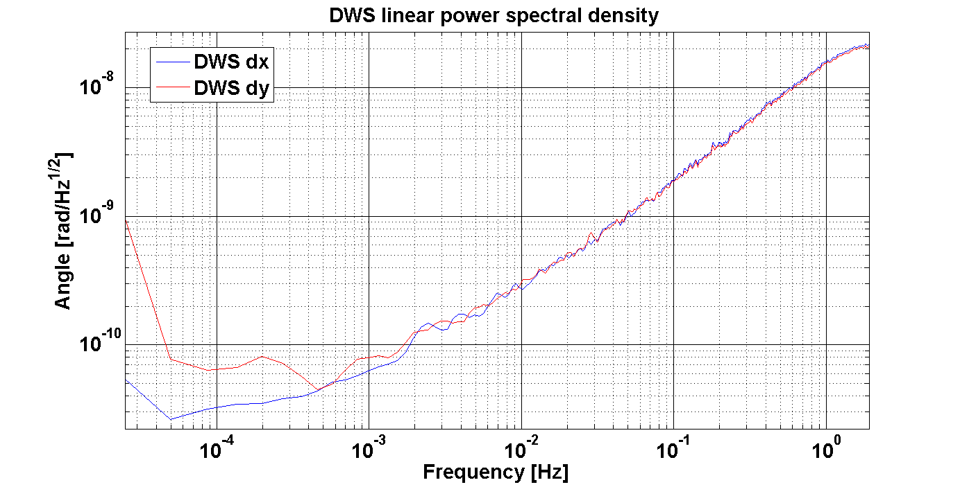
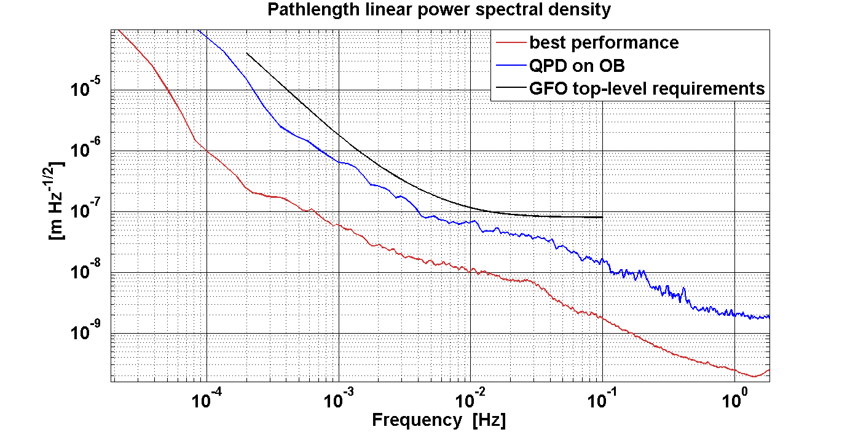
Optical bench prototype - DWS/Steering mirror closed-loop, DWS and length stability

Slide 32
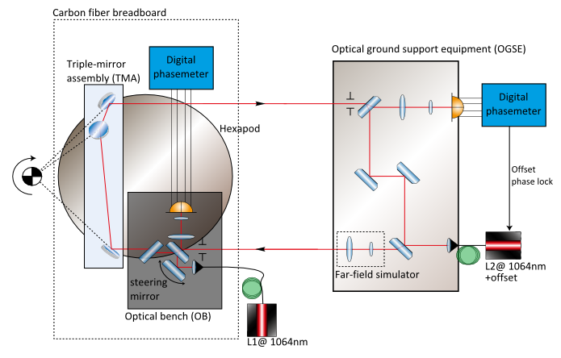
Next steps
Verify performance of Optical bench
Integrate Optical bench and Triple mirror assembly (will be delivered from ANU) in one setup

Slide 33
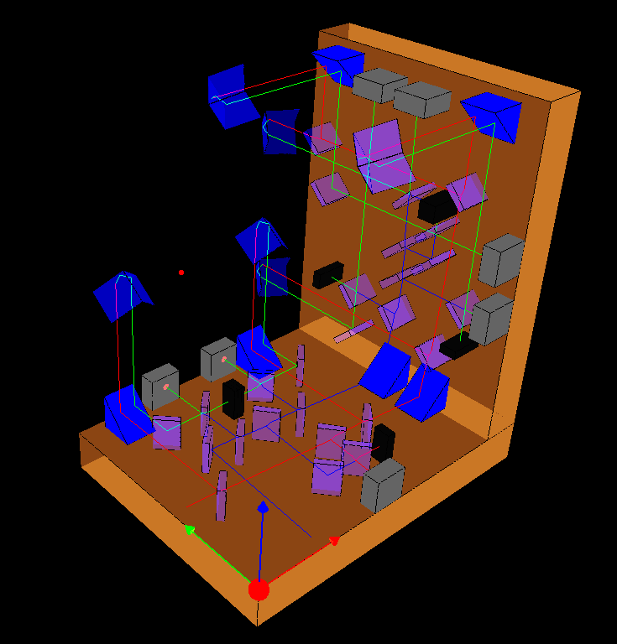
Summary
GRACE follow-on will be a milestone as the first inter-satellite laser interferometer with many similarities to LISA
Work progress at AEI:
Triple Mirror Assembly test setup: Determine vertex of TMA by rotating hexapod
Optical Bench prototype: DWS with closed steering mirror loop established
Thanks for your attention!

