Slide 1

Science with
LISA Pathfinder
Tim Sumner
Imperial College, London, UK
With acknowledgements to material from: C. Trenkel (ASU)
J. Magueijo (ICL)
C. Speake (BU)

Slide 2
Overview
General Motivation
  LISA Pathfinder will be a unique opportunity to make use of a drag free instrument once its main mission is completed
  Use as is without any modifications/design drivers
LISA Pathfinder as a Weak Force Instrument
  Measurement of Big G
  Inverse Square Law at large distances
  Inertial response to weak force changes
  Direct MOND/TEVES tests with LISA Pathfinder
Conclusions

Slide 3
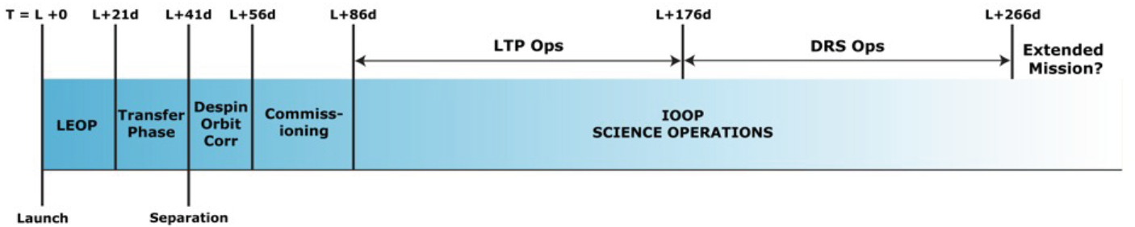
Motivation
LISA Pathfinder planned launch 2014
Timescale until another “LISA Pathfinder” >>(10-20years)

Slide 4
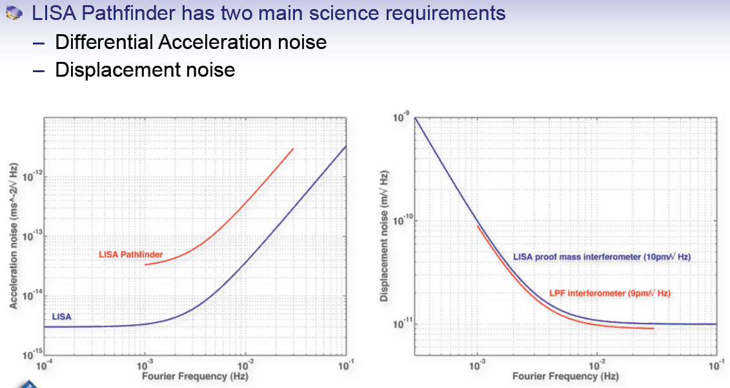
Motivation

Slide 5
Motivation
LISA Pathfinder offers the following measurement capability (ESA-SCI(2007)1):
  Differential Force Measurement Sensitivity:
  ≈ 1.3x10⁻¹⁴N / √Hz around 1mHz
  Drag-Free Platform Stability: Platform Free-Fall Quality of ≈ 10⁻¹³ms⁻²/ √Hz around 1mHz ≈ 10⁻⁹ms⁻² at DC
  Gravity Gradiometer Sensitivity: ≈ 1.5x10⁻¹⁴s⁻²/ √Hz around 1mHz
  Spacecraft Master Clock: (stability TBC)
  …

Slide 6
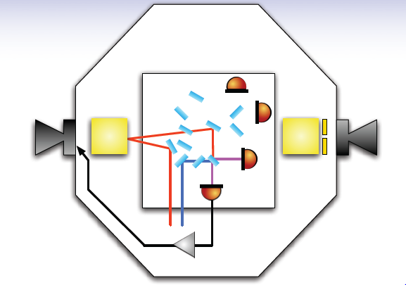
Big G Measurement
Use one mass as the ‘Source’ mass and the other as the ‘Test’ mass
$$∆x=1\text{mm} \text{to} 2\text{mm}$$

Slide 7
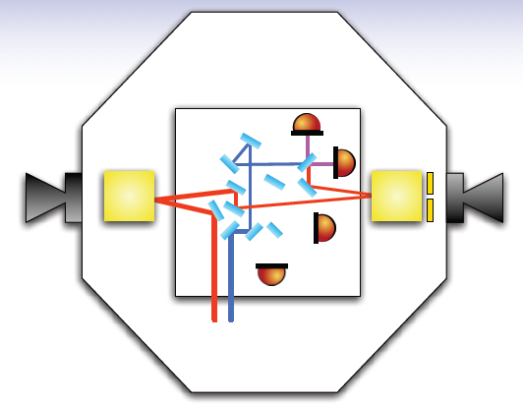
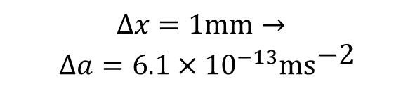
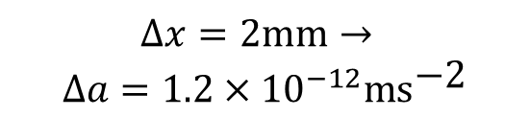
Big G Measurement
Use one mass as the ‘Source’ mass and the other as the ‘Test’ mass
$$∆x=1\text{mm}→$$
$$∆a=6.1×{10}^{−13}\text{m}{\text{s}}^{\text{−2}}$$
$$∆x=\text{2}\text{mm}→$$
$$∆a=1.2×{10}^{−12}\text{m}{\text{s}}^{\text{−2}}$$

Slide 8
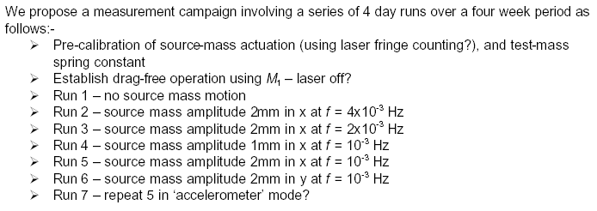
Big G Measurement
A measurement to 1 part in 10⁴ looks feasible
This is not individually competitive
Of similar order to discrepancy between other measurements
Different scale length
Different environment

Slide 9
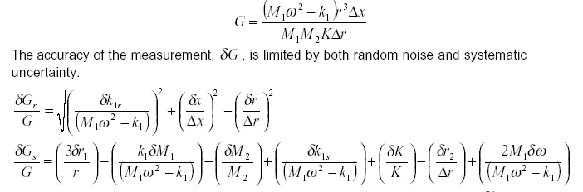
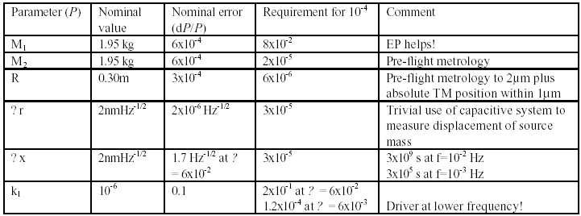
Big G Measurement

Slide 10
Inverse Square Law
LISA Pathfinder can be used to set limits on the inverse square law on both large and intermediate scales
  During transfer orbit via s/c tracking*
  During halo orbit via s/c tracking
  During dedicated science run on orbit
  During mission extension transit orbit(s)
Drag-free needs to be operational
  Requires that s/c bias is known
  Use LTP as a gradiometer
  *No current plan to release test masses and turn on drag-free during transfer phase

Slide 11
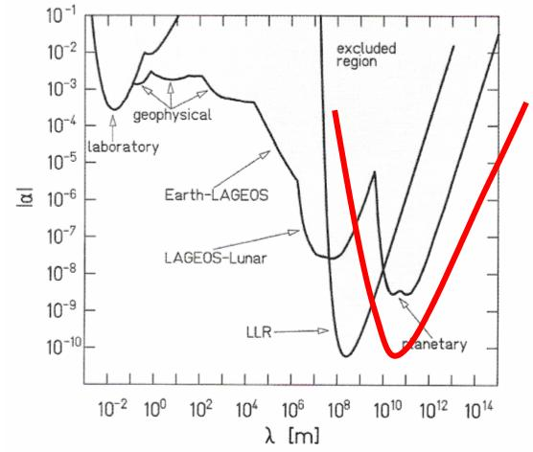
Inverse Square Law
Need to calibrate out internal S/C bias
Align TM-TM axis along Sun line
Tracking to cm accuracy needed

Slide 12
Inertial Response to Weak Forces
Application of weak forces using different means
  Gravitationally – as for Big G
  Electrostatically using electrode structure
  Photon radiation pressure
Gives cross-check on systematics but is it interesting in its own right?

Slide 13
Alternative Theories of Gravity
Background Motivation:
  Solution to Dark Matter ‘problem’?
  Clue to quantum gravity?
  Low-field study of GR?
  Connection to Dark Energy?
The (Unique) Opportunity
  A high-precision calibrated gravity gradiometer
  Suitable orbits to allow a visit (or two) through a gravity balance region (saddle point)
  A sweet-spot coincidence

Slide 14
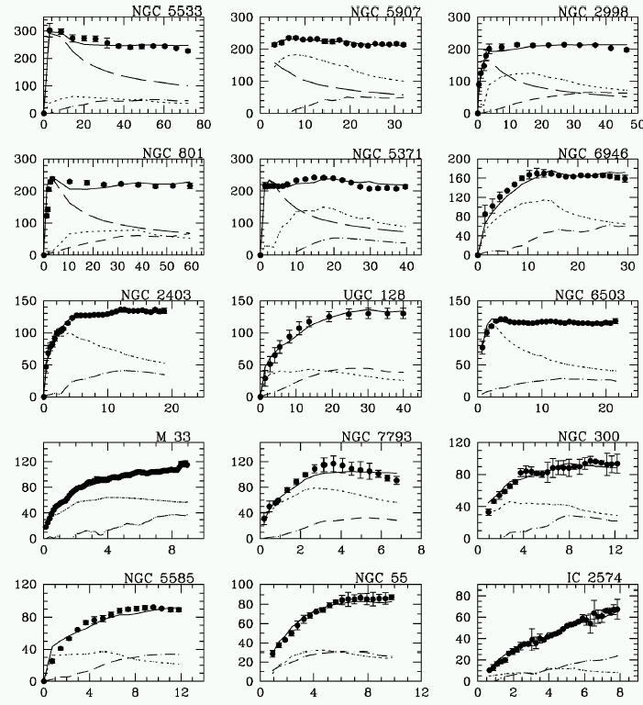
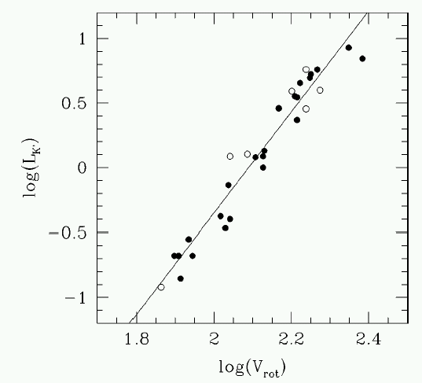
Alternative Theories of Gravity
Dark Matter (or not):
  MOND is a phenomenological formula to use when system acceleration falls below 10⁻¹⁰ms⁻² (Milgrom 1983)
    Extremely successful in describing galactic rotation with no DM
    Tulley Fischer relationship

Slide 15
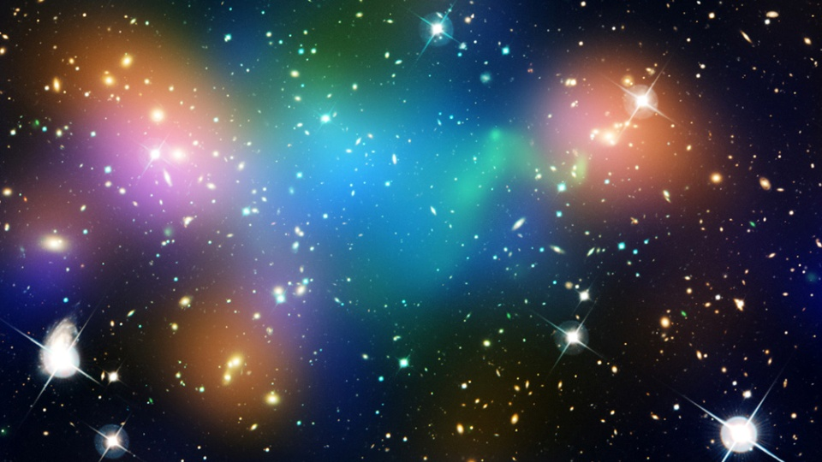
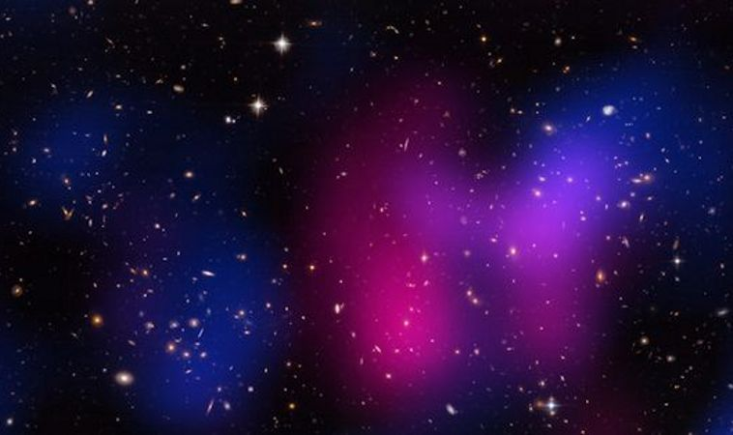

Alternative Theories of Gravity
Dark Matter (or not):
  MOND
    Extremely successful in describing galactic rotation with no DM
    Tulley Fischer relationship
    Relativistic Tensor-Vector-Scalar (TEVES) theory developed with non-relativistic “MOND” limit (Bekenstein 2004)

Slide 16
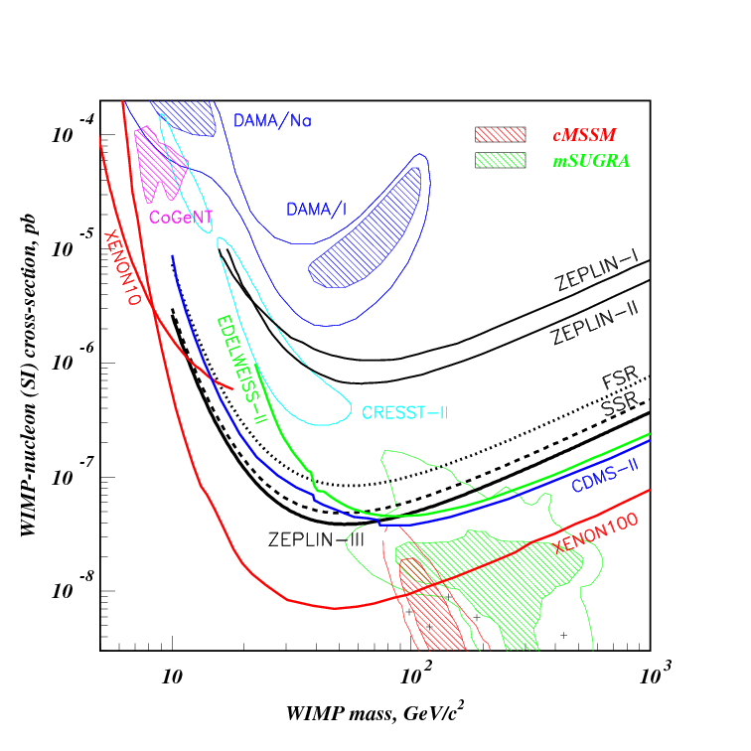
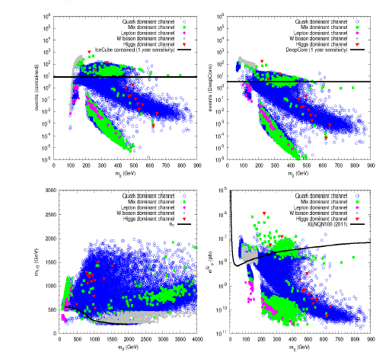
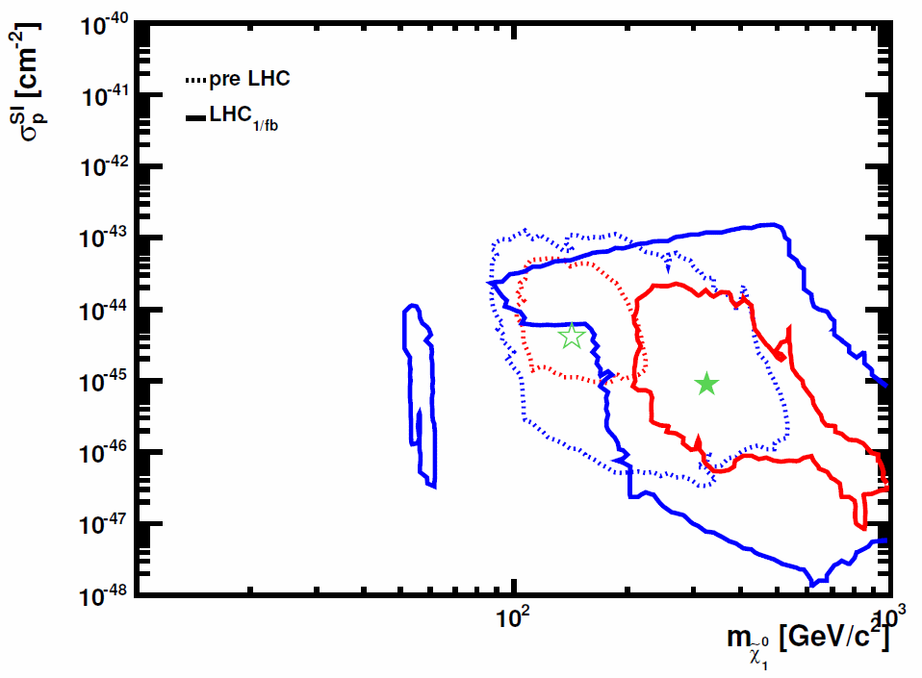
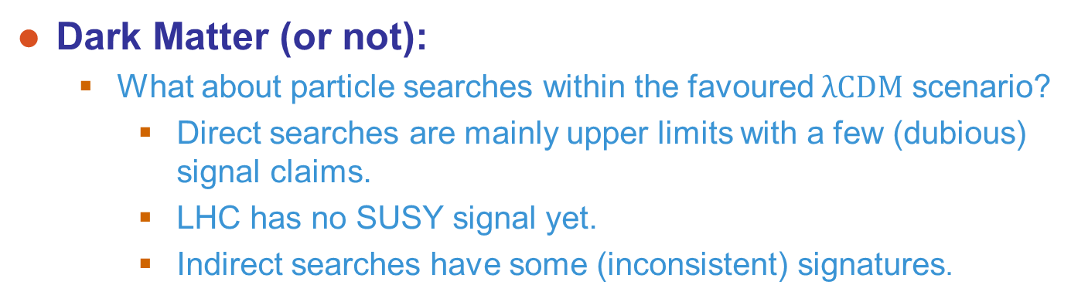
Alternative Theories of Gravity
Dark Matter (or not):
  What about particle searches within the favoured $\text{λ}\text{CDM}$ scenario?
    Direct searches are mainly upper limits with a few (dubious) signal claims.
    LHC has no SUSY signal yet.
    Indirect searches have some (inconsistent) signatures.
Roszkowski2012
Buchmueller2011

Slide 17
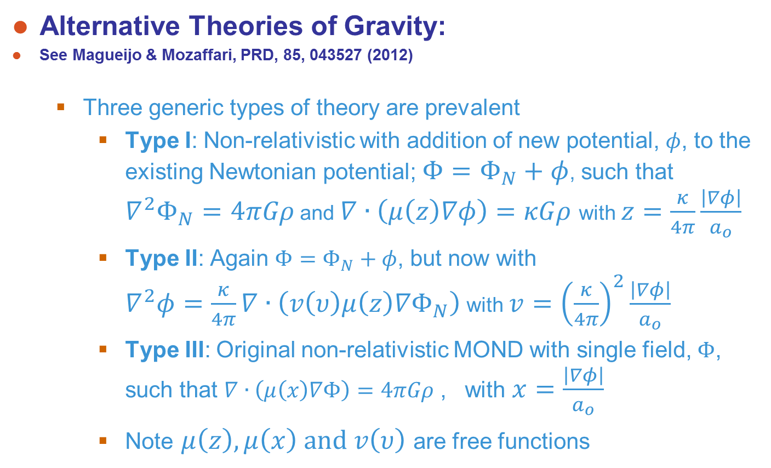
Alternative Theories of Gravity
Alternative Theories of Gravity:
See Magueijo & Mozaffari, PRD, 85, 043527 (2012)
  Three generic types of theory are prevalent
    Type I: Non-relativistic with addition of new potential, $φ$, to the existing Newtonian potential; $Φ=Φ_{N}+φ$, such that $∇^{2}Φ_{N}=4πGρ$ and $∇∙\left(μ\left(z\right)∇φ\right)=κGρ$ with $z=\frac{κ}{4π}\frac{\left|∇φ\right|}{a_{o}}$
    Type II: Again $Φ=Φ_{N}+φ$, but now with $∇^{2}φ=\frac{κ}{4π}∇∙\left(v\left(υ\right)μ\left(z\right)∇Φ_{N}\right)$ with $v={\left(\frac{κ}{4π}\right)}^{2}\frac{\left|∇φ\right|}{a_{o}}$
    Type III: Original non-relativistic MOND with single field, $Φ$, such that $∇∙\left(μ\left(x\right)∇Φ\right)=4πGρ$ , with $x=\frac{\left|∇φ\right|}{a_{o}}$
    Note $μ\left(z\right), μ\left(x\right) \text{and} v\left(υ\right)$ are free functions

Slide 18
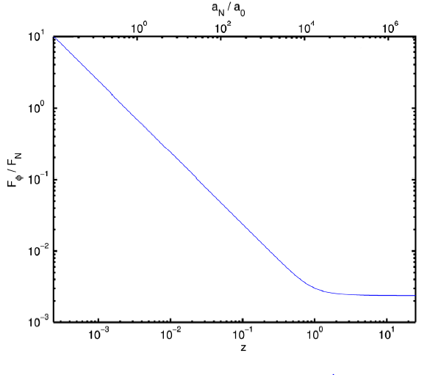
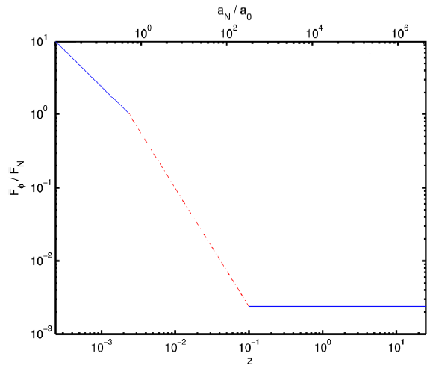
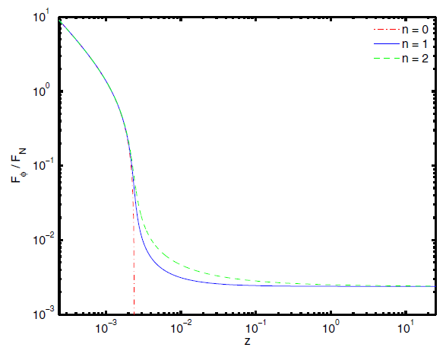
Alternative Theories of Gravity
Alternative Theories of Gravity:
See Magueijo & Mozaffari, PRD, 85, 043527 (2012)
  Newtonian/Mond transition function (free function)
  Type III can always be contrived to avoid signal

Slide 19
MOND/TEVES Tests with LISA Pathfinder
Measurement of gravity gradients in close transits through the Saddle Point (SP)
  Size and location of “bubble” in which gradients become significant (considering Sun and Earth only):
→ Need to get within a few 100km of the SP
1532km
766km
259000km

Slide 20
MOND/TEVES Tests with LISA Pathfinder
We need to take account of:
  The dynamic location of MOND “bubbles” around SPs in the Sun-Earth-Moon System
  Establish that LISA Pathfinder can be made to fly through those special regions
  Estimate the anomalous MOND / TEVES gradients that LISA Pathfinder will experience
  Confirm that LISA Pathfinder’s gradiometer sensitivity is adequate to detect them!

Slide 21
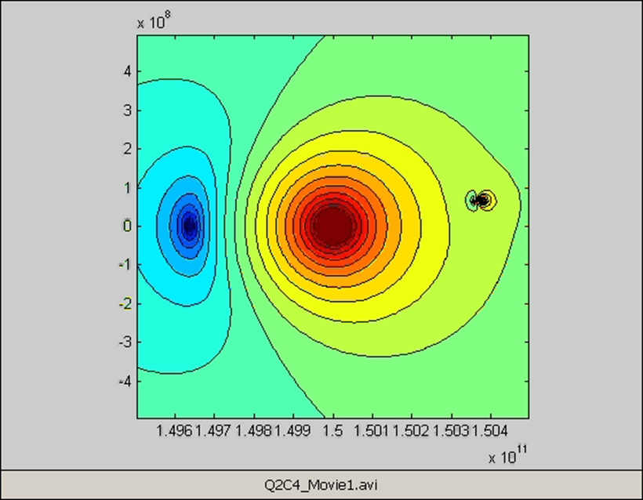
MOND/TEVES Tests with LISA Pathfinder
Saddle Points
  Defined by zero total gravitational field
  SPs are not a stable location for spacecraft orbits
  In the Sun-Earth-Moon system, there are two SPs:
Earth
Sun
Moon

Slide 22
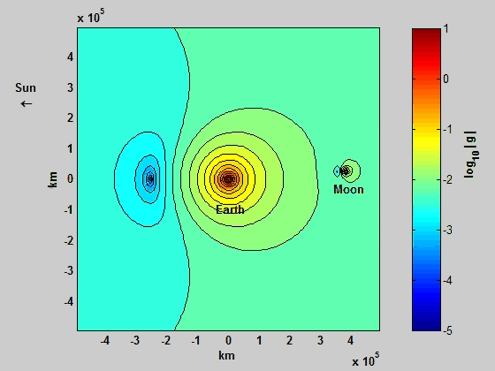

Slide 23
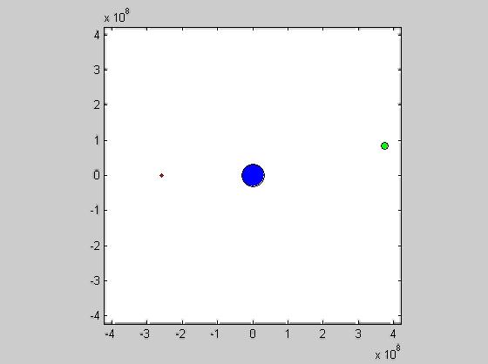
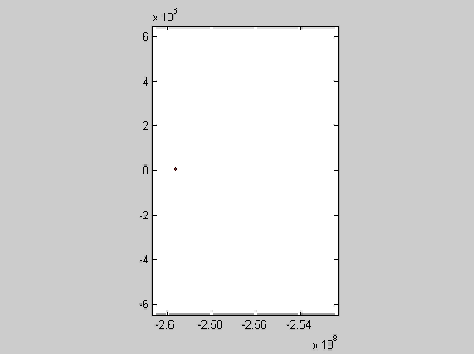
MOND/TEVES Tests with LISA Pathfinder
The Sun-Earth SP is perturbed by the motion of the Moon*:
*also, in much smaller measure, by Jupiter etc
12000km
Need to consider Moon position when targeting Sun-Earth SP

Slide 24
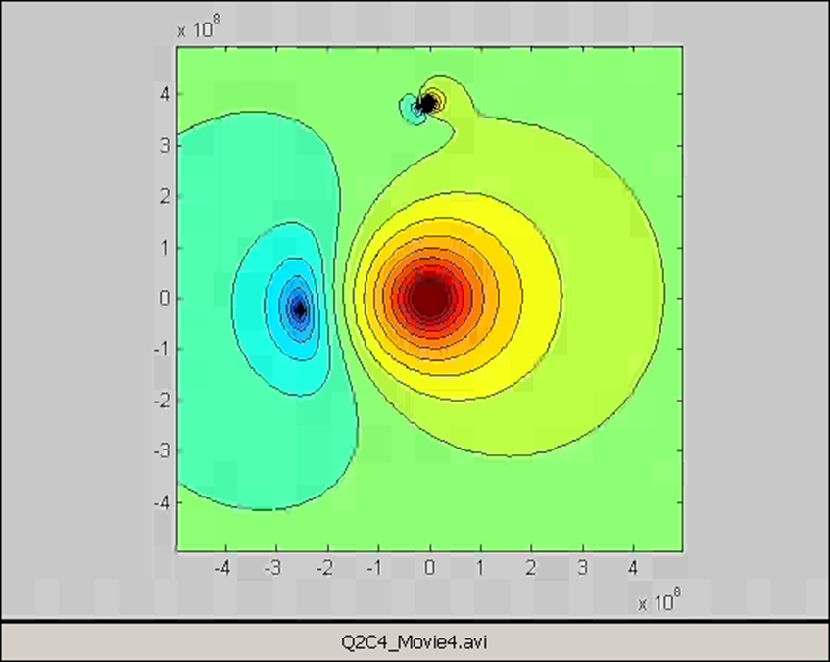
MOND/TEVES Tests with LISA Pathfinder
The “Earth-Moon SP” is perturbed by the Sun (in fact we should call it the “Sun-Moon SP”)

Slide 25
MOND/TEVES Tests with LISA Pathfinder
Orbital manoeuvres to get to Sun-Earth SP (ASU)
  Single dV manoeuvres up to 1m/s considered
    compatible with residual FEEP control authority
    reasonable timescales for manoeuvres (10-30days)
    maximum individual FEEP thrust 90μN
  Nominal Solar Radiation Pressure on LPF assumed
  Propagator includes standard gravitational environment
  Control parameters have been restricted to:
    Time of initial manoeuvre (determines departure point)
    Magnitude of dV manoeuvre
  In practice, any real trajectory would include continuous navigation and (small) additional trajectory correction manoeuvres

Slide 26
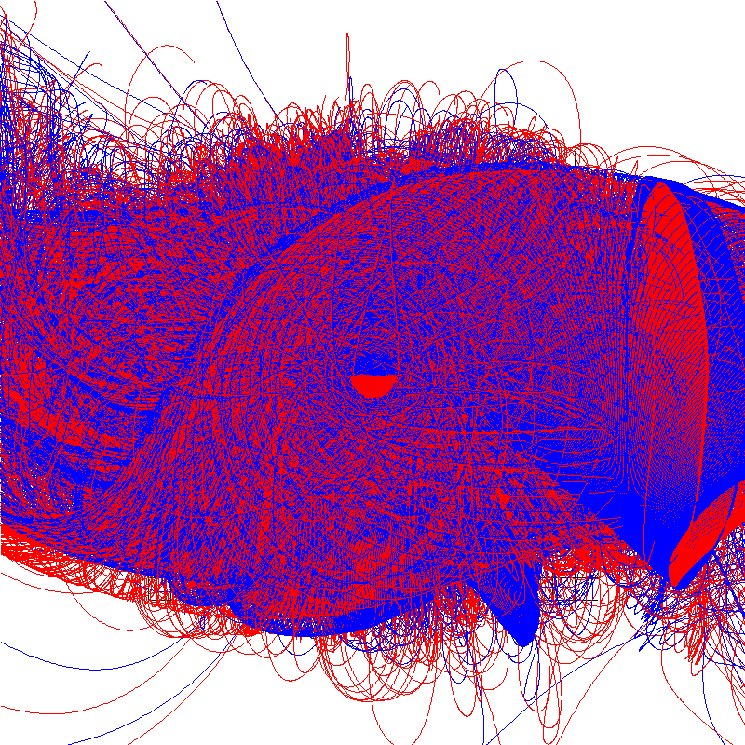

MOND/TEVES Tests with LISA Pathfinder
Illustration of the chaotic nature of the problem:
Single dV manoeuvres between 0.5m/s and 1m/s applied at 0.25 day intervals
1.5mio km
Earth
Sun

Slide 27
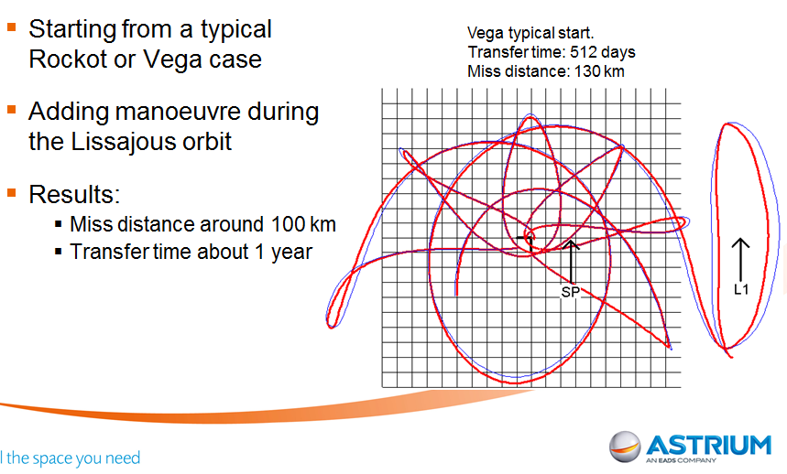
LISA Pathfinder Trajectories
Example of “fast” transfer:
  Solution transiting Sun-Earth SP within 100km

Slide 28
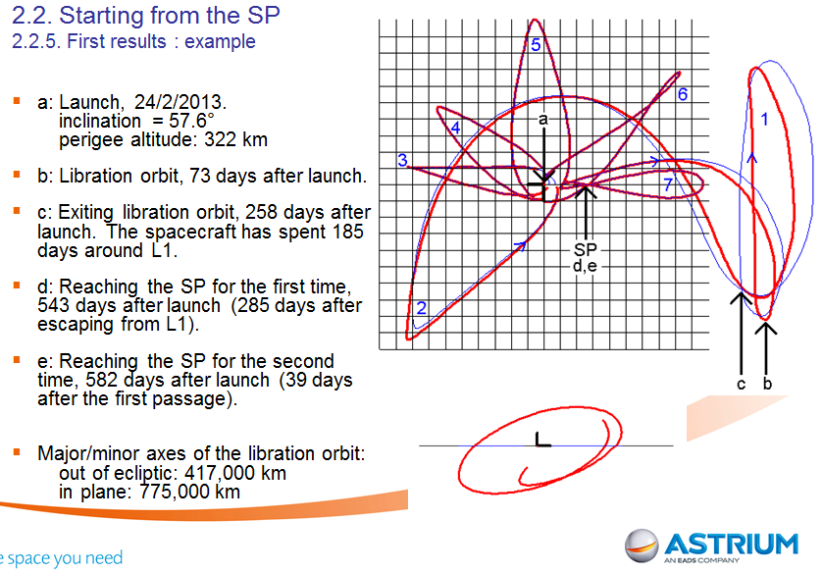
LISA Pathfinder Trajectories
Example of double pass:
  Solution achieving two SP transits by 582 days

Slide 29
LISA Pathfinder Trajectories
Lunar fly-bys could have additional spin-offs:
  Fly-by could be used as direct absolute calibration for the gradiometer, by providing the external gravity gradient due to the Moon
  If we are VERY lucky, we could fly through both the Earth-Moon and the Sun-Earth SPs – unfortunately highly unlikely!

Slide 30
LISA Pathfinder Trajectories
Summary of Results
  Chaotic nature of the problem makes it difficult to search for the “best” local minimum
  Main challenge to targeting the SP is to remove the out-of ecliptic component of LISA Pathfinder motion
  In practice, the real trajectory will be iterative through continuous navigation and trajectory correction manoeuvres – approach distances ~10-20km likely
  In principle multiple passages are possible
  The devil is in the detail – requires precise knowledge of starting conditions

Slide 31

MOND/TEVES Anomalous Gradients
Prediction of anomalous gravity gradients that LISA Pathfinder will see:
  Numerical method yields cube volume with gradients at its grid points (as a function of Sun, Earth and Moon position)
  Representative LPF trajectory is propagated through the volume and the anomalous gradients are extracted at each point:
Sun
Sun-Earth SP
Typical LPF Trajectory
45°
45°
Earth

Slide 32
MOND/TEVES Anomalous Gradients
Prediction of anomalous gravity gradients that LISA Pathfinder will see
  Only gradients in the sensitive direction of the LPF gradiometer are relevant
  In principle, there is a choice of orientation for LPF around the Earth - Sun axis (no significant difference in gradients):
  Finally, the spacecraft speed (typically around 1.5km/s) is used to predict the temporal gradient variations
or
Solar Array

Slide 33
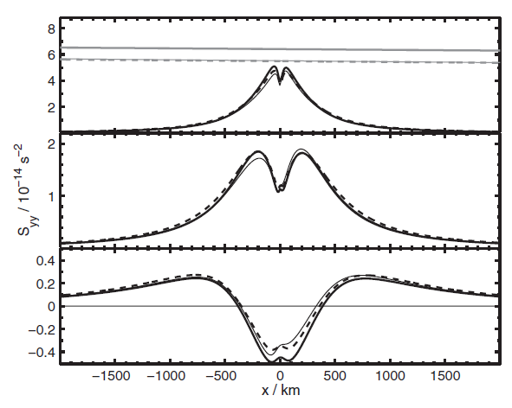
MOND/TEVES Anomalous Gradients
Results (from M & M PRD)
  The transverse stress anomaly assuming a simple transfer function

Slide 34
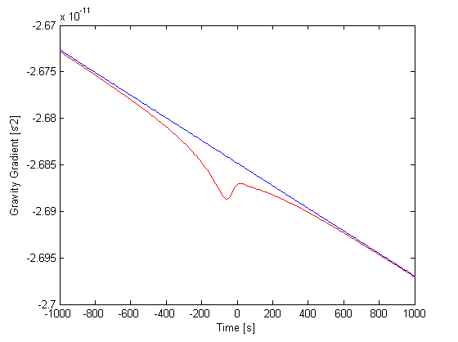
MOND/TEVES Anomalous Gradients
Results
  Of course LPF will see the (much larger) Newtonian background gradient as well. For the 50km approach distance, it will see:
Newtonian only
Newtonian + TEVES
Note: TEVES signal roughly at 1/1000s = 1mHz ☺

Slide 35
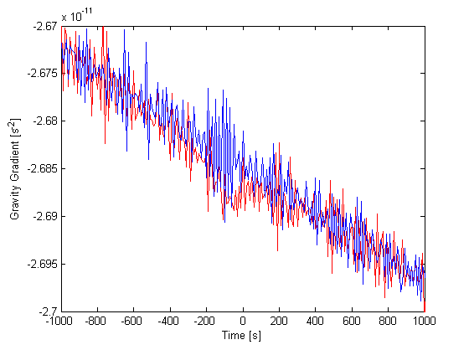
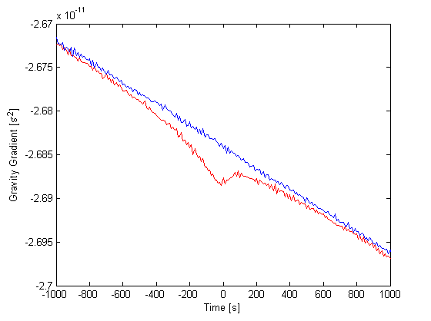
LISA Pathfinder Gradient Sensitivity
Results
  How will LPF noise affect this signal? Time series with simulated LPF gradiometer noise (between 50μHz and 50mHz) added:
10 point moving average
LPF Noise + Newtonian
LPF Noise + Newtonian + TEVES

Slide 36
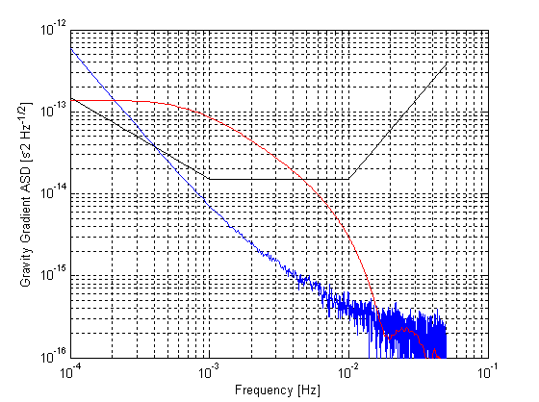
LISA Pathfinder Gradient Sensitivity
Results
  It is useful to compare the relative spectral densities:
Power in Signal / Power in Noise ≈ 28 around 1mHz!
Newtonian
TEVES
LPF Gradiometer Noise [TBC]
→ LISA Pathfinder has more than adequate sensitivity!

Slide 37
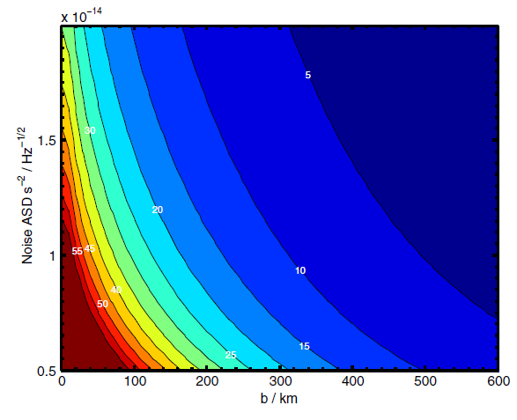
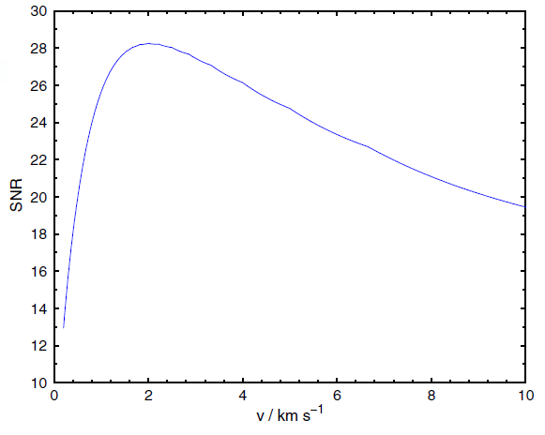
LISA Pathfinder Gradient Sensitivity
Results (from M & M PRD)
  Dependence on impact parameter, noise (and speed):

Slide 38
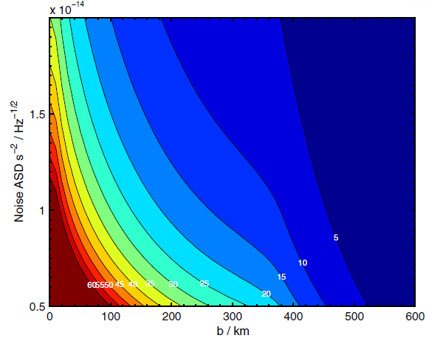
LISA Pathfinder Gradient Sensitivity
Results (from M & M PRD)
  Type II transfer functions

Slide 39
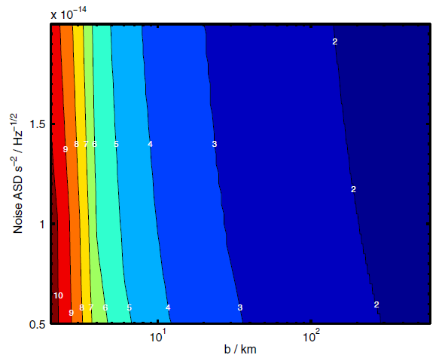
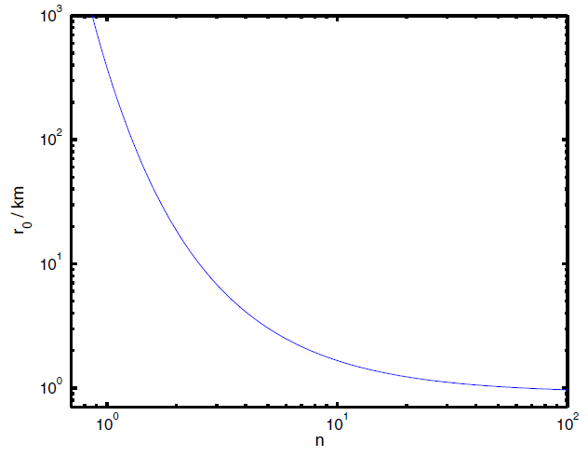
LISA Pathfinder Gradient Sensitivity
Results (from M & M PRD)
  Type II transfer functions – null result
Make second power law steeper
SNR = 1 detection

Slide 40
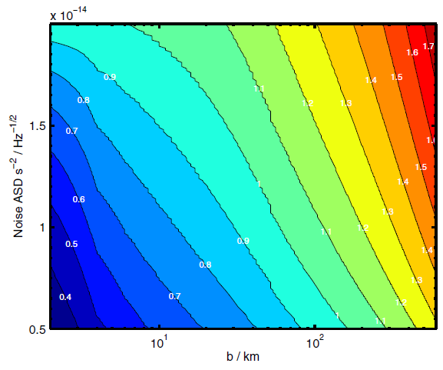
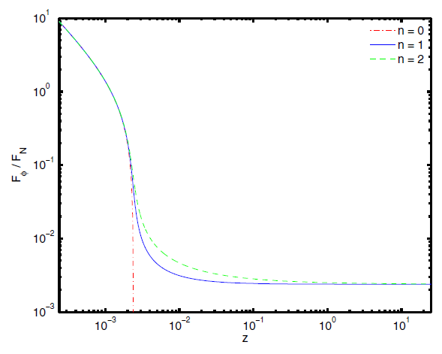

LISA Pathfinder Gradient Sensitivity
Results (from M & M PRD)
  Type III (designer) transfer functions
Characterise with parameter, n
1 $σ$ Null detection - upper limit on n

Slide 41
Conclusions
  LISA Pathfinder offers a unique opportunity to fly a sensitive gravity gradient instrument through the Sun-Earth Saddle Point
    Very timely given evolving dark matter search programs
    A positive result will be of enormous and far reaching importance
    A null result will be conclusive for Type I and II transfer functions
    Type III transfer functions will be heavily constrained
  A new measurement of Big G to 1 in 10⁴ requires a few months of dedicated time and would be a useful addition to the current suite of measurements
  A large scale 1/r² measurement during the SP transfer is challenging and would probably need more motivation to justify

Slide 42
Summary and Conclusions
Having demonstrated the basic feasibility of the proposal, a few questions remain (feedback welcome!):
  Is the scientific motivation for such a MOND/TEVES test strong enough? The mission would be extended by just over a year, for a one-off experiment lasting around 1000s, at a financial cost estimated at ≤10⁷€
  This proposal suffers, to some extent, from the common “Fundamental Physics in Space syndrome”: a positive detection would represent a major breakthrough, a null result would be less interesting – but (relatively) low cost!
  Are there other meaningful GR tests that would benefit from the special gravitational environment found around SPs? If so, this would increase the motivation to make the trip to the SP!

